Slide 1

Be Iceman !
Make ice anywhere
Bozhao Jiaming

Slide 2
A portable device that uses mechanical energy(only) to make ice cubes.
Pour the water inside the container
Rotate a handle
Open it and see ice
[idea]

Slide 3
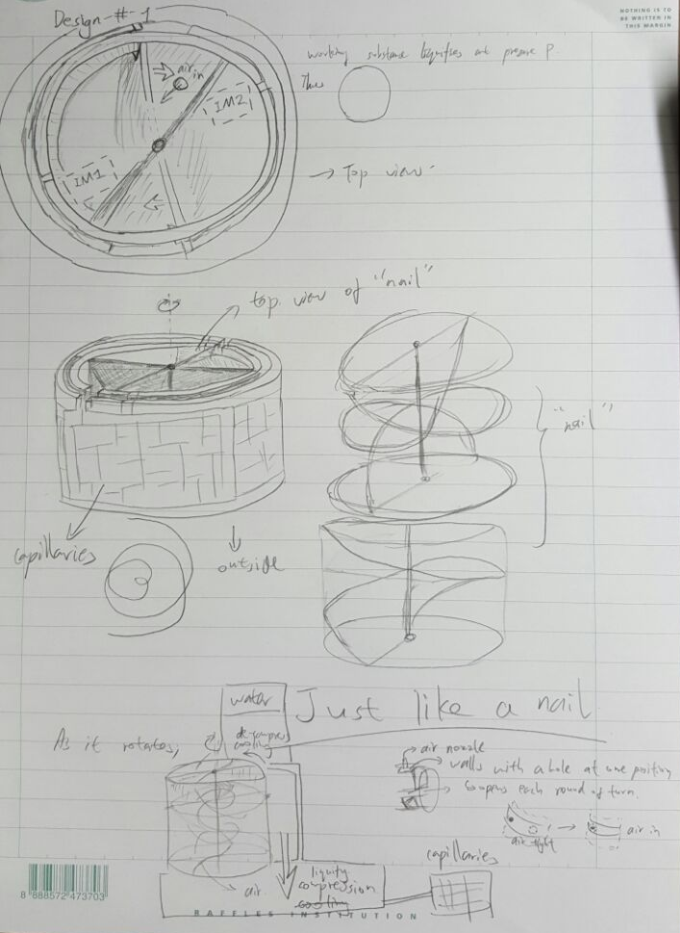

Slide 4
Whose problems are we trying to solve?

Slide 5
Multi-purposeness
From providing portable electricity-free cooling device to third world countries
To giving you a cup of ice drink on a hot summer day
Or give you some emergency treatment after a sports injury

Slide 6
What problems are people facing?
How are these already being solved?

Slide 7
Multi-purposeness
Electricity shortage while fridge is needed to store necessities like medicines
No ice at hand when you want some ice drinks
Injured when doing sports/hiking in the field but there is no ice in the first aid pack

Slide 8
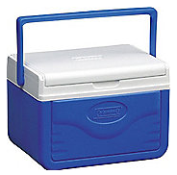
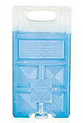
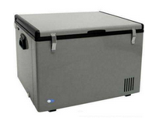
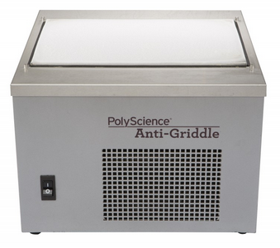
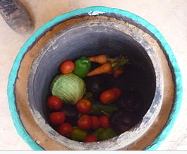
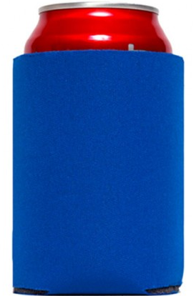
Existing Alternatives:
1. Portable Freezer
6. Pot-in-pot refrigerator
2. Anti-griddle
3. Insulated Cool Containers
4. Ice Packs
5. Koozie

Slide 9
OUR SOLUTION

Slide 10
Be a metahuman! If you need ice, make it within a minute!

Slide 11
Assumptions made:

Slide 12
That the thing is actually feasible.

Slide 13
Our Unique Selling Points

Slide 14
Easy to use Portable Cheap Reliable Completely Green

Slide 15
When competition comes in...

Slide 16
Theirs are expensive while ours is cheap Theirs need large energy input while ours do not. Theirs are bulky while ours are portable and light-weight

Slide 17
Thank you for your attention! (feel free to ask any questions)

Slide 18
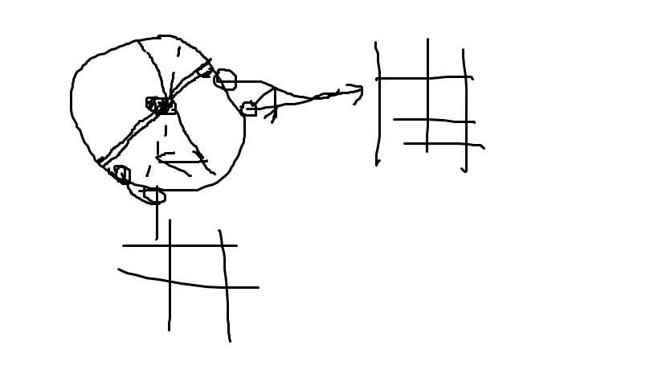

Slide 19
