Slide 1


Be Iceman !
Make ice anywhere
Bozhao Jiaming

Slide 2
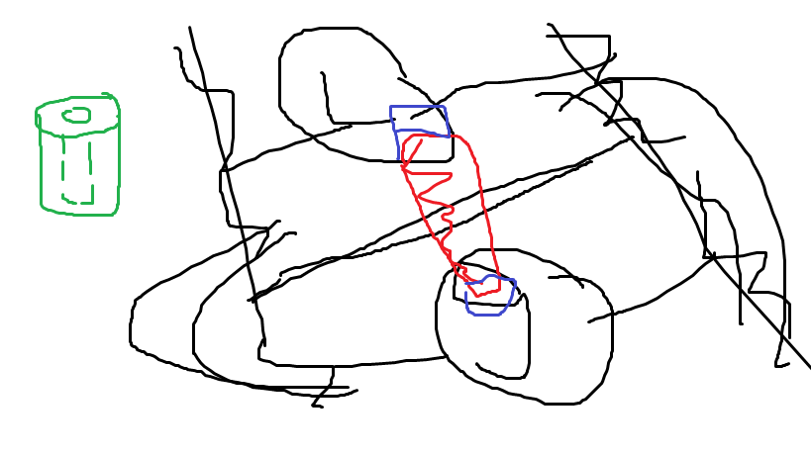

Slide 3
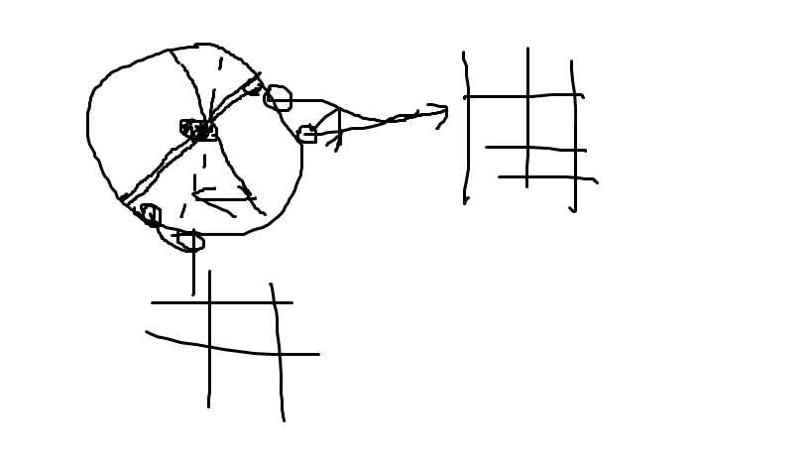

Slide 4
A portable device that uses mechanical energy(only) to make ice cubes.
Pour the water inside the container→Rotate a handle→open it and see ice
[idea]

Slide 5
(Feel free to change the slides, but do address the various points raised)

Slide 6
Whose problems are we trying to solve?

Slide 7
Multi-purposeness
From providing portable electricity-free refrigerators to third world countries
To giving you a cup of ice drink on a hot summer day
Or give you some emergency treatment after a sports injury

Slide 8
What problems are people facing?
How are these already being solved?

Slide 9
Multi-purposeness
Electricity shortage while fridge is needed to store necessities like medicines
No ice at hand when you want some ice drinks
Sprained when doing sports/hiking in the field but there is no ice in the first aid pack

Slide 10
What’s your solution, in one sentence? Can you find an analogy to describe it?

Slide 11
Be a metahuman! If you need ice, make it within a minute!

Slide 12
What assumptions are we making?

Slide 13
That the thing is actually feasible.

Slide 14
Our version will succeed because…
What’s our unique selling point?

Slide 15
Portable Multi-purpose Very Cheap Reliable Completely Green

Slide 16
There are competitors, but we’re unique/better because?

Slide 17
Theirs are expensive while ours is cheap Theirs need large energy input while ours do not Theirs are bulky while ours are portable and light-weight Theirs has one purpose while ours has many

