Slide 1
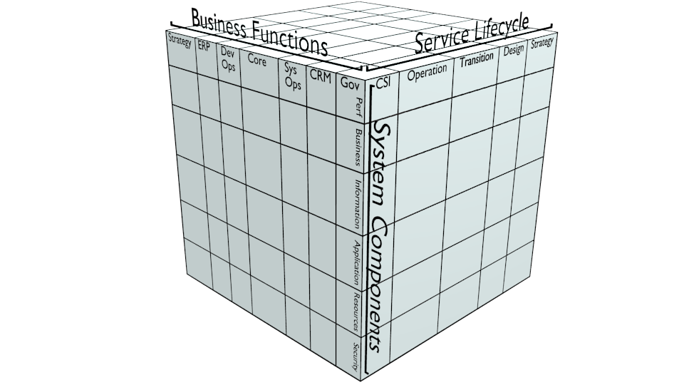
A Whole-Enterprise Architecture Framework: Construction
1) Define Enterprise Dimensions and Align Standards
2) Assemble Enterprise Model
3) Derive Assurance Viewpoints
4) Construct Assurance Ecosystem
5) Create Requirement Specification
Template and Methodology

Slide 2
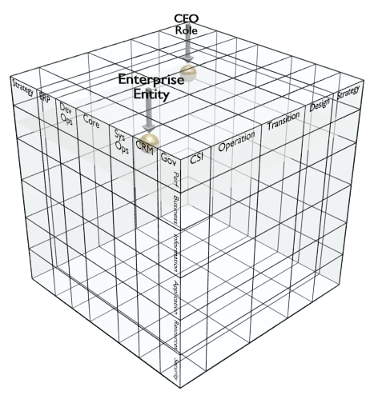
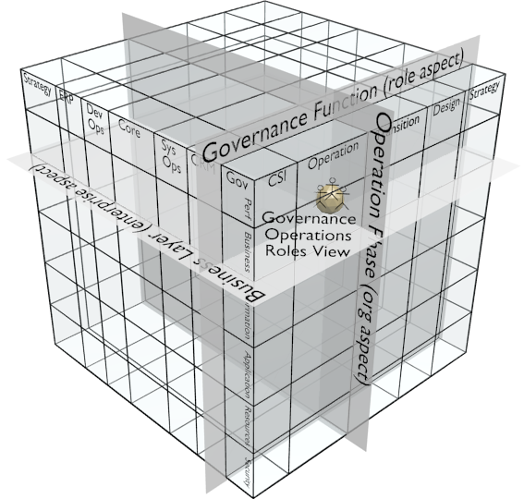
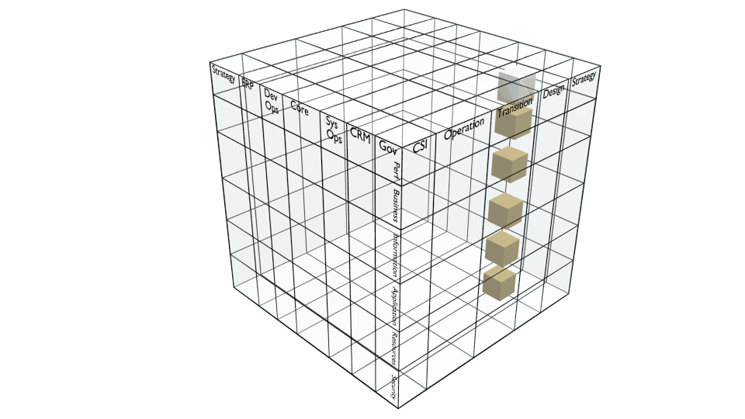

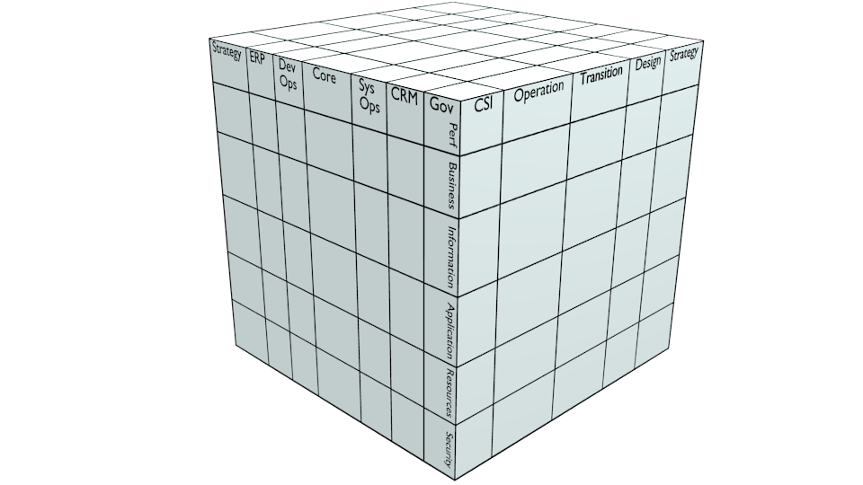
A Whole-Enterprise Architecture Framework: Usage
1) Initialize the model
Select and align standards
Define the enterprise and owner as initial entities of interest (SoI)
2) Populate the model
Identify SoI
Specify attributes
  Position SoI in model
  Establish trace links
Specify requirements
  Iterate on stakeholders and change management
  Recurse on decomposition
Update with instance details
3) Generate Views
Select viewpoints by projections and restrictions on dimensions
4) Exchange requirements
Client defines and exports SoI enterprise requirements for partner
  Attributes referencing alignment-level dimension elements
  Applicable requirements, standards, design guidance, and success criteria
Partner exports SoI instance information for client model update and proof of compliance
Client
Partner
5) Merge/reconcile models
Export participant models
Import to merged model
Analyse and reconcile redundancies
design
reqs
instance information
(evidence of compliance)
Enterprise A
Merged
Enterprise
Enterprise B

