Slide 1
Whole Enterprise Architecture Framework (WEAF):
Detailed Summary
Overview
Construction
Usage
Enterprise Dimensions
  Business Functions
  System Components
  Service Lifecycle
Enterprise Model
Assurance Viewpoints
  Function Governance
  System Management
  Service Realization
Assurance Ecosystem
Requirement Specification
  Template
  Methodology

Slide 2
WEAF Overview
The Challenge
An enterprise is a complex network of people, processes, and resources that change continuously.
No standard for a unified model of the whole enterprise.
Business assurance is a key concern for realizing business outcomes.
Coverage and traceability of requirements are major challenges for business assurance.
No standard for an assurance ecosystem that covers assurance across an enterprise and supports traceability.
Enforcing coverage and traceability is problematic without a common model of the enterprise.
An Answer
WEAF is proposed as a framework providing a unified enterprise model and an assurance ecosystem while enforcing coverage and traceability through structured requirement specification.
Enterprise dimensions are defined to provide coverage and standards alignment.
An enterprise model is constructed to represent all business entities throughout the lifecycle.
Representation viewpoints are derived via projections and restrictions of the dimensions.
Canonical assurance viewpoints are defined for the model and used together with strategy to build an assurance ecosystem covering all assurance concerns.
Requirement specification template and methodology to capture SoI attributes and requirements, enforce coverage of strategic and stakeholder concerns, and enable ubiquitous traceability.

Slide 3
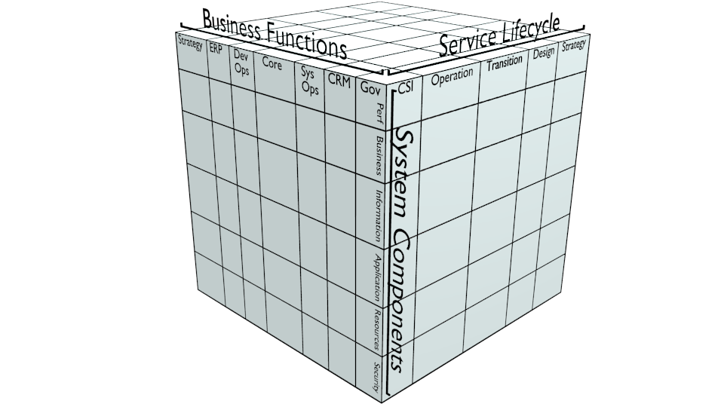
WEAF Construction
1) Define Enterprise Dimensions and Align Standards
2) Assemble Enterprise
Model
3) Derive Assurance
Viewpoints
4) Construct Assurance
Ecosystem
5) Create Requirement
Specification Template
6) Create Requirement
Specification Methodology

Slide 4
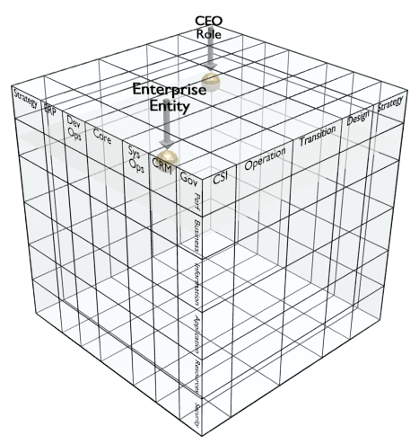
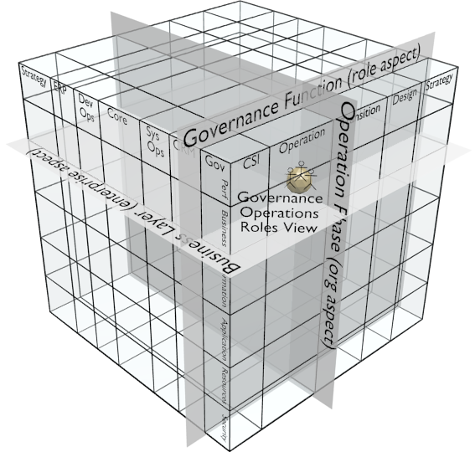
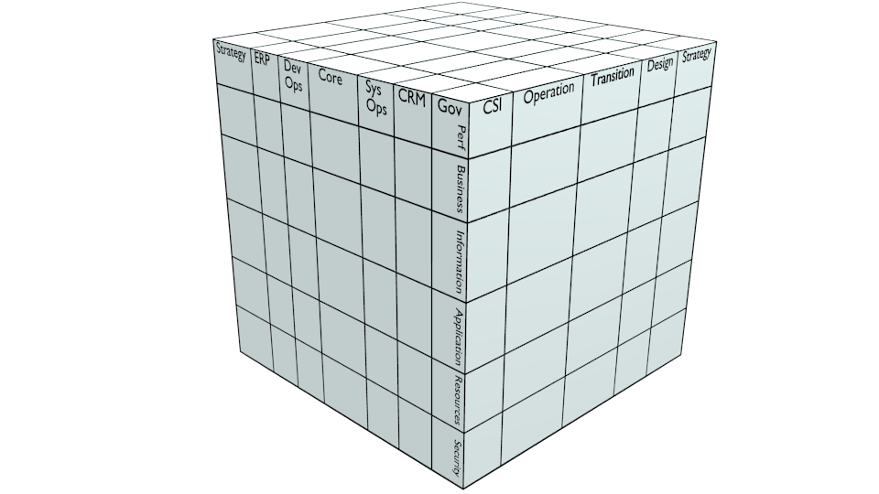
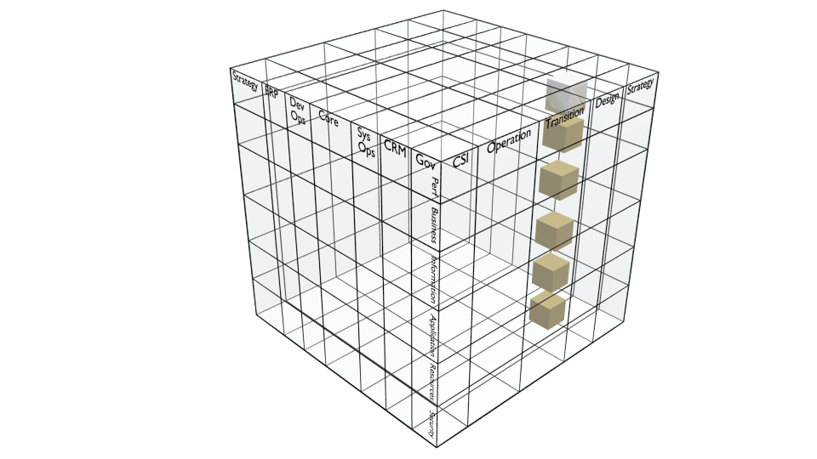
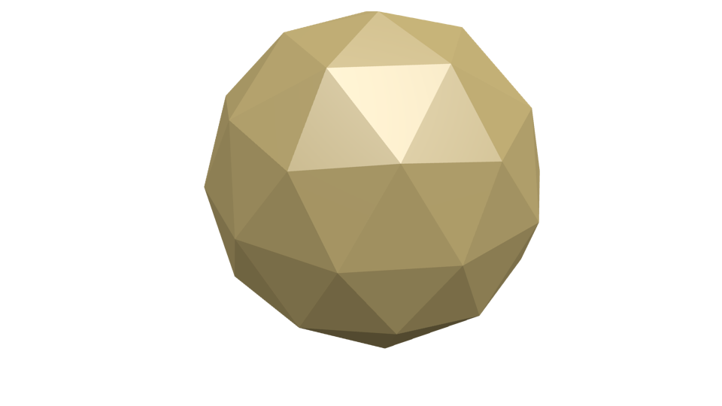
WEAF Usage
1) Initialize the model
Select and align standards
Define the enterprise and owner as initial entities of interest (SoI)
2) Populate the model
Identify SoI
Specify attributes
  Position SoI in model
  Establish trace links
Specify requirements
  Iterate on stakeholders and change management
  Recurse on decomposition
Update with instance details
3) Generate Views
Select viewpoints by projections and restrictions on dimensions
4) Exchange requirements
Client defines and exports SoI enterprise requirements for partner
  Attributes referencing alignment-level dimension elements
  Applicable requirements, standards, design guidance, and success criteria
Partner exports SoI instance information for client model update and proof of compliance
5) Merge/reconcile models
Export participant models
Import to merged model
Analyse and reconcile redundancies
Enterprise A
Enterprise B
Client
Partner
design
reqs
Merged
Enterprise
instance information
(evidence of compliance)

Slide 5
WEAF Dimensions
Interpretation:
Characterization of business entities throughout their life history using aspects of “people, process, technology” and lifecycle.
Common basis for standards alignment.
Alignment of standards:
Business process frameworks
Reference architectures
Lifecycle methodologies
Utility of aspects:
Separation of processes grouping by service and role
Separation of enterprise system and technical solution
Separation of lifecycle support and lifecycle maturity

Slide 6
WEAF Dimension - Business Functions
Interpretation:
Characterization of business processes grouped by organizational structure, role, and service.
Standards mapping:
Business process frameworks -
APQC PCF
eTOM
SCOR
ARTS
...
Aspects:
Role – processes grouped to assign responsibility
Service – processes grouped to specify an outcome

Slide 7
WEAF Dimension – System Components
Interpretation:
Characterization of enterprise systems as components grouped into logical layers.
In contrast to the other dimensions, the representation differs between aspects. This reflects transition from high-level design to detailed design.
The enterprise aspect representation is the alignment view. The solution aspect must be aligned to maintain traceability.
The solution aspect dimension elements vary based on chosen solution RA.
Standards mapping:
Reference architectures (RA):
FEAF RAs
TOGAF RAs
DoD IEA RAs
...
SOA
ODP
TOGAF TRM and III-RM
...
Aspects:
Enterprise – enterprise decomposition
Solution – technical decomposition

Slide 8
WEAF Dimension – Service Lifecycle
Interpretation:
Characterization of lifecycle phases following ITIL.
Aspects characterize SoI by organizational support of phase OR phase of life history.
Detailed views are a tentative decomposition to reflect DevOps practice.
Standards mapping:
Lifecycle methodologies -
ITIL
TOGAF ADM
PRINCE2
PMBOK
...
Aspects:
static – organization view of SoI in terms of lifecycle phase(s) supported
dynamic - life history view of SoI maturity in terms of lifecycle phase

Slide 9
WEAF Enterprise Model
Interpretation:
Representation of an enterprise and business entities (SoI).
Characterization of SoI people and processes by the business functions dimension and aspects.
Characterization of SoI systems, solutions, technology, and resources by the system components dimension and aspects.
Characterization of SoI lifecycle support and state by the service lifecycle dimension and aspects.
Populate:
Position SoI in model
Establish trace links up and across enterprise
Decompose SoI to establish trace links and design requirements for deployed instance components
Design guided by linked standards and principles
Extract:
Derive viewpoints via dimension projections and restrictions
Generate SoI views
Perform gap, redundancy, and compliance analysis
Exchange SoI information and requirements

Slide 10
WEAF Assurance Viewpoints
Interpretation:
Representation of assurance concerns covering the enterprise.
Each assurance viewpoint has a corresponding business function.
Corresponding business function services define categories of assurance requirements.
Dimension aspects define sub-viewpoints for each assurance viewpoint
Assurance Concerns:
Coverage - across business functions, between strategy and instances, throughout the lifecycle
Traceability- links up to strategy, across to indirect dependencies, and down to instance components
Assurance Cases:
Claim – compliance with assurance service requirements
Argument – fulfillment of assurance service criteria
Evidence – generated views with criteria values

Slide 11
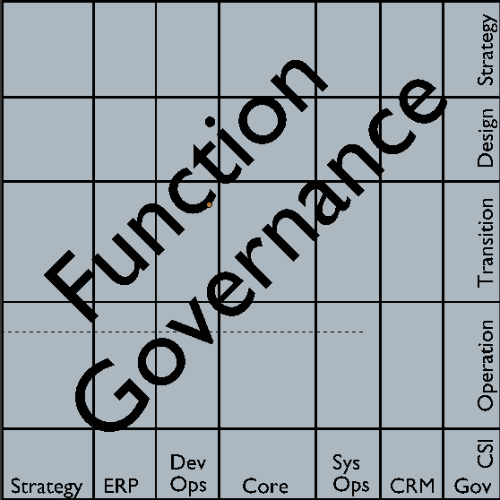
WEAF Viewpoint – Function Governance
Interpretation:
Assurance viewpoint for business operation and business change
Lifecycle static/organization aspect defines an audit sub-viewpoint
Lifecycle dynamic/life history aspect define a change management sub-viewpoint
Corresponding business function and services:
Governance
Compliance
Dispensation
Communication
Sub-viewpoints by aspect* and categorized:
Audit Viewpoint
As-is role
As-is service
Change Management Viewpoint
Role change
Service change
Service Lifecycle (static or dynamic)
Business Functions (role or service)
* lifecycle aspect naming:
static = as-is
dynamic = change

Slide 12
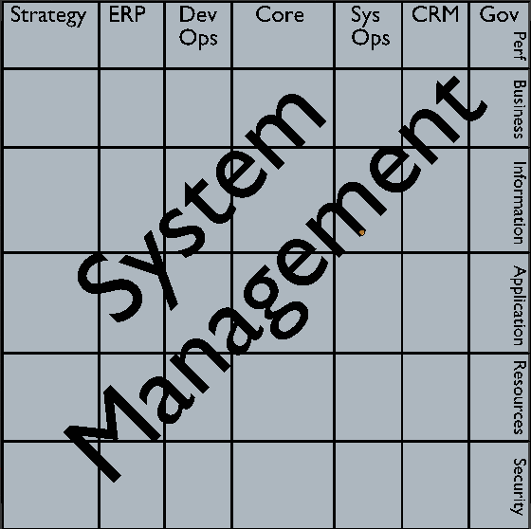
WEAF Viewpoint – System Management
Interpretation:
Assurance viewpoint for enterprise and technical systems supporting business functions
System component enterprise aspect defines an organization management sub-viewpoint
System component solution aspect defines a technical management sub-viewpoint
Corresponding business function and services*:
System Management
Fault monitoring
Configuration management
Usage accounting
Performance
Security
Continuity
Request fulfillment/change control
Business Functions (role or service)
Sub-viewpoints by aspect and categorized:
Org Mgmt Viewpoint
Enterprise role
Enterprise service
Tech Mgmt Viewpoint
Solution role
Solution service
System Components
(enterprise or solution)
* System management services are a tentative merger of ISO-7498 FCAPS, eTOM FAB, and continuity.

Slide 13
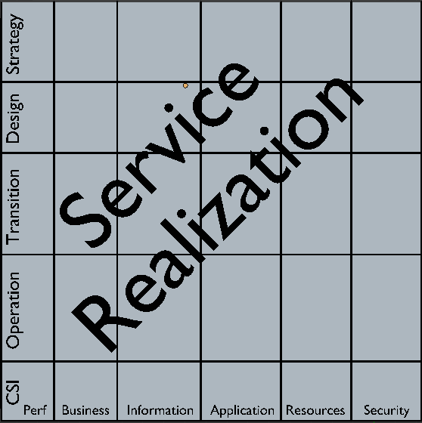
WEAF Viewpoint – Service Realization
Interpretation:
Assurance viewpoint for enterprise and solution system change through the lifecycle.
Lifecycle static/organization aspect defines a baseline sub-viewpoint.
Lifecycle dynamic/life history aspect defines a project management sub-viewpoint.
Corresponding business function and services†:
Service Realization
Design
Plan
Develop/Source
Implement/integrate
Document
Test
Deploy
Sub-viewpoints by aspect* and categorized:
Baseline Viewpoint
As-is enterprise
As-is solution
Project Management Viewpoint
Enterprise change
Solution change
Service Lifecycle (static or dynamic)
System Components
(enterprise or solution)
† Service Realization services are a tentative decomposition to reflect DevOps practice.
* Lifecycle aspect naming:
static = as-is
dynamic = change

Slide 14
WEAF Assurance Ecosystem
Interpretation:
Representation of business functions encompassing assurance for any business entity.
Assurance business functions correspond to canonical assurance viewpoints.
Assurance Structure:
Strategy establishes SoI principles and goals
Governance ensures SoI compliance
Service Realization ensures SoI change delivery
System Management ensures SoI operation
Assurance Interactions:
Strategy defines objectives for Governance
Governance defines SoI compliance for Service Realization
Service Realization delivers SoI to System Management
System Management measures and reports SoI performance to Governance
SoI stakeholders define/validate requirements and performance with each assurance function
Assurance Ecosystem
Strategy
Governance
SoI
System
Management
Service
Realization

Slide 15
WEAF Requirement Specification
Interpretation:
Capture and presentation of SoI attributes and requirements.
Locates SoI in enterprise model.
Central tool to enforce coverage and traceability.
Coverage:
Position in enterprise
Relevant strategy, objectives, and design guidance
Stakeholder requirements
Assurance requirements
Solution requirements
Indirect dependencies
Traceability:
Trace links up to strategy, goals, objectives
Trace links across to indirect system, service, and role dependencies
Trace links down to solution components and instances

Slide 16
WEAF Requirement Specification - Template
Interpretation:
Representation of SoI attributes and requirements.
Attributes locate SoI in enterprise model and identify trace links up and across enterprise.
Requirements specified for enterprise and solution layers.
Attributes:
Generic
Unique ID
Owning Role
Supported services
Containing systems
Supported phases
Lifecycle phase
Version
Type specific
- Process
Trigger process
Consumer process
- Resource
Location
- ...
Requirements:
Enterprise
  Begin with objective as a business requirement
  Design guidance provided by layer principles
Assurance
  Extracted from the enterprise section (e.g. performance metrics)
  Validated by assurance stakeholders
Solution
  Enterprise requirements translated to ref arch for detailed design

Slide 17
WEAF Requirement Specification - Methodology
Interpretation:
Process to collect SoI requirements.
Identifies SoI location within the enterprise model.
Enforces coverage of stakeholder concerns.
Enforces traceability of requirements from strategy to deployed instance.
Iteration:
Coverage of stakeholder concerns
Management of requirement changes
Recursion:
Trace up and across
Trace up to goals, principles, drivers, and constraints.
Trace across to indirect system and service dependencies
Trace down
Decompose services to level suitable for translation into solution requirements.
Decompose solution into components suitable for translation into implemented instances.
Update SoI information with instance details

