Slide 1
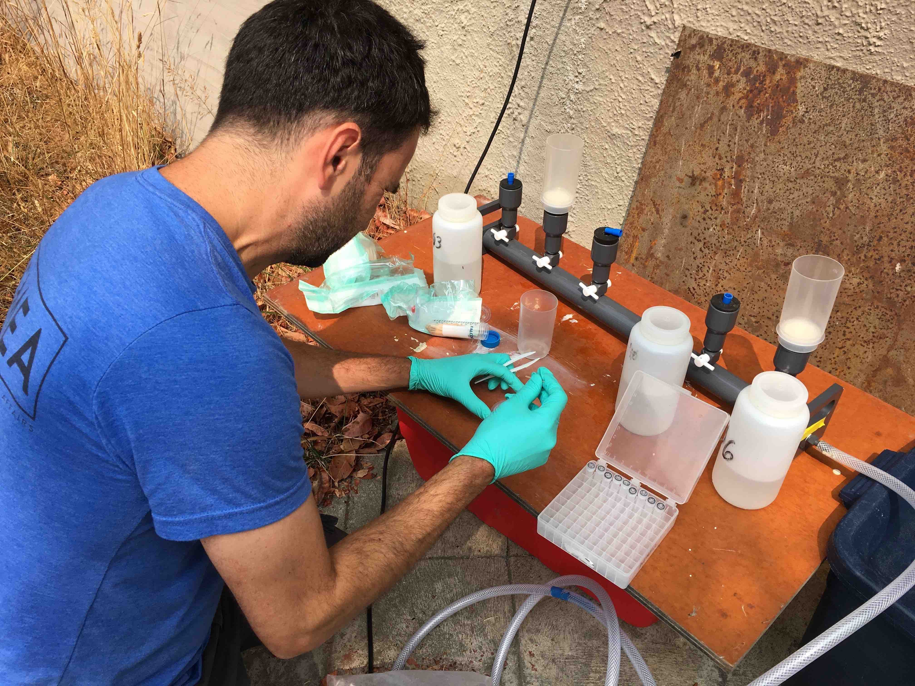

When You Have a Hammer…
Ryan Kelly
School of Marine and Environmental Affairs
University of Washington

Slide 2
The fallacy of the instrument:
When you have a hammer, everything looks like a nail.
“Hey! we have these samples…”
“Let’s just see what we get when…”
“What could we use eDNA for ?”
Notes:
Without a goal, and without the right tools to meet that goal, you’re bound to be disappointed.

Slide 3
The fallacy of the instrument:
When you have a hammer, everything looks like a nail.
Without a goal, and without the right tools to meet that goal,
you’re bound to be disappointed.
Cool ≠ Useful
Notes:
Without a goal, and without the right tools to meet that goal, you’re bound to be disappointed.

Slide 4
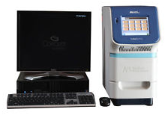
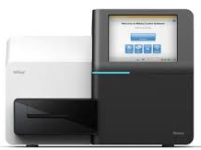
Cool and Useful
qPCR
Amplicon Sequencing
Sensitivity; rare targets
rapid quantification
Replication
Depth and breadth
10^(3-4) of taxa
Replication
Notes:
qPCR vs. Sequencing. Two approaches to eDNA.
qPCR: 1. vastly improved detection of rare targets 2. rapid quantification
Amplicon sequencing: alleviates depth/breadth tradeoff

Slide 5
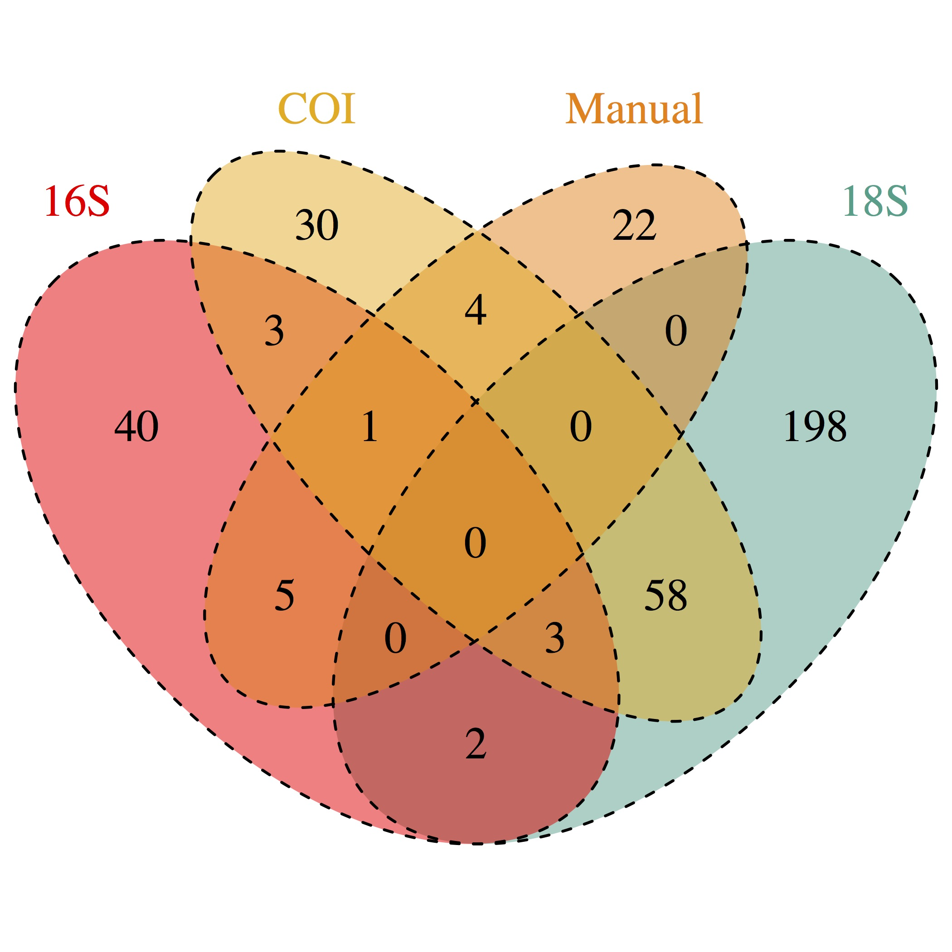
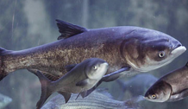
But… how to interpret?
“Witchcraft” ?
“Validation” vs. other methods
1. One apple, one orange
2. Different performance tolerances
Notes:
qPCR vs. Sequencing. Two approaches to eDNA.
qPCR: 1. vastly improved detection of rare targets 2. rapid quantification
Amplicon sequencing: alleviates depth/breadth tradeoff

Slide 6
Onward
Not “Witchcraft”
Repeatable
Precise; low variance among replicates
Signal : Noise
“Validation” vs. other methods
Not the same. Deal with it.
Roll into abundance index, e.g.
Notes:
qPCR vs. Sequencing. Two approaches to eDNA.
qPCR: 1. vastly improved detection of rare targets 2. rapid quantification
Amplicon sequencing: alleviates depth/breadth tradeoff

Slide 7
The Right Tools for the Job
Single / few target species? qPCR
Multispecies survey, target-agnostic? Amplicon sequencing
Multispecies survey, specific targets? Custom primers, sequencing
If you have a better tool, use it.
Notes:
qPCR vs. Sequencing. Two approaches to eDNA.
qPCR: 1. vastly improved detection of rare targets 2. rapid quantification
Amplicon sequencing: alleviates depth/breadth tradeoff

Slide 8
Thanks
Ramón Gallego
Emily Jacobs-Palmer
Kelly Cribari
Jimmy O’Donnell
Jimmy Kralj
Mike Tillotson
Natalie Lowell
Ole Shelton
Jameal Samhouri
Greg Williams
Blake Feist
Linda Park
Packard Foundation, Stanford (Boehm lab and Center for Ocean Solutions), UW CEG (Armbrust, Morris, Rocap labs), Phil Levin, USGS (Jeff Duda, Marshall Hoy), WA DNR

Slide 9
Notes:
In your heart of hearts, says Ole, you think more reads == more fish. It’s not true. It’s all in the primers. And the reason it worked for us in Monterey is we were aiming at very few species… There’s still a ton of primer bias, but you’ve reduced one source of variance (sampling variance). Also, we’re comparing within-taxon trends, not between-taxon trends.

