Slide 1

invesdwin
Software-Product-Line Platform

Slide 2
Agenda
Introduction
Software-Product-Line
Development Environment
Configuration Management
Assets
Binding Variability
DDD and MDA
Conclusion
Feel free to ask questions!

Slide 3
invesdwin
1. Introduction
Story
Motivation

Slide 4

1. Introduction
- Background -
Bachelor Thesis -> Companies platform vs SPL (Software-Product-Line)?
  Company decided to stick to their business components
  Blueprint for projects instead of SPL
Decided to research SPL further as a side project
  Domain of Algorithmic Trading, SPL as foundation
    Research Project
    Suitable for any Team Size
    low/no running costs
  OpenSource Leverage
  Reuse has highest priority
  R&D requires Flexibility
  Development Comfort very important
  It has to be FUN!
In development since October 2009
relatively stable since 2012
Open Source since 2016

Slide 5
invesdwin
2. Software-Product-Line
Scientific Background

Slide 6
2. Software-Product-Line
- Classification -
Standard-Software
Software-Product-Line
Individual-Software
Cost increases with Individuality
Flexibility decreases with Standardization
Customization
Blueprint
Solution:
Reduce costs through Reuse
Keep flexibility through Variability

Slide 7
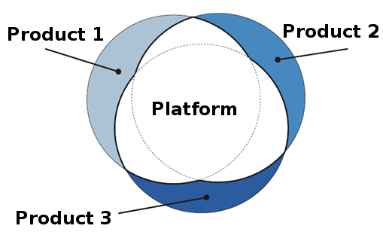
2. Software-Product-Line
- Assets -
Assets
  Artifacts such as Documentation, Code, Libs, Configuration, Products, Platform
  SPL is made of - and manages Assets
Reuse
  Artifacts are designed to be reused
  Creation of Synergies
  Reduction of Development Cost
  Faster Time-To-Market
  Avoid Copy/Paste (Artifact duplication)
Modularity
  Bundle Artifacts
  Only deliver what the customer paid for!

Slide 8
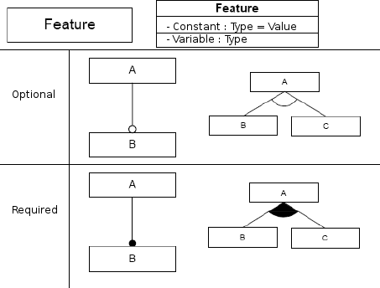
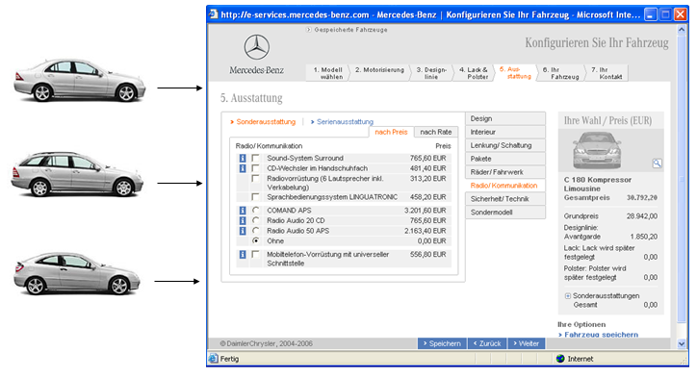
2. Software-Product-Line
- Variability -
Variability
  Interchangeability of used Implementation
  Selection of Features
  Make price variable and align it to the customer
Variability Points
  Decision „where“ Variants can be chosen
  Planned Flexibility Options
  Configurable or Chooseable
  Customer makes the Decision here
Variants
  Encapsulate Features to be chosen optionally
  Compare with Car Manufacturing:
    Coupling Device yes/no
    Sport Suspension vs Comfort Suspension
    Combi-Van vs Limousine

Slide 9
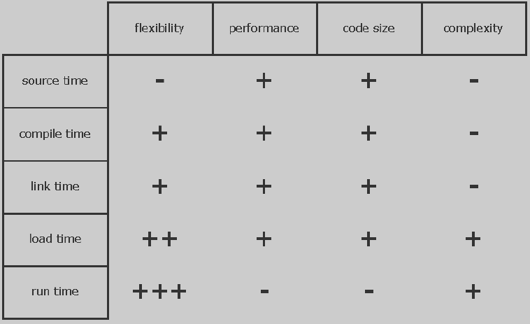
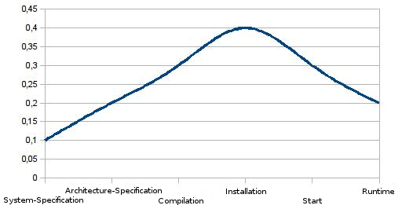
2. Software-Product-Lines
- Binding -
Binding
  Variability Point gets placed with a Variant
Binding Points
  Decision „how“ in Code/Deployment a Variant gets chosen
  Patterns: Dependencies, Properties, Runtime-Button
Binding Times
  Decision „when“ a Variant can be chosen
  Compare with a finished Car:
    Choose Equipment (when Buying)
    Update Navigation-Maps (before Engine Start)
    Activate Sportgear (while Driving)
    Deactivate Electronic Stability Control (while Driving)
Overview of Binding Times:
Usage of Binding Times:
illustrative
- Early -
- Late -

Slide 10
invesdwin
3. Development Environment
What is the SPL realized in?
Standard Stuff…

Slide 11
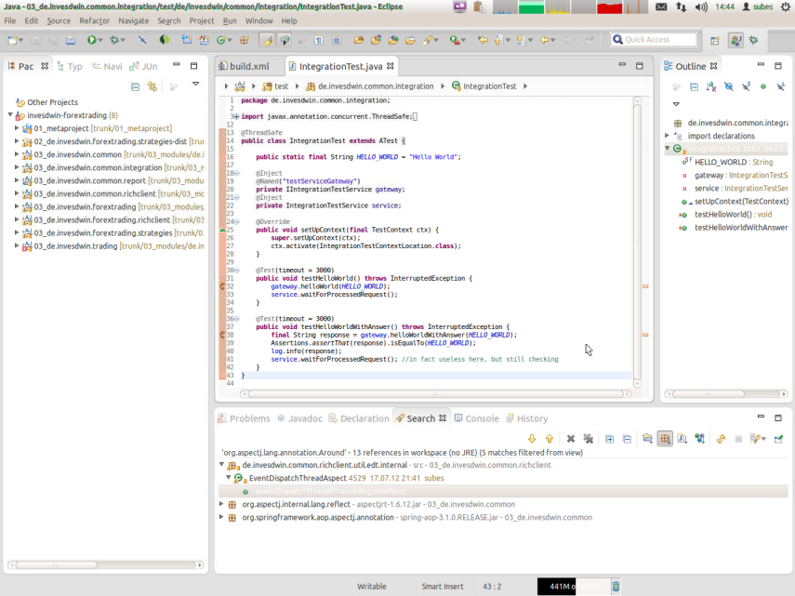

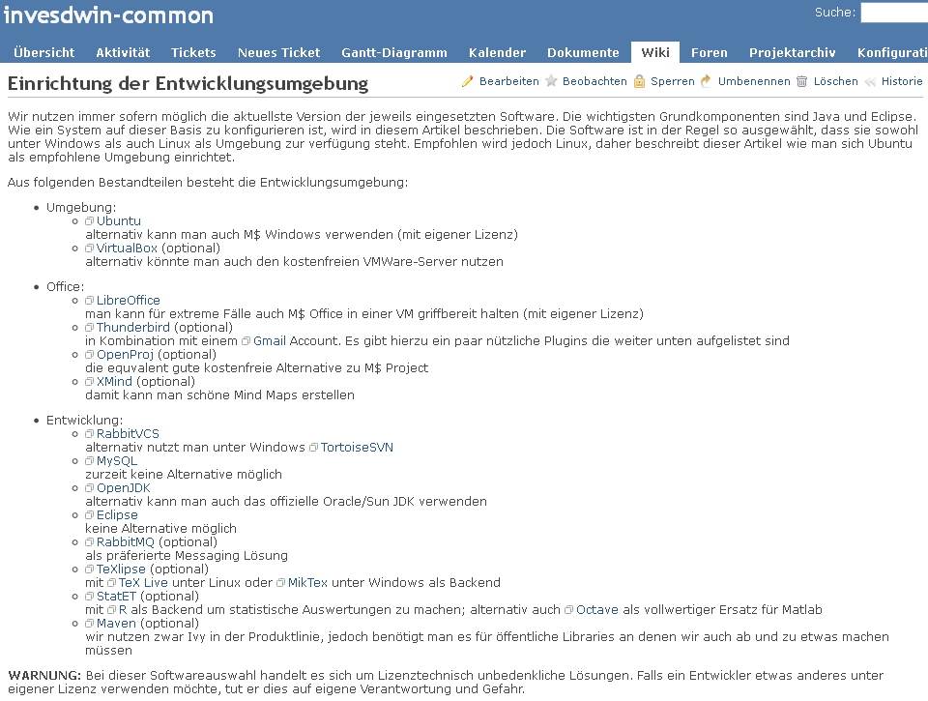
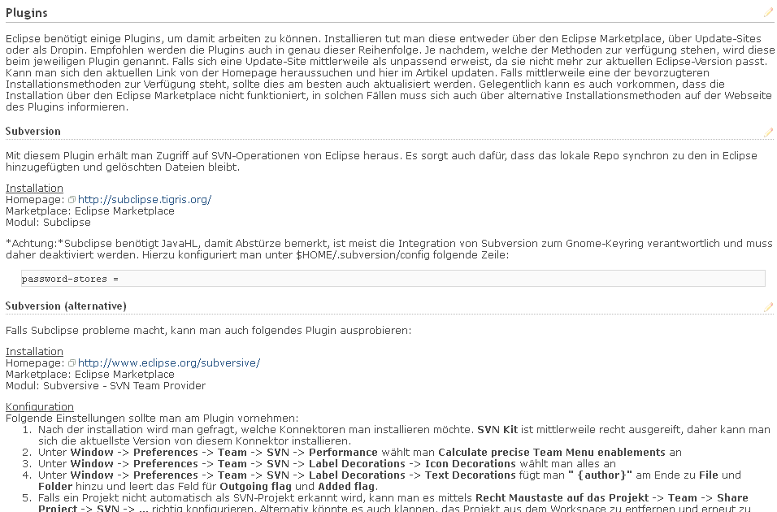


3. Development Environment
- Low Impact -
OS: Windows/Linux
Versioning: SVN/Git
Language: Java 8 (started with Java 6)
IDE: Eclipse + Plugins
Build & Dependency Mgmt: Maven
Earlier Ant+Ivy+Groovy was used (basis for this concept),
later reimplemented with Maven to improve build times.
Documentation:
moving

Slide 12
invesdwin
4. Configuration Management
New Approach

Slide 13
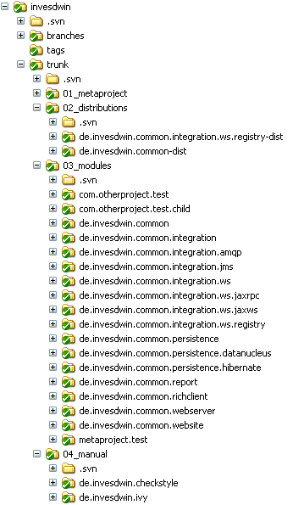
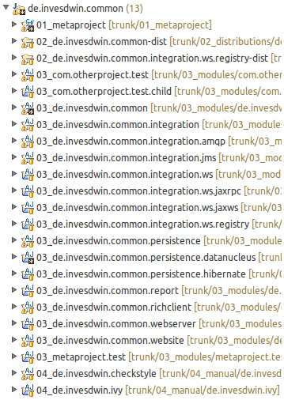
4. Configuration Management
- Overview -
REPLACED BY MAVEN
with a better implementation of this concept
← Explorer
Eclipse →
Product:
01 Metaproject
02 Distribution
03 Module
(04 manual Module)
Metaproject got turned into:
Invesdwin-maven-plugin
+ parent pom.xmls

Slide 14


4. Configuration Management
- Module I -
Reusable Building Blocks for Products
  Technology: Best Practices, Patterns, Frameworks, Utils, Tools
  Domain: Services, Entities, Logic, Algorithm
→ Each has its own Eclipse-Project to ensure Modularity
Combine &
make Reusable
Components
Insurer, Contract, Customer, …
Module
Contract Management

Slide 15
4. Configuration Management
- Module II -
Previous Platform had a monolithic architecture where
services/beans/components were bundled into „containers“
that had tight coupling among each other.
A module in this sense can bundle multiple containers,
thus is more than a container.
Comparison to previous Platform:
  Module > Container
  Upgrade-Path instead of Copy-Paste
    Rather add Variability to a Module, instead of creating another one
    Goal: Effectively less Maintenance Cost
Fix Bug multiple times differently VS Fix Bug once + update Version multiple times
Apply Lessons Learned from old Business Components:
  YAGNI & KISS
  Do not develop on Green Field and avoid Over-Engineering
→ Only add Variability when it is actually needed
  Enforce Loose Coupling
→ Utilize submodules to encapsulate Functionality/Alternatives

Slide 16

4. Configuration Management
- Module III -
Why no OSGI?
  Dynamic Load/Unload not needed
  OSGI-Descriptors not maintained well by Open Source Projects
  Avoid Classpath-Problems (one common Classpath is easier)
  Jar-Hell and Version-Conflicts already solved by Dependency Management
  Loose Coupling via „internal“ Packages enforced by Checkstyle-Rule
→ reasoned deviations from the „internal“ Package Rule possible
→ without technical challenges
only
OSGI
Compatible

Slide 17
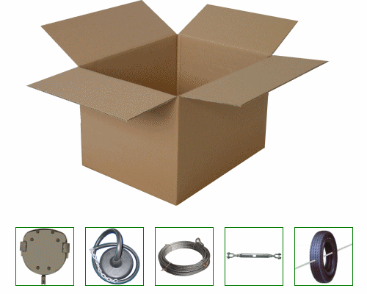
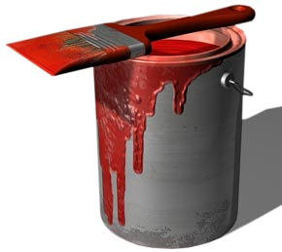
4. Configuration Management
- Distribution -
A configurable, deployable Product
  Bundles multiple Modules
  Configuration of Variability via
    Dependencies
    Properties
    Additional Resources
  Customer Specific
  Target Environment Specific
  Decision about package type only here:
    Executable Fat-Jar
    Zip with launch scripts
    War as Container
→ Example Web-Application: Fat-Jar with embedded Jetty or War for Tomcat?

Slide 18
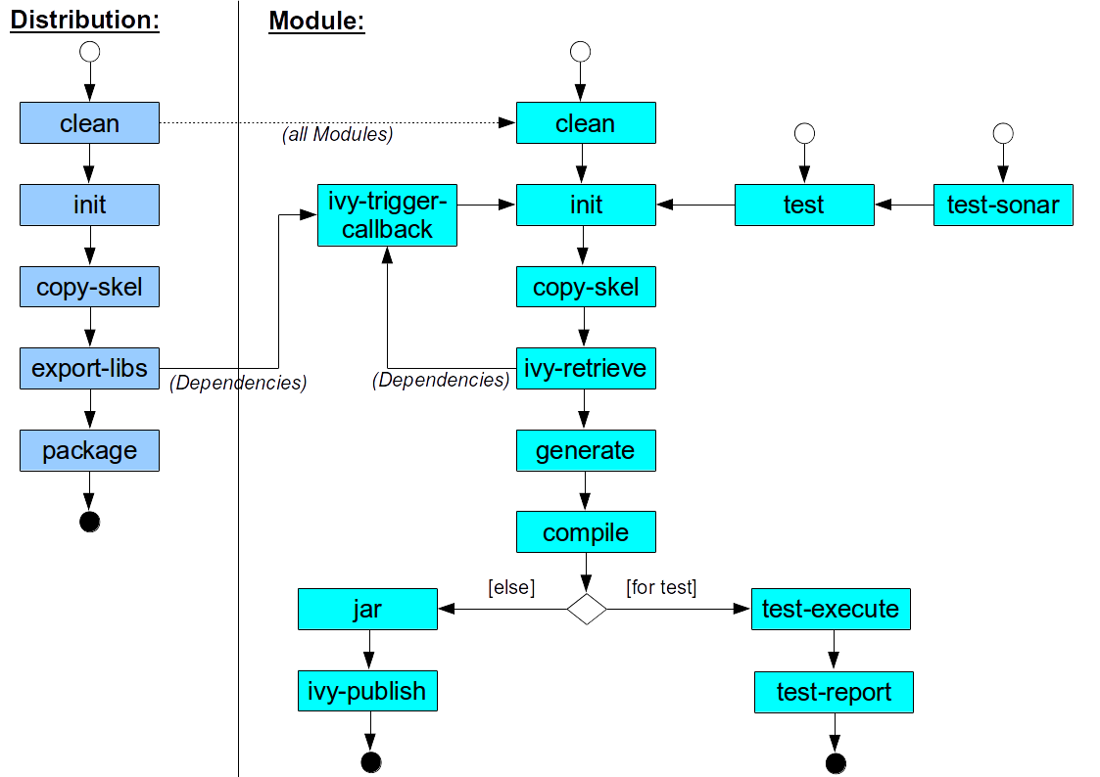
4. Configuration Management
- Metaproject I -
REPLACED BY MAVEN
with a better implementation of this concept
Definition of unified Build-Process:
Maven Reactor achieves
the same today

Slide 19
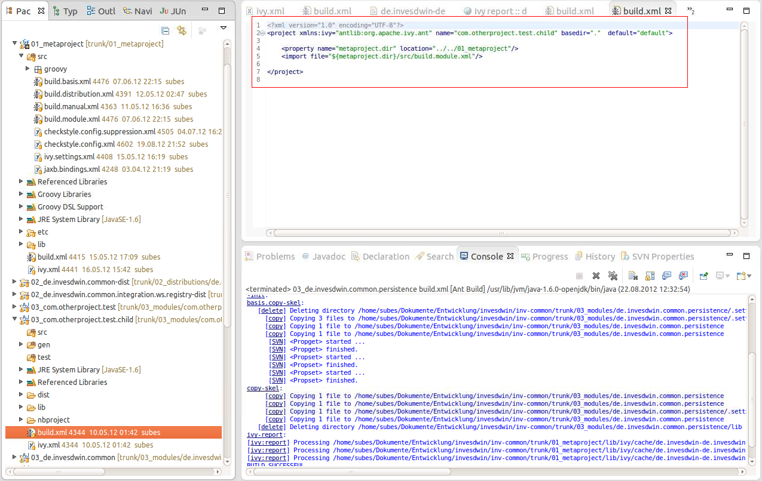
4. Configuration Management
- Metaproject II -
REPLACED BY MAVEN
with a better implementation of this concept
Reusable standardized Ant-Scripts → maintain in only one place
Project Templates for Modules and Distributions → à la Maven Archetype
Other Assets inherit Eclipse-Project-Configuration → configure only once
Maven won when it
introduced parallel builds

Slide 20
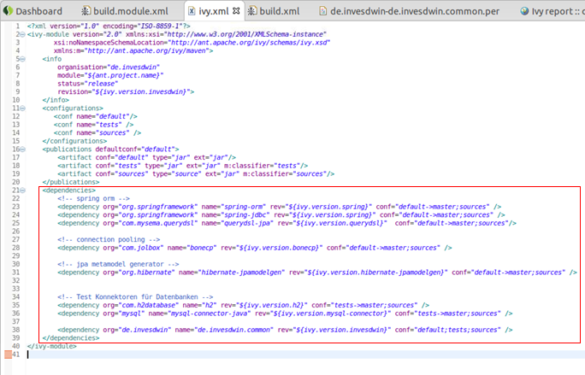
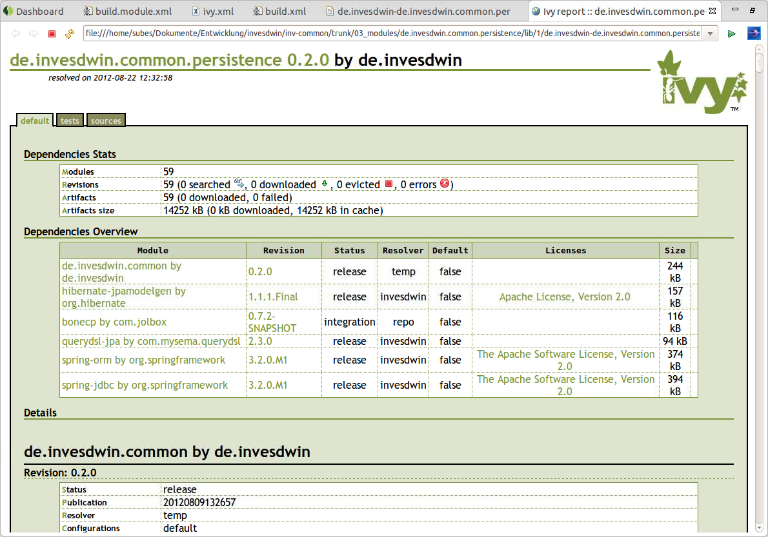
4. Configuration Management
- Metaproject III -
REPLACED BY MAVEN
with a better implementation of this concept
Automatically generated Eclipse-Classpath for Dependencies:
  Project-References for multiple modules spanning Refactorings
  Unified Naming of Dependencies (<Module>-<Version>.jar)
  Sources for all Jars automatically linked
  AspectJ and other Eclipse-Plugins automatically configured
→ Reduction of maintenance effort for Modules, only configuration in ivy.xml required!
M2E Plugin for Eclipse
achieves the same today

Slide 21
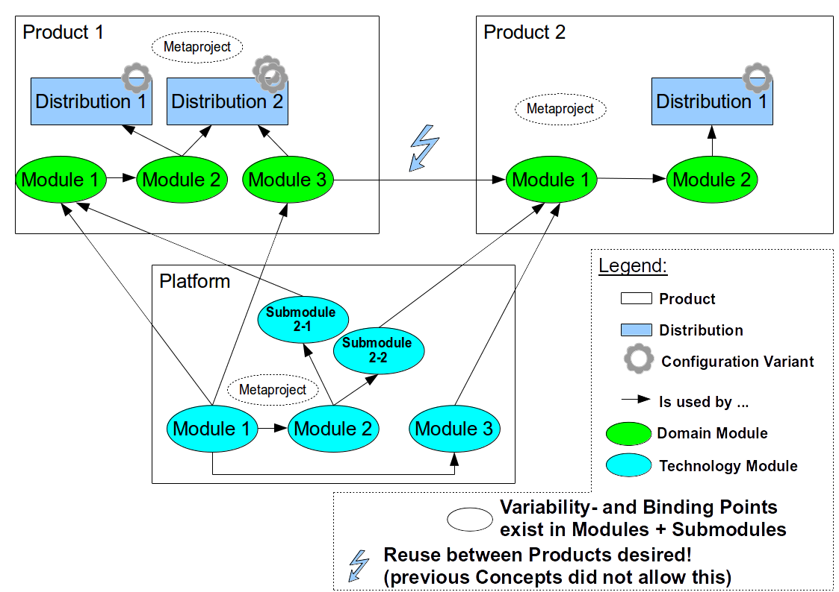
4. Configuration Management
- Multi-Product-Management -

Slide 22
invesdwin
5. Assets
What exists already?
Platform, Products, Components

Slide 23














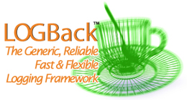
















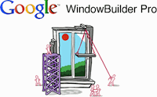



5. Assets
- Platform I -
Outdated Information
some components/names have changed
also today there are more modules
metaproject
invesdwin-common
invesdwin-common-persistence
invesdwin-common-report
invesdwin-common-richclient
Infrastructure
Dependency Repos

Slide 24
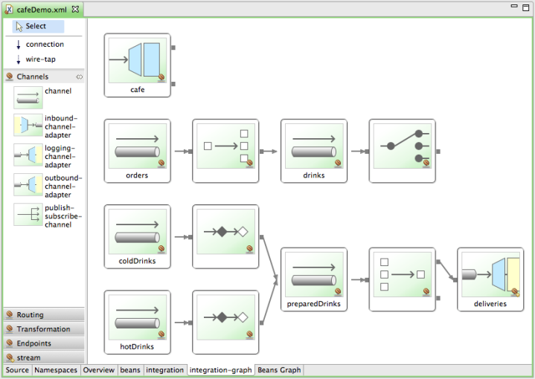







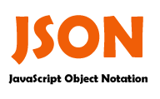
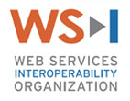
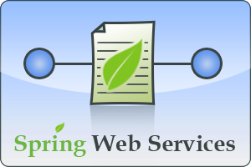








5. Assets
- Platform II -
Outdated Information
some components/names have changed
also today there are more modules
invesdwin-common-integration
  invesdwin-common-integration-amqp
  invesdwin-common-integration-jms
  invesdwin-common-integration-ws -jaxrpc -jaxws -registry
invesdwin-common-website
invesdwin-common-webserver
JAXR → UDDI
Deployment in Tomcat as WAR
configurable in Distribution

Slide 25
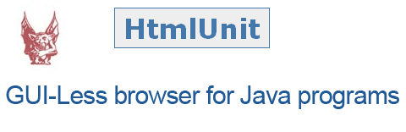
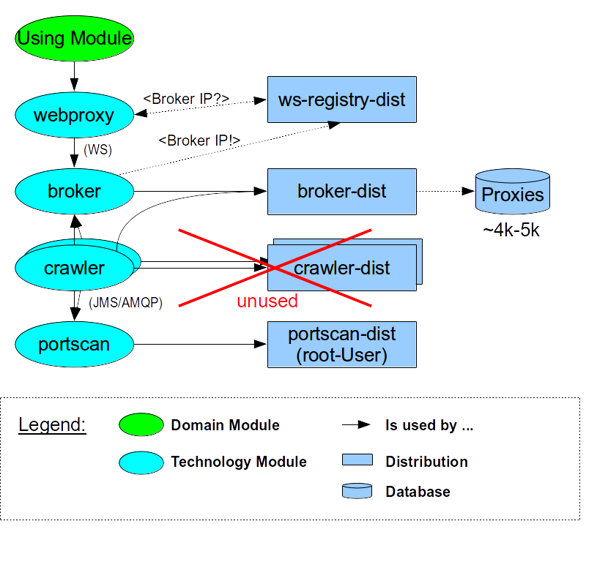
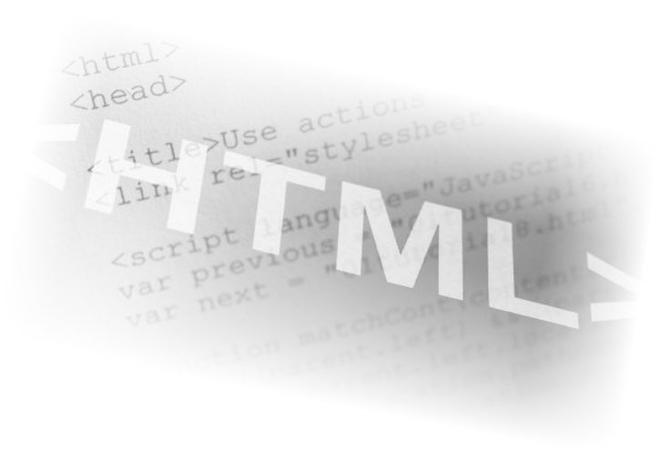
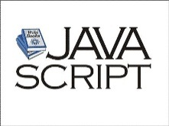







5. Assets
- Example Product webproxy -
ínvesdwin-webproxy(-...)
Simplified Context Diagram:
win/lib/j -
→ Proxies
→ Location

Slide 26
invesdwin
6. Binding Variability
Bootstrap creates Flexibility
Pattern-Examples

Slide 27
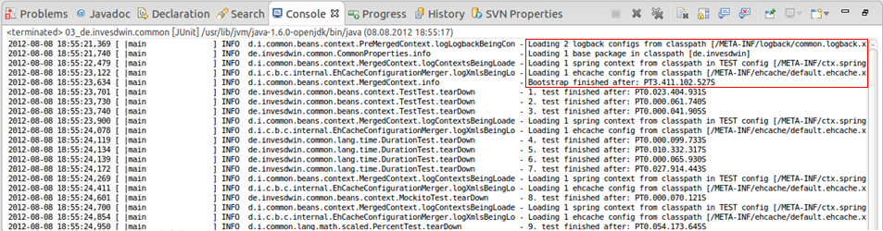
6. Binding Variability
- Application Bootstrap -
Configuration spread among various Modules
Common Classpath (no OSGI)
Two Spring ApplicationContexts
  Premerged → collect and configure
  Merged → running Application
Per JUnit Test-Class a new Bootstrap (fast)
for Configuration Changes:
    Selecting Spring-XMLs via IContextLocation
    In Test via setUpContext()
    In Mocks/Stubs via ITestLifecycle

Slide 28
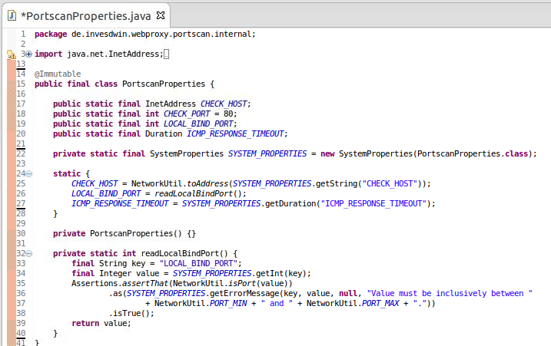
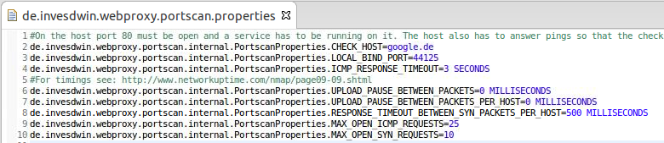
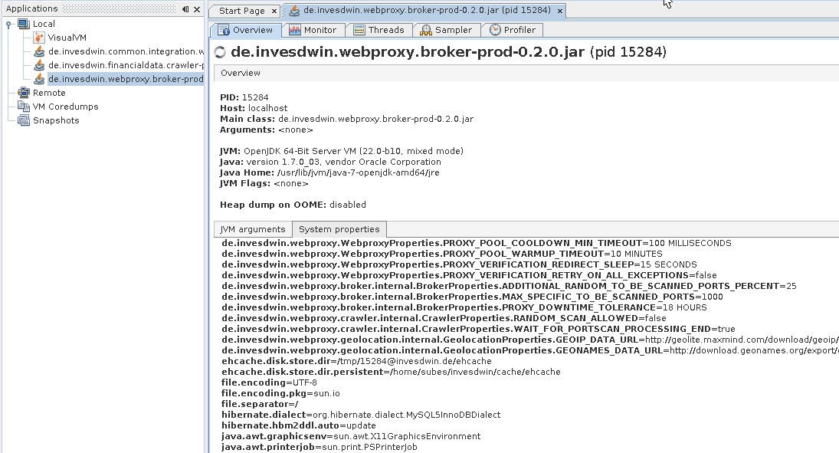
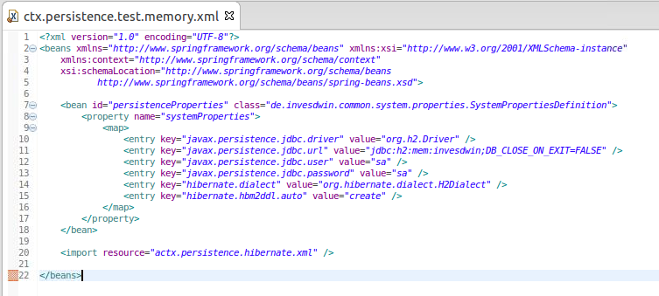
6. Binding Variability
- Properties I -
All Properties are System-Properties
Thus available in:
  other Properties Files à la Ant ${property}
  XML (Spring, Frameworks with Commons-Configuration)
  Java (System.getProperty(„property“))
  VisualVM (Monitoring, be aware of security!)

Slide 29
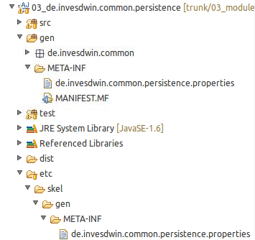
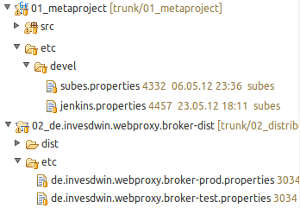
6. Binding Variability
- Properties II -
Now per Module Overrides
with Maven Implementation
- Default-Values in Module-Properties and Replacements by
Developer- and Distribution-Properties as in previous Platform
- Build-Process replaces the Properties in
references Module-Projects (in gen-Source)
and retrieved invesdwin-Libs (in Jar)
- Variable Binding-Time with the following Priority for Overrides:
Source-Time: Default-Values in Properties-File
or Spring-XML
Build-Time: Developer- or Distribution-Properties
Load-Time: Spring-XML
or Java-Parameter via –Dproperty=value
Runtime: Java via Properties.setProperty(„value“)
XOR

Slide 30
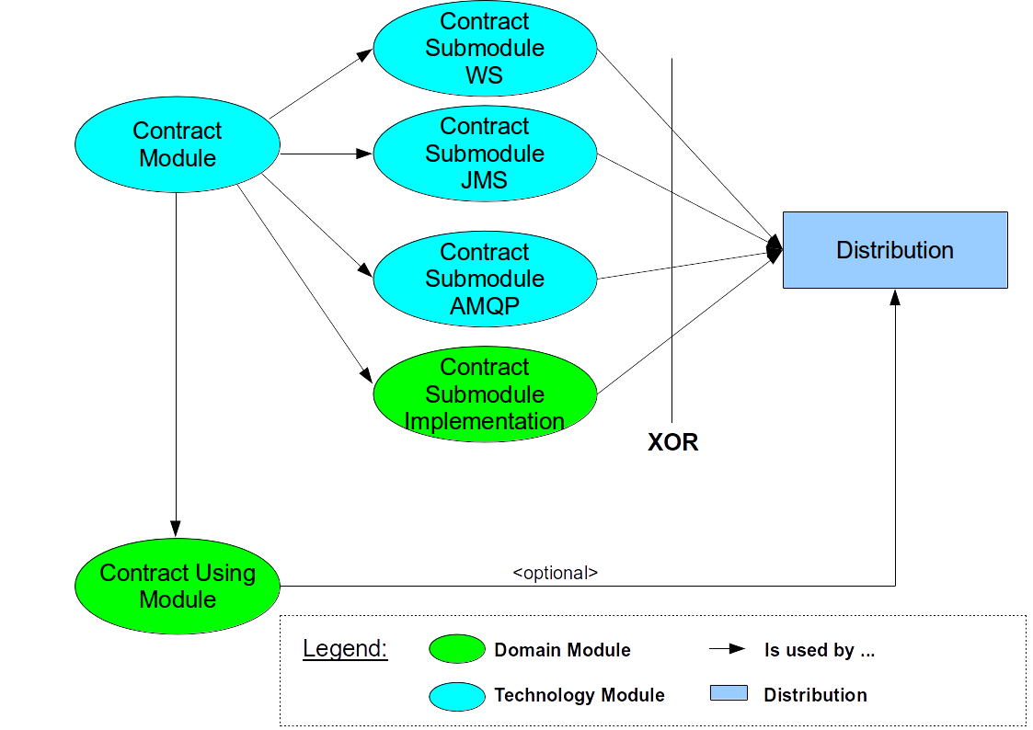
6. Binding Variability
- Contract Modules -
Buch: Enterprise Integration Patterns
Framework: Spring Integration (SI)
SPL-Usage:
  Separate Interface and Implementation
  Enforce loose coupling
  Technological indifference
    to Communication-Type
Contract: Interfaces
Contract Submodule: SI-Configuration
Contract Impl: Interface-Implementation
Possibilities:
  Communication-Overhead reduced by putting Implementation in Distribution directly
  Multiple Instances of Impl with Fail-Over or Load-Balancing

Slide 31
invesdwin
7. DDD and MDA
DDD!
Where could MDA be used?

Slide 32


7. DDD und MDA
- Concepts -
DDD – Domain Driven Design/Development
  Technology Modules in Englisch
  Domain Modules in Domain-Language
  Frontend internationalized → no Module copies that get translated
MDA – Model Driven Architecture
  As of now no MDA:
    Prefer Framework over Generator → easier Maintenance, simpler Build-Process
    Research Project:
      Less recurring Concepts
      Initial invest for Generator would not provide ROI fast enough
  MDA possible:
    Code-Generation at Module-Level, not all-encompassing
    One Model per Module
    Extension of „generate“-Build-Step
    Lots of SPL-Productivity-Potential

Slide 33
invesdwin
8. Conclusion
Benefits
Drawbacks

Slide 34
8. Conclusion
- Your opinion is very welcome! -
Benefits | Drawbacks
+ SPL not just theory, but usable | Learning Curve
+ High Development Comfort | - New Platform
+ High Flexibility | - New Technologies
+ Cheaper Maintenance for complex Projects and in Multi-Project-Environment | - Change of Organizational Structure needed?
+ Matches most Features/Requirements of previous platform | - More Diversity to manage
+ Standardized Eclipse-Projects and Build-Scripts
+ Open, widely used technologies
+ Reuse as highest goal

Slide 35
Thanks a lot for your attention!

