Slide 1
Casos Particulares en Programación Lineal
Clase 16
Investigación Operativa UTN FRBA 2022
Elaborado por: Rodrigo Maranzana
Curso: I4051 (Prof. Martin Palazzo)

Slide 2
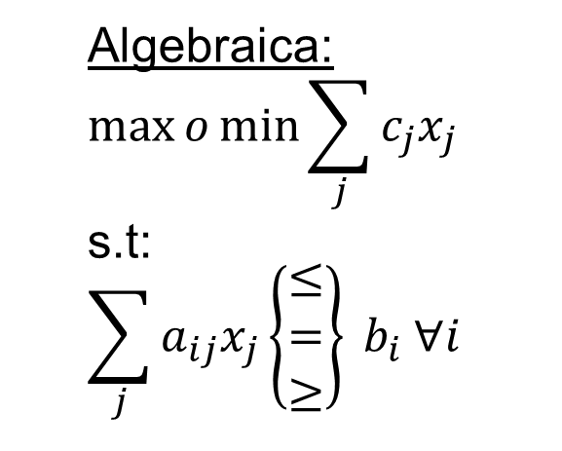
Recordemos las partes del modelo lineal
Algebraica:
$$\max{o\min{\sum_{j}{c_{j}x_{j}}}}$$
s.t:
$$\sum_{j}{a_{ij}x_{j}\left\{\begin{matrix}≤ \\ = \\ ≥\end{matrix}\right\} b_{i} ∀i}$$

Slide 3
¿Cuáles son los casos particulares?
Soluciones alternativas
Solución degenerada
Poliedro Abierto
Solución incompatible

Slide 4
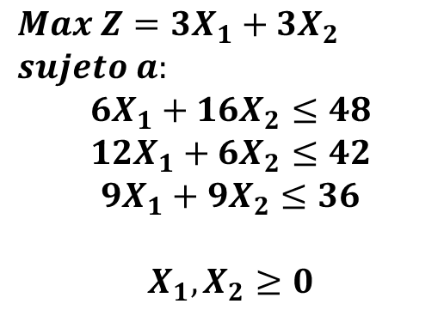
Soluciones alternativas
$$Max Z=3X_{1}+3X_{2}$$
$$sujeto a:$$
$$6X_{1}+16X_{2}≤48$$
$$12X_{1}+6X_{2}≤42$$
$$9X_{1}+9X_{2}≤36$$
$$X_{1}, X_{2}≥0$$

Slide 5
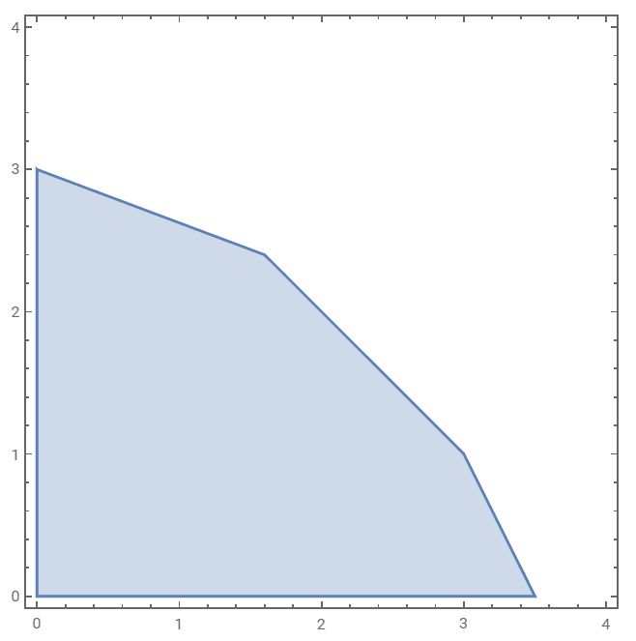
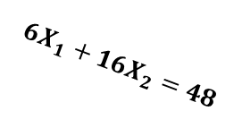
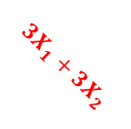


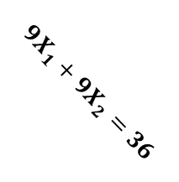
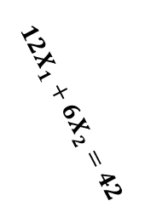
Soluciones alternativas
Combinación lineal de soluciones: $Z^{∗}=f\left(α\right)$
$$X_{2}$$
$$Max Z=3X_{1}+3X_{2}$$
$$sujeto a:$$
$$6X_{1}+16X_{2}≤48$$
$$12X_{1}+6X_{2}≤42$$
$$9X_{1}+9X_{2}≤36$$
$$X_{1}, X_{2}≥0$$
$$6X_{1}+16X_{2}=48$$
$$9X_{1}+9X_{2}=36$$
$$12X_{1}+6X_{2}=42$$
Gráfico hecho en Wolfram Cloud:
RegionPlot[6x1+16x2<=48&&12x1+6x2<=42&&9x1+9x2<=36, {x1, 0,4}, {x2, 0,4}]
$$3X_{1}+3X_{2}$$
$$X_{1}$$

Slide 6
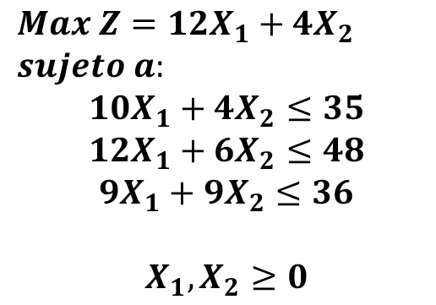
Soluciones degeneradas
$$Max Z=12X_{1}+4X_{2}$$
$$sujeto a:$$
$$10X_{1}+4X_{2}≤35$$
$$12X_{1}+6X_{2}≤48$$
$$9X_{1}+9X_{2}≤36$$
$$X_{1}, X_{2}≥0$$

Slide 7
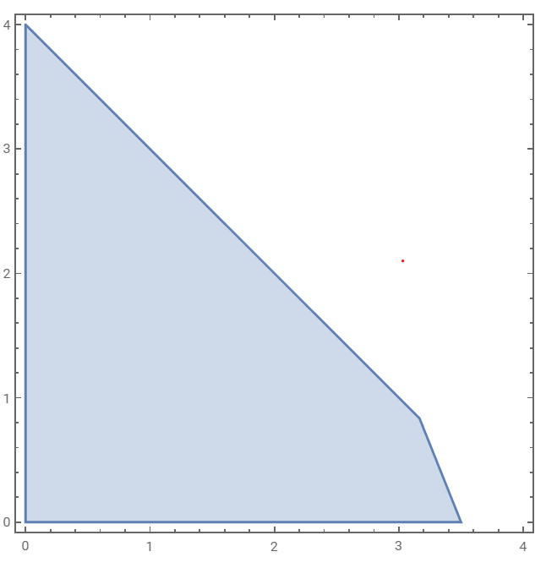
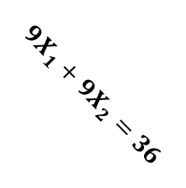
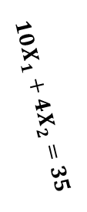

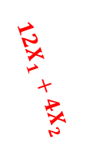
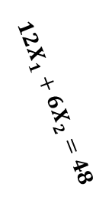
Soluciones degeneradas
$$X_{2}$$
$$Max Z={12X}_{1}+4X_{2}$$
$$sujeto a:$$
$$10X_{1}+4X_{2}≤35$$
$$12X_{1}+6X_{2}≤48$$
$$9X_{1}+9X_{2}≤36$$
$$X_{1}, X_{2}≥0$$
$$9X_{1}+9X_{2}=36$$
$$10X_{1}+4X_{2}=35$$
$$12X_{1}+6X_{2}=48$$
$${12X}_{1}+4X_{2}$$
Gráfico hecho en Wolfram Cloud:
RegionPlot[10x1+4x2<=35&&12x1+6x2<=48&&9x1+9x2<=36,
{x1, 0,4}, {x2, 0,4}]
$$X_{1}$$

Slide 8
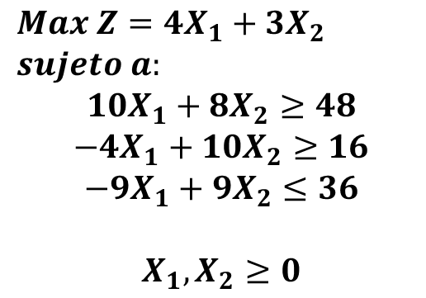
Poliedro abierto
$$Max Z=4X_{1}+3X_{2}$$
$$sujeto a:$$
$$10X_{1}+8X_{2}≥48$$
$$−4X_{1}+10X_{2}≥16$$
$$−9X_{1}+9X_{2}≤36$$
$$X_{1}, X_{2}≥0$$

Slide 9
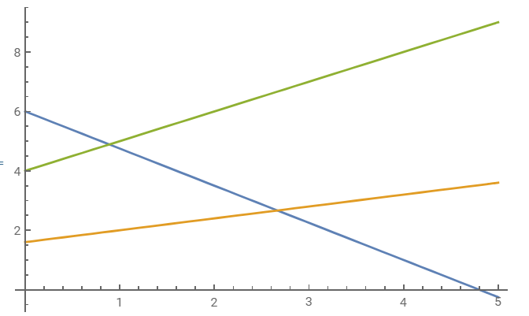
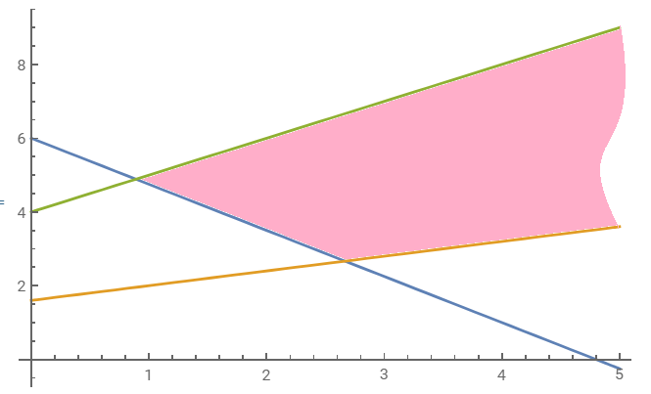
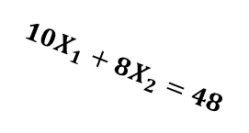

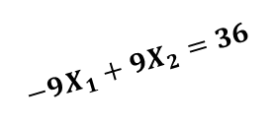

Poliedro abierto
$$Max Z=4X_{1}+3X_{2}$$
$$sujeto a:$$
$$10X_{1}+8X_{2}≥48$$
$$−4X_{1}+10X_{2}≥16$$
$$−9X_{1}+9X_{2}≤36$$
$$X_{1}, X_{2}≥0$$
$$X_{2}$$
$$−9X_{1}+9X_{2}=36$$
$$10X_{1}+8X_{2}=48$$
$$−4X_{1}+10X_{2}=16$$
$$X_{1}$$
Gráfico hecho en Wolfram Cloud:
Plot[{48/8-10/8*x1,16/10 + 4/10*x1,36/9 +x1}, {x1, 0,5}]

Slide 10
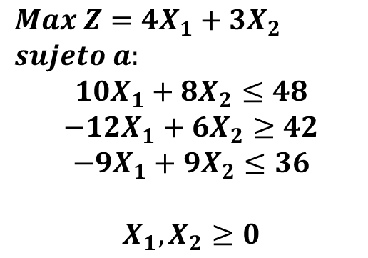
Solución incompatible
$$Max Z=4X_{1}+3X_{2}$$
$$sujeto a:$$
$$10X_{1}+8X_{2}≤48$$
$$−12X_{1}+6X_{2}≥42$$
$$−9X_{1}+9X_{2}≤36$$
$$X_{1}, X_{2}≥0$$

Slide 11
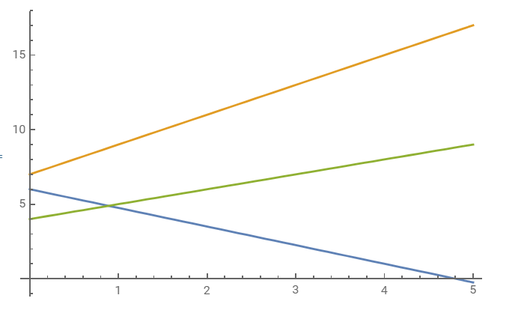
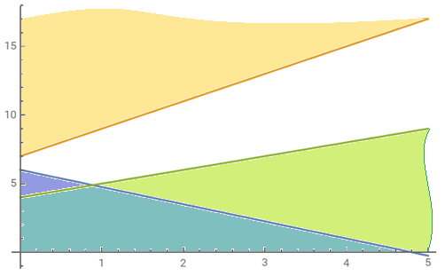
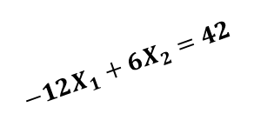
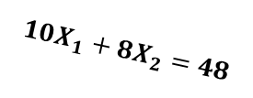
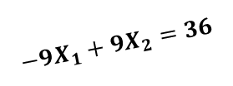

Solución incompatible
$$Max Z=4X_{1}+3X_{2}$$
$$sujeto a:$$
$$10X_{1}+8X_{2}≤48$$
$$−12X_{1}+6X_{2}≥42$$
$$−9X_{1}+9X_{2}≤36$$
$$X_{1}, X_{2}≥0$$
$$X_{2}$$
$$−12X_{1}+6X_{2}=42$$
$$−9X_{1}+9X_{2}=36$$
$$10X_{1}+8X_{2}=48$$
Gráfico hecho en Wolfram Cloud:
Plot[{48/8-10/8*x1,42/6+12/6*x1,36/9 +x1}, {x1, 0,5}]
$$X_{1}$$

