Slide 1
Casos Particulares en SIMPLEX
Clase 18
Investigación Operativa UTN FRBA 2021
Elaborado por Docente: Rodrigo Maranzana
Curso: I4051 (Prof. Martin Palazzo)

Slide 2
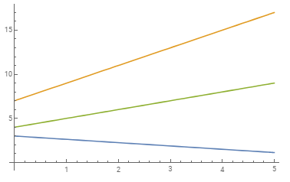

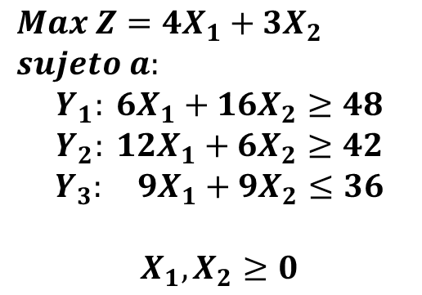







Problema incompatible
$$X_{2}$$
$$Max Z=4X_{1}+3X_{2}$$
$$sujeto a:$$
$$Y_{1}: 6X_{1}+16X_{2}≥48$$
$$Y_{2}: 12X_{1}+6X_{2}≥42$$
$$Y_{3}: 9X_{1}+9X_{2}≤36$$
$$X_{1}, X_{2}≥0$$
$$Y_{2}$$
$$RP_{1}$$
$$Y_{3}$$
$$Y_{1}$$
$$X_{1}$$
$$RP_{2}$$
$$RP_{i}:restricciones de positividad$$

Slide 3


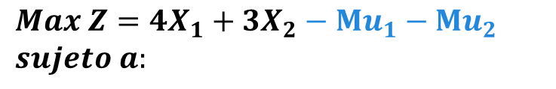











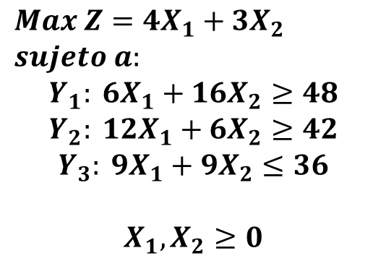
Problema incompatible
$$Max Z=4X_{1}+3X_{2}$$
$$sujeto a:$$
$$Y_{1}: 6X_{1}+16X_{2}≥48$$
$$Y_{2}: 12X_{1}+6X_{2}≥42$$
$$Y_{3}: 9X_{1}+9X_{2}≤36$$
$$X_{1}, X_{2}≥0$$
$$Max Z=4X_{1}+3X_{2}−Mu_{1}−Mu_{2}$$
$$sujeto a:$$
Modelo Extendido
$$Y_{1}: 6X_{1}+16X_{2}$$
$$−X_{3}$$
$$+u_{1}$$
$$=48$$
$$Y_{2}: 12X_{1}+ 6X_{2}$$
$$−X_{4}$$
$$+u_{2}$$
$$=42$$
$$Y_{3}: 9X_{1}+ 9X_{2}$$
$$+X_{5}$$
$$=36$$
$$X_{1}, X_{2}≥0$$
$M$: $un número muy grande$
$u_{i}$: variable ficticia

Slide 4
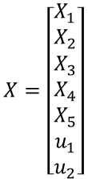


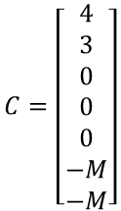














Problema incompatible
$$Max Z=4+3X_{2}$$
$$sujeto a:$$
Modelo Extendido
Matricial
$$Y_{1}: 6X_{1}+16X_{2}$$
$$−X_{3}$$
$$+u_{1}$$
$$=48$$
$$Max Z=C^{T}X$$
$$sujeto a:$$
$$Y_{2}: 12X_{1}+ 6X_{2}$$
$$−X_{4}$$
$$+u_{2}$$
$$=42$$
$$AX=b$$
$$Y_{3}: 9X_{1}+ 9X_{2}$$
$$+X_{5}$$
$$=36$$
$$X≥0$$
Valores de matrices:
$$X_{1}, X_{2}≥0$$
$$A=\left[\begin{matrix}6 & 16 & −1 & 0 & 0 & 1 & 0 \\ 12 & 6 & 0 & −1 & 0 & 0 & 1 \\ 9 & 9 & 0 & 0 & 1 & 0 & 0\end{matrix}\right]$$
$$b=\left[\begin{matrix}48 \\ 42 \\ 36\end{matrix}\right]$$
$$C=\left[\begin{matrix}4 \\ 3 \\ 0 \\ 0 \\ 0 \\ −M \\ −M\end{matrix}\right]$$
$$X=\left[\begin{matrix}X_{1} \\ X_{2} \\ X_{3} \\ X_{4} \\ X_{5} \\ u_{1} \\ u_{2}\end{matrix}\right]$$

Slide 5


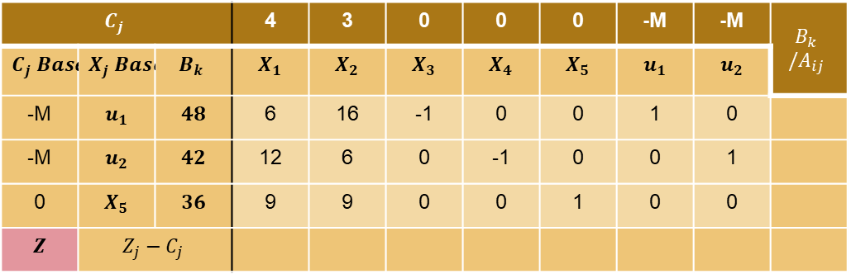

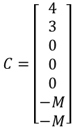



Problema incompatible
$$Max Z=4+3X_{2}$$
$$sujeto a:$$
$$Max Z=C^{T}X$$
$$sujeto a:$$
$$A=\left[\begin{matrix}6 & 16 & −1 & 0 & 0 & 1 & 0 \\ 12 & 6 & 0 & −1 & 0 & 0 & 1 \\ 9 & 9 & 0 & 0 & 1 & 0 & 0\end{matrix}\right]$$
$$AX=b$$
$$Y_{1}: 6X_{1}+16X_{2}$$
$$−X_{3}$$
$$+u_{1}$$
$$=48$$
$$b=\left[\begin{matrix}48 \\ 42 \\ 36\end{matrix}\right]$$
$$C=\left[\begin{matrix}4 \\ 3 \\ 0 \\ 0 \\ 0 \\ −M \\ −M\end{matrix}\right]$$
$$X=\left[\begin{matrix}X_{1} \\ X_{2} \\ X_{3} \\ X_{4} \\ X_{5} \\ u_{1} \\ u_{2}\end{matrix}\right]$$
$$X≥0$$
$$Y_{2}: 12X_{1}+ 6X_{2}$$
$$−X_{4}$$
$$+u_{2}$$
$$=42$$
$$Y_{3}: 9X_{1}+ 9X_{2}$$
$$+X_{5}$$
$$=36$$
$$X_{1}, X_{2}≥0$$
$$C_{j}$$ |  |  | 4 | 3 | 0 | 0 | 0 | -M | -M | $$B_{k} /A_{ij}$$
$$C_{j} Base$$ | $$X_{j} Base$$ | $$B_{k}$$ | $$X_{1}$$ | $$X_{2}$$ | $$X_{3}$$ | $$X_{4}$$ | $$X_{5}$$ | $$u_{1}$$ | $$u_{2}$$
-M | $$u_{1}$$ | $$48$$ | 6 | 16 | -1 | 0 | 0 | 1 | 0
-M | $$u_{2}$$ | $$42$$ | 12 | 6 | 0 | -1 | 0 | 0 | 1
0 | $$X_{5}$$ | $$36$$ | 9 | 9 | 0 | 0 | 1 | 0 | 0
$$Z$$ | $$Z_{j}−C_{j}$$

Slide 6
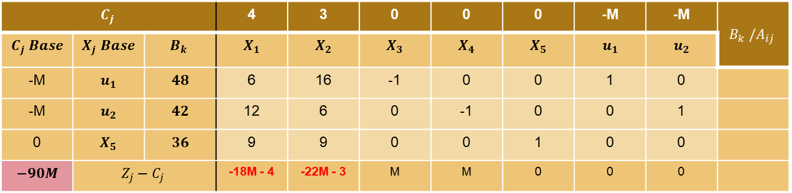


Problema incompatible
$$C_{j}$$ |  |  | 4 | 3 | 0 | 0 | 0 | -M | -M | $$B_{k} /A_{ij}$$
$$C_{j} Base$$ | $$X_{j} Base$$ | $$B_{k}$$ | $$X_{1}$$ | $$X_{2}$$ | $$X_{3}$$ | $$X_{4}$$ | $$X_{5}$$ | $$u_{1}$$ | $$u_{2}$$
-M | $$u_{1}$$ | $$48$$ | 6 | 16 | -1 | 0 | 0 | 1 | 0
-M | $$u_{2}$$ | $$42$$ | 12 | 6 | 0 | -1 | 0 | 0 | 1
0 | $$X_{5}$$ | $$36$$ | 9 | 9 | 0 | 0 | 1 | 0 | 0
$$−90M$$ | $$Z_{j}−C_{j}$$ |  | -18M - 4 | -22M - 3 | M | M | 0 | 0 | 0
Resolvemos $Z_{j}−C_{j}$y valor del funcional $Z$
Existen variables no básicas con $Z_{j}−C_{j}$ negativo, ¡$Z$ puede mejorar!
Seleccionamos $X_{2}$ para entrar a la base

Slide 7
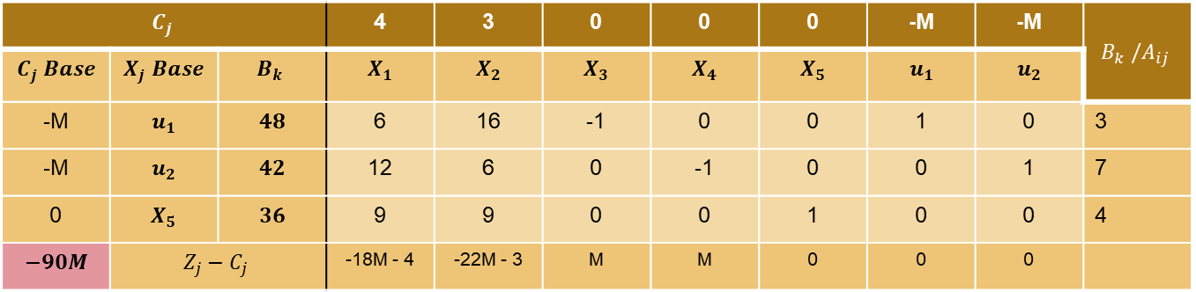




Problema incompatible
$$C_{j}$$ |  |  | 4 | 3 | 0 | 0 | 0 | -M | -M | $$B_{k} /A_{ij}$$
$$C_{j} Base$$ | $$X_{j} Base$$ | $$B_{k}$$ | $$X_{1}$$ | $$X_{2}$$ | $$X_{3}$$ | $$X_{4}$$ | $$X_{5}$$ | $$u_{1}$$ | $$u_{2}$$
-M | $$u_{1}$$ | $$48$$ | 6 | 16 | -1 | 0 | 0 | 1 | 0 | 3
-M | $$u_{2}$$ | $$42$$ | 12 | 6 | 0 | -1 | 0 | 0 | 1 | 7
0 | $$X_{5}$$ | $$36$$ | 9 | 9 | 0 | 0 | 1 | 0 | 0 | 4
$$−90M$$ | $$Z_{j}−C_{j}$$ |  | -18M - 4 | -22M - 3 | M | M | 0 | 0 | 0
Resolvemos $B_{k} /A_{ij}$
Mínimo positivo $B_{k} /A_{ij}$ en $u_{2}$
Sale $u_{1}$, entra $X_{2}$
De ahora en más: $−M−c≈−M…$
ya que “-c” es despreciable

Slide 8
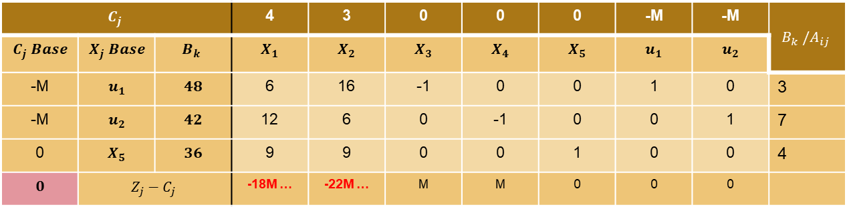
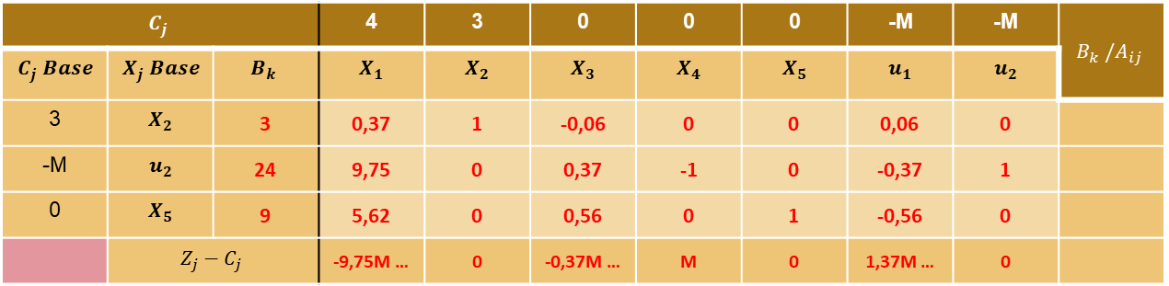
Problema incompatible
$$C_{j}$$ |  |  | 4 | 3 | 0 | 0 | 0 | -M | -M | $$B_{k} /A_{ij}$$
$$C_{j} Base$$ | $$X_{j} Base$$ | $$B_{k}$$ | $$X_{1}$$ | $$X_{2}$$ | $$X_{3}$$ | $$X_{4}$$ | $$X_{5}$$ | $$u_{1}$$ | $$u_{2}$$
-M | $$u_{1}$$ | $$48$$ | 6 | 16 | -1 | 0 | 0 | 1 | 0 | 3
-M | $$u_{2}$$ | $$42$$ | 12 | 6 | 0 | -1 | 0 | 0 | 1 | 7
0 | $$X_{5}$$ | $$36$$ | 9 | 9 | 0 | 0 | 1 | 0 | 0 | 4
$$0$$ | $$Z_{j}−C_{j}$$ |  | -18M … | -22M … | M | M | 0 | 0 | 0
Tabla
iteración 0
$$C_{j}$$ |  |  | 4 | 3 | 0 | 0 | 0 | -M | -M | $$B_{k} /A_{ij}$$
$$C_{j} Base$$ | $$X_{j} Base$$ | $$B_{k}$$ | $$X_{1}$$ | $$X_{2}$$ | $$X_{3}$$ | $$X_{4}$$ | $$X_{5}$$ | $$u_{1}$$ | $$u_{2}$$
3 | $$X_{2}$$ | 3 | 0,37 | 1 | -0,06 | 0 | 0 | 0,06 | 0
-M | $$u_{2}$$ | 24 | 9,75 | 0 | 0,37 | -1 | 0 | -0,37 | 1
0 | $$X_{5}$$ | 9 | 5,62 | 0 | 0,56 | 0 | 1 | -0,56 | 0
 | $$Z_{j}−C_{j}$$ |  | -9,75M … | 0 | -0,37M … | M | 0 | 1,37M … | 0
Tabla
iteración 1

Slide 9

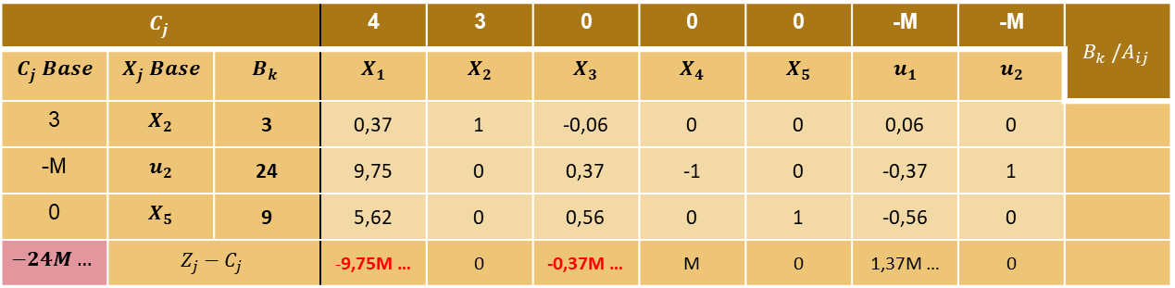

Problema incompatible
$$C_{j}$$ |  |  | 4 | 3 | 0 | 0 | 0 | -M | -M | $$B_{k} /A_{ij}$$
$$C_{j} Base$$ | $$X_{j} Base$$ | $$B_{k}$$ | $$X_{1}$$ | $$X_{2}$$ | $$X_{3}$$ | $$X_{4}$$ | $$X_{5}$$ | $$u_{1}$$ | $$u_{2}$$
3 | $$X_{2}$$ | 3 | 0,37 | 1 | -0,06 | 0 | 0 | 0,06 | 0
-M | $$u_{2}$$ | 24 | 9,75 | 0 | 0,37 | -1 | 0 | -0,37 | 1
0 | $$X_{5}$$ | 9 | 5,62 | 0 | 0,56 | 0 | 1 | -0,56 | 0
$$−24M…$$ | $$Z_{j}−C_{j}$$ |  | -9,75M … | 0 | -0,37M … | M | 0 | 1,37M … | 0
Resolvemos el valor del funcional $Z$
Existen variables no básicas con $Z_{j}−C_{j}$ negativo, ¡$Z$ puede mejorar!
$X_{1}$ debe entrar a la base

Slide 10
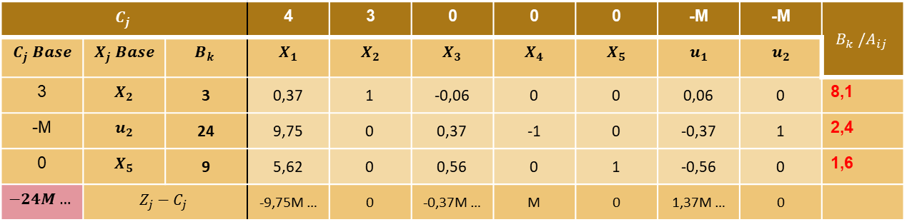


Problema incompatible
$$C_{j}$$ |  |  | 4 | 3 | 0 | 0 | 0 | -M | -M | $$B_{k} /A_{ij}$$
$$C_{j} Base$$ | $$X_{j} Base$$ | $$B_{k}$$ | $$X_{1}$$ | $$X_{2}$$ | $$X_{3}$$ | $$X_{4}$$ | $$X_{5}$$ | $$u_{1}$$ | $$u_{2}$$
3 | $$X_{2}$$ | 3 | 0,37 | 1 | -0,06 | 0 | 0 | 0,06 | 0 | 8,1
-M | $$u_{2}$$ | 24 | 9,75 | 0 | 0,37 | -1 | 0 | -0,37 | 1 | 2,4
0 | $$X_{5}$$ | 9 | 5,62 | 0 | 0,56 | 0 | 1 | -0,56 | 0 | 1,6
$$−24M…$$ | $$Z_{j}−C_{j}$$ |  | -9,75M … | 0 | -0,37M … | M | 0 | 1,37M … | 0
Resolvemos $B_{k} /A_{ij}$
Mínimo positivo $B_{k} /A_{ij}$ en $X_{5}$
Sale $X_{5}$, entra $X_{1}$

Slide 11
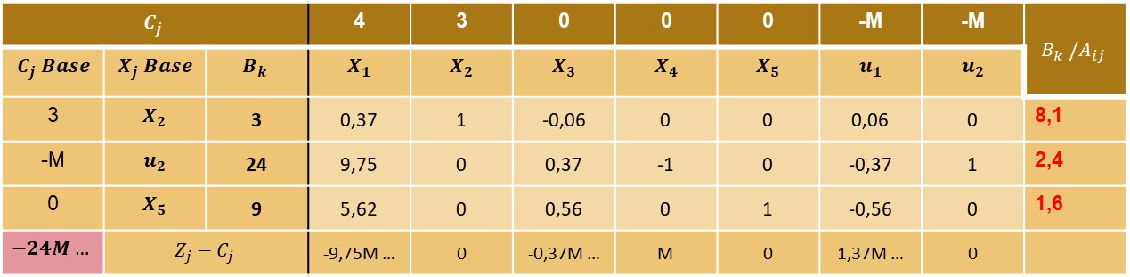
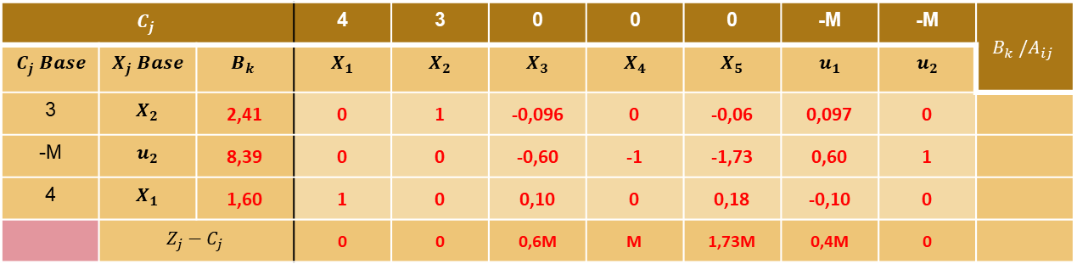
Problema incompatible
$$C_{j}$$ |  |  | 4 | 3 | 0 | 0 | 0 | -M | -M | $$B_{k} /A_{ij}$$
$$C_{j} Base$$ | $$X_{j} Base$$ | $$B_{k}$$ | $$X_{1}$$ | $$X_{2}$$ | $$X_{3}$$ | $$X_{4}$$ | $$X_{5}$$ | $$u_{1}$$ | $$u_{2}$$
3 | $$X_{2}$$ | 3 | 0,37 | 1 | -0,06 | 0 | 0 | 0,06 | 0 | 8,1
-M | $$u_{2}$$ | 24 | 9,75 | 0 | 0,37 | -1 | 0 | -0,37 | 1 | 2,4
0 | $$X_{5}$$ | 9 | 5,62 | 0 | 0,56 | 0 | 1 | -0,56 | 0 | 1,6
$$−24M…$$ | $$Z_{j}−C_{j}$$ |  | -9,75M … | 0 | -0,37M … | M | 0 | 1,37M … | 0
Tabla
iteración 1
$$C_{j}$$ |  |  | 4 | 3 | 0 | 0 | 0 | -M | -M | $$B_{k} /A_{ij}$$
$$C_{j} Base$$ | $$X_{j} Base$$ | $$B_{k}$$ | $$X_{1}$$ | $$X_{2}$$ | $$X_{3}$$ | $$X_{4}$$ | $$X_{5}$$ | $$u_{1}$$ | $$u_{2}$$
3 | $$X_{2}$$ | 2,41 | 0 | 1 | -0,096 | 0 | -0,06 | 0,097 | 0
-M | $$u_{2}$$ | 8,39 | 0 | 0 | -0,60 | -1 | -1,73 | 0,60 | 1
4 | $$X_{1}$$ | 1,60 | 1 | 0 | 0,10 | 0 | 0,18 | -0,10 | 0
 | $$Z_{j}−C_{j}$$ |  | 0 | 0 | 0,6M | M | 1,73M | 0,4M | 0
Tabla
iteración 2

Slide 12


Problema incompatible
$$C_{j}$$ |  |  | 4 | 3 | 0 | 0 | 0 | -M | -M | $$B_{k} /A_{ij}$$
$$C_{j} Base$$ | $$X_{j} Base$$ | $$B_{k}$$ | $$X_{1}$$ | $$X_{2}$$ | $$X_{3}$$ | $$X_{4}$$ | $$X_{5}$$ | $$u_{1}$$ | $$u_{2}$$
3 | $$X_{2}$$ | 2,41 | 0 | 1 | -0,096 | 0 | -0,06 | 0,097 | 0
-M | $$u_{2}$$ | 8,39 | 0 | 0 | -0,60 | -1 | -1,73 | 0,60 | 1
4 | $$X_{1}$$ | 1,60 | 1 | 0 | 0,10 | 0 | 0,18 | -0,10 | 0
 | $$Z_{j}−C_{j}$$ |  | 0 | 0 | 0,6M | M | 1,73M | 0,4M | 0
Resolvemos el valor del funcional $Z$
No existen variables no básicas con $Z_{j}−C_{j}$ negativo, la variable ficticia $u_{2}$ sigue en la base
Encontramos caso particular de problema incompatible

Slide 13
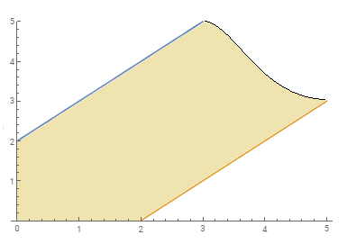


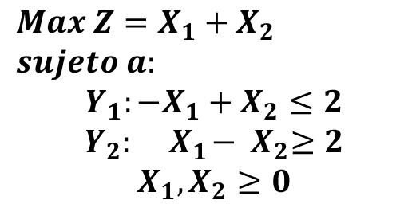
Problema no acotado
$$X_{2}$$
$$Max Z=X_{1}+X_{2}$$
$$sujeto a:$$
$$Y_{1}:−X_{1}+X_{2}≤2$$
$$Y_{2}: { X}_{1}−{ X}_{2}≥2$$
$$X_{1}, X_{2}≥0$$
$$Y_{1}$$
$$RP_{1}$$
$$Y_{2}$$
$$RP_{2}$$
$$X_{1}$$
Z=0
$$RP_{i}:restricciones de positividad$$

Slide 14

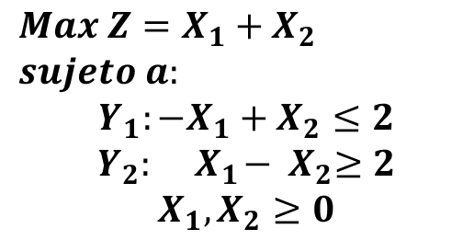







Problema no acotado
$$Max Z=X_{1}+X_{2}$$
$$sujeto a:$$
$$Y_{1}:−X_{1}+X_{2}≤2$$
$$Y_{2}: { X}_{1}−{ X}_{2}≥2$$
$$X_{1}, X_{2}≥0$$
$$Max Z=X_{1}+X_{2}−Mu_{1}$$
$$sujeto a:$$
Modelo Extendido
$$Y_{1}: −X_{1}+X_{2}$$
$$+X_{3}$$
$$=2$$
$$Y_{2}: X_{1}−X_{2}$$
$$−X_{4}$$
$$+u_{1}$$
$$=2$$
$$X_{1}, X_{2}≥0$$
$M$: $un número muy grande$
$u_{i}$: variable ficticia

Slide 15
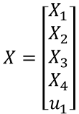
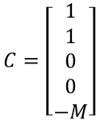








Problema no acotado
$$Max Z=X_{1}+X_{2}−Mu_{1}$$
$$sujeto a:$$
Modelo Extendido
Matricial
$$Max Z=C^{T}X$$
$$sujeto a:$$
$$Y_{1}: −X_{1}+X_{2}$$
$$+X_{3}$$
$$=2$$
$$Y_{2}: X_{1}−X_{2}$$
$$−X_{4}$$
$$+u_{1}$$
$$=2$$
$$AX=b$$
$$X≥0$$
$$X_{1}, X_{2}≥0$$
Valores de matrices:
$$A=\left[\begin{matrix}−1 & 1 & 1 & 0 & 0 \\ 1 & −1 & 0 & −1 & 1\end{matrix}\right]$$
$$b=\left[\begin{matrix}2 \\ 2\end{matrix}\right]$$
$$C=\left[\begin{matrix}1 \\ 1 \\ 0 \\ 0 \\ −M\end{matrix}\right]$$
$$X=\left[\begin{matrix}X_{1} \\ X_{2} \\ X_{3} \\ X_{4} \\ u_{1}\end{matrix}\right]$$

Slide 16

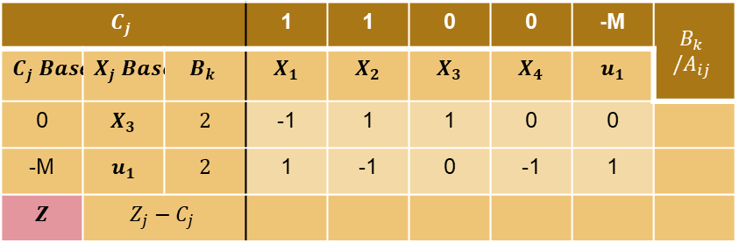


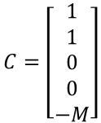
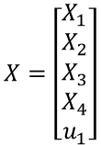
Problema no acotado
$$Max Z=X_{1}+X_{2}−Mu_{1}$$
$$sujeto a:$$
$$Max Z=C^{T}X$$
$$sujeto a:$$
$$A=\left[\begin{matrix}−1 & 1 & −1 & 0 & 0 \\ 1 & −1 & 0 & −1 & 1\end{matrix}\right]$$
$$AX=b$$
$$b=\left[\begin{matrix}2 \\ 2\end{matrix}\right]$$
$$C=\left[\begin{matrix}1 \\ 1 \\ 0 \\ 0 \\ −M\end{matrix}\right]$$
$$X=\left[\begin{matrix}X_{1} \\ X_{2} \\ X_{3} \\ X_{4} \\ u_{1}\end{matrix}\right]$$
$$Y_{1}: −X_{1}+X_{2}$$
$$+X_{3}$$
$$=2$$
$$X≥0$$
$$Y_{2}: X_{1}−X_{2}$$
$$−X_{4}$$
$$+u_{1}$$
$$=2$$
$$X_{1}, X_{2}≥0$$
$$C_{j}$$ |  |  | 1 | 1 | 0 | 0 | -M | $$B_{k} /A_{ij}$$
$$C_{j} Base$$ | $$X_{j} Base$$ | $$B_{k}$$ | $$X_{1}$$ | $$X_{2}$$ | $$X_{3}$$ | $$X_{4}$$ | $$u_{1}$$
0 | $$X_{3}$$ | $$2$$ | -1 | 1 | 1 | 0 | 0
-M | $$u_{1}$$ | $$2$$ | 1 | -1 | 0 | -1 | 1
$$Z$$ | $$Z_{j}−C_{j}$$

Slide 17
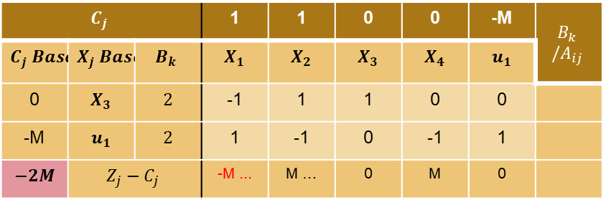

Problema no acotado
$$C_{j}$$ |  |  | 1 | 1 | 0 | 0 | -M | $$B_{k} /A_{ij}$$
$$C_{j} Base$$ | $$X_{j} Base$$ | $$B_{k}$$ | $$X_{1}$$ | $$X_{2}$$ | $$X_{3}$$ | $$X_{4}$$ | $$u_{1}$$
0 | $$X_{3}$$ | $$2$$ | -1 | 1 | 1 | 0 | 0
-M | $$u_{1}$$ | $$2$$ | 1 | -1 | 0 | -1 | 1
$$−2M$$ | $$Z_{j}−C_{j}$$ |  | -M ... | M … | 0 | M | 0
Resolvemos $Z_{j}−C_{j}$y valor del funcional $Z$
Existen variables no básicas con $Z_{j}−C_{j}$ negativo, ¡$Z$ puede mejorar!
Seleccionamos $X_{1}$ para entrar a la base

Slide 18
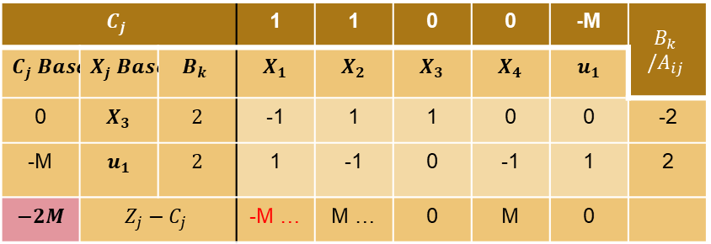


Problema no acotado
$$C_{j}$$ |  |  | 1 | 1 | 0 | 0 | -M | $$B_{k} /A_{ij}$$
$$C_{j} Base$$ | $$X_{j} Base$$ | $$B_{k}$$ | $$X_{1}$$ | $$X_{2}$$ | $$X_{3}$$ | $$X_{4}$$ | $$u_{1}$$
0 | $$X_{3}$$ | $$2$$ | -1 | 1 | 1 | 0 | 0 | -2
-M | $$u_{1}$$ | $$2$$ | 1 | -1 | 0 | -1 | 1 | 2
$$−2M$$ | $$Z_{j}−C_{j}$$ |  | -M … | M … | 0 | M | 0
Resolvemos $B_{k} /A_{ij}$
Mínimo positivo $B_{k} /A_{ij}$ en $u_{1}$
Sale $u_{1}$, entra $X_{1}$

Slide 19
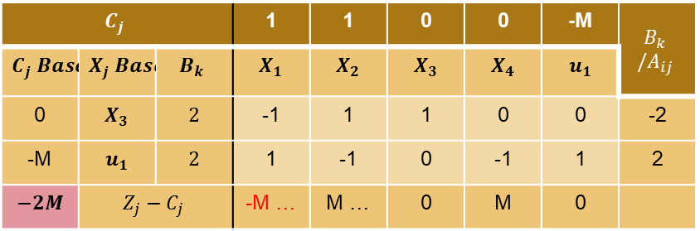
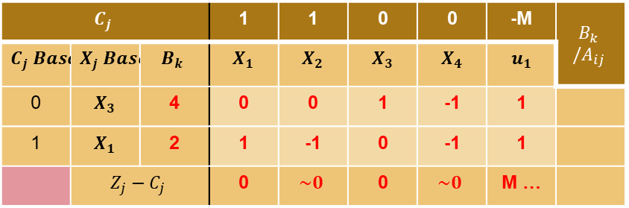
Problema no acotado
$$C_{j}$$ |  |  | 1 | 1 | 0 | 0 | -M | $$B_{k} /A_{ij}$$
$$C_{j} Base$$ | $$X_{j} Base$$ | $$B_{k}$$ | $$X_{1}$$ | $$X_{2}$$ | $$X_{3}$$ | $$X_{4}$$ | $$u_{1}$$
0 | $$X_{3}$$ | $$2$$ | -1 | 1 | 1 | 0 | 0 | -2
-M | $$u_{1}$$ | $$2$$ | 1 | -1 | 0 | -1 | 1 | 2
$$−2M$$ | $$Z_{j}−C_{j}$$ |  | -M … | M … | 0 | M | 0
Tabla
iteración 0
$$C_{j}$$ |  |  | 1 | 1 | 0 | 0 | -M | $$B_{k} /A_{ij}$$
$$C_{j} Base$$ | $$X_{j} Base$$ | $$B_{k}$$ | $$X_{1}$$ | $$X_{2}$$ | $$X_{3}$$ | $$X_{4}$$ | $$u_{1}$$
0 | $$X_{3}$$ | 4 | 0 | 0 | 1 | -1 | 1
1 | $$X_{1}$$ | 2 | 1 | -1 | 0 | -1 | 1
 | $$Z_{j}−C_{j}$$ |  | 0 | $$\sim 0$$ | 0 | $$\sim 0$$ | M …
Tabla
iteración 1

Slide 20
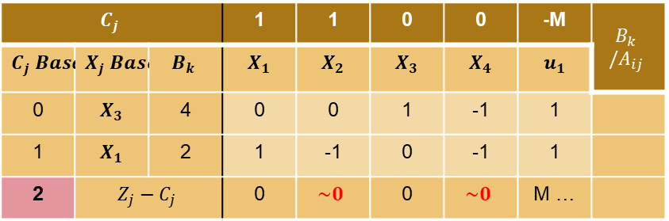

Problema no acotado
$$C_{j}$$ |  |  | 1 | 1 | 0 | 0 | -M | $$B_{k} /A_{ij}$$
$$C_{j} Base$$ | $$X_{j} Base$$ | $$B_{k}$$ | $$X_{1}$$ | $$X_{2}$$ | $$X_{3}$$ | $$X_{4}$$ | $$u_{1}$$
0 | $$X_{3}$$ | 4 | 0 | 0 | 1 | -1 | 1
1 | $$X_{1}$$ | 2 | 1 | -1 | 0 | -1 | 1
2 | $$Z_{j}−C_{j}$$ |  | 0 | $$\sim 0$$ | 0 | $$\sim 0$$ | M …
Resolvemos el valor del funcional $Z$
Existen variables no básicas con $Z_{j}−C_{j}$ negativo, ¡$Z$ puede mejorar!
$X_{2}$ podría entrar a la base

Slide 21
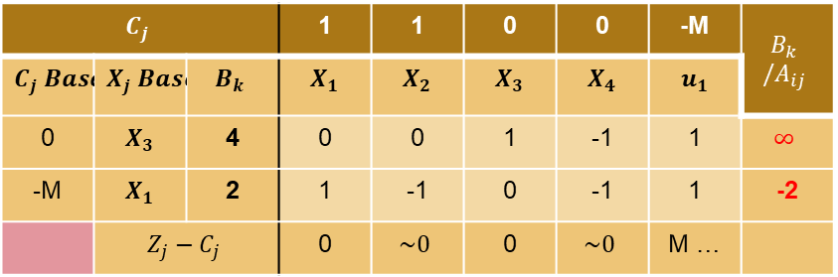
Problema no acotado
$$C_{j}$$ |  |  | 1 | 1 | 0 | 0 | -M | $$B_{k} /A_{ij}$$
$$C_{j} Base$$ | $$X_{j} Base$$ | $$B_{k}$$ | $$X_{1}$$ | $$X_{2}$$ | $$X_{3}$$ | $$X_{4}$$ | $$u_{1}$$
0 | $$X_{3}$$ | 4 | 0 | 0 | 1 | -1 | 1 | $$∞$$
-M | $$X_{1}$$ | 2 | 1 | -1 | 0 | -1 | 1 | -2
 | $$Z_{j}−C_{j}$$ |  | 0 | $$\sim 0$$ | 0 | $$\sim 0$$ | M …
Resolvemos $B_{k} /A_{ij}$
No existe mínimo positivo $B_{k} /A_{ij}$, problema no acotado.

