Slide 1
SIMPLEX con método de la M
Clase 20
Investigación Operativa UTN FRBA 2021
Docente: Rodrigo Maranzana
Curso: I4051 (Palazzo)

Slide 2
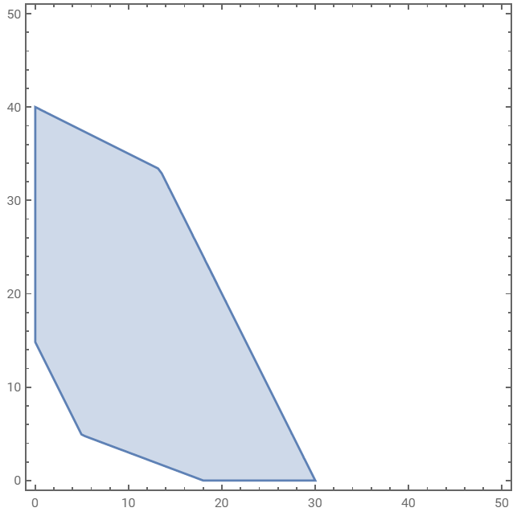







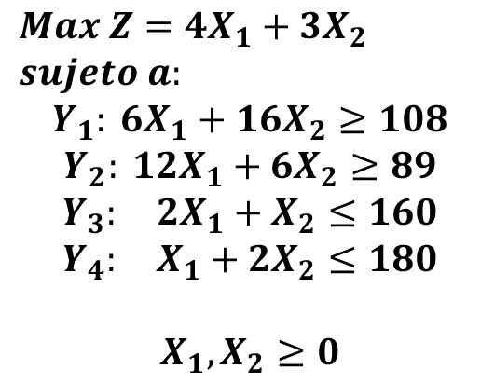


Región del poliedro factible
$$X_{2}$$
$$Max Z=4X_{1}+3X_{2}$$
$$sujeto a:$$
$$Y_{1}: 6X_{1}+16X_{2}≥108$$
$$Y_{2}: 12X_{1}+6X_{2}≥89$$
$$Y_{3}: 2X_{1}+X_{2}≤160$$
$$Y_{4}: X_{1}+{2X}_{2}≤180$$
$$X_{1}, X_{2}≥0$$
$$Y_{4}$$
$$RP_{X_{1}}$$
$$Y_{3}$$
$$Y_{2}$$
$$Y_{1}$$
$$RP_{X_{2}}$$
$$X_{1}$$
$$RP_{i}:restricciones de positividad$$

Slide 3






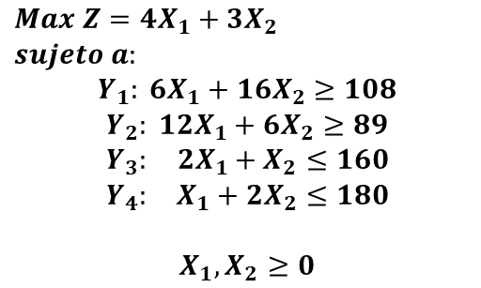











Modelo extendido
$$Max Z=4X_{1}+3X_{2}$$
$$sujeto a:$$
$$Y_{1}: 6X_{1}+16X_{2}≥108$$
$$Y_{2}: 12X_{1}+6X_{2}≥89$$
$$Y_{3}: 2X_{1}+X_{2}≤160$$
$$Y_{4}: X_{1}+{2X}_{2}≤180$$
$$X_{1}, X_{2}≥0$$
$$Max Z=4X_{1}+3X_{2}−Mu_{1}−Mu_{2}$$
$$sujeto a:$$
Modelo Extendido
$$Y_{1}: 6X_{1}+16X_{2}$$
$$−X_{3}$$
$$+u_{1}$$
$$=108$$
$$Y_{2}: 12X_{1}+ 6X_{2}$$
$$−X_{4}$$
$$+u_{2}$$
$$=89$$
$$Y_{3}: 2X_{1}+ X_{2}$$
$$+X_{5}$$
$$=160$$
$$Y_{4}: X_{1} + {2X}_{2}$$
$$+X_{6}$$
$$=180$$
$$X_{1}, X_{2}≥0$$
$M$: un número muy grande
$u_{i}$: variable ficticia

Slide 4
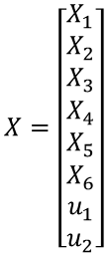



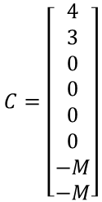










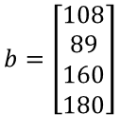




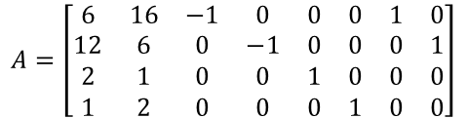


Modelo Matricial
$$Max Z=4X_{1}+3X_{2}−Mu_{1}−Mu_{2}$$
$$sujeto a:$$
Modelo Extendido
Matricial
$$Y_{1}: 6X_{1}+16X_{2}$$
$$−X_{3}$$
$$+u_{1}$$
$$=108$$
$$Max Z=C^{T}X$$
$$sujeto a:$$
$$Y_{2}: 12X_{1}+ 6X_{2}$$
$$−X_{4}$$
$$+u_{2}$$
$$=89$$
$$AX=b$$
$$Y_{3}: 2X_{1}+ X_{2}$$
$$+X_{5}$$
$$=160$$
$$X≥0$$
$$Y_{4}: X_{1} + {2X}_{2}$$
$$+X_{6}$$
$$=180$$
Valores de
matrices:
$$A=\left[\begin{matrix}6 & 16 & −1 & 0 & 0 & 0 & 1 & 0 \\ 12 & 6 & 0 & −1 & 0 & 0 & 0 & 1 \\ 2 & 1 & 0 & 0 & 1 & 0 & 0 & 0 \\ 1 & 2 & 0 & 0 & 0 & 1 & 0 & 0\end{matrix}\right]$$
$$X_{1}, X_{2}≥0$$
$$C=\left[\begin{matrix}4 \\ 3 \\ 0 \\ 0 \\ 0 \\ 0 \\ −M \\ −M\end{matrix}\right]$$
$$X=\left[\begin{matrix}X_{1} \\ X_{2} \\ X_{3} \\ X_{4} \\ X_{5} \\ X_{6} \\ u_{1} \\ u_{2}\end{matrix}\right]$$
$$b=\left[\begin{matrix}108 \\ 89 \\ 160 \\ 180\end{matrix}\right]$$

Slide 5



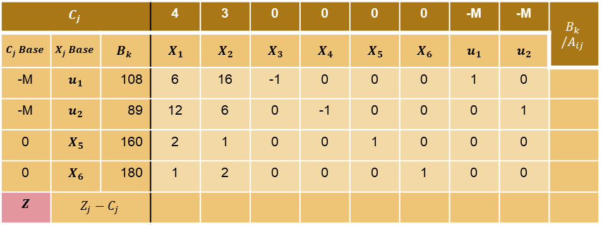
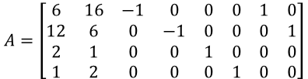





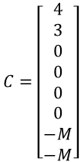










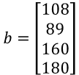
Resolución con SIMPLEX
$$Max Z=4X_{1}+3X_{2}−Mu_{1}−Mu_{2}$$
$$sujeto a:$$
$$Max Z=C^{T}X$$
$$sujeto a:$$
$$A=\left[\begin{matrix}6 & 16 & −1 & 0 & 0 & 0 & 1 & 0 \\ 12 & 6 & 0 & −1 & 0 & 0 & 0 & 1 \\ 2 & 1 & 0 & 0 & 1 & 0 & 0 & 0 \\ 1 & 2 & 0 & 0 & 0 & 1 & 0 & 0\end{matrix}\right]$$
$$Y_{1}: 6X_{1}+16X_{2}$$
$$−X_{3}$$
$$+u_{1}$$
$$=108$$
$$−X_{4}$$
$$AX=b$$
$$Y_{2}: 12X_{1}+ 6X_{2}$$
$$+u_{2}$$
$$=89$$
$$+X_{5}$$
$$X≥0$$
$$Y_{3}: 2X_{1}+ X_{2}$$
$$=160$$
$$C=\left[\begin{matrix}4 \\ 3 \\ 0 \\ 0 \\ 0 \\ 0 \\ −M \\ −M\end{matrix}\right]$$
$$X=\left[\begin{matrix}X_{1} \\ X_{2} \\ X_{3} \\ X_{4} \\ X_{5} \\ X_{6} \\ u_{1} \\ u_{2}\end{matrix}\right]$$
$$Y_{4}: X_{1} + {2X}_{2}$$
$$+X_{6}$$
$$=180$$
$$b=\left[\begin{matrix}108 \\ 89 \\ 160 \\ 180\end{matrix}\right]$$
$$X_{1}, X_{2}≥0$$
$$C_{j}$$ |  |  | 4 | 3 | 0 | 0 | 0 | 0 | -M | -M | $$B_{k} /A_{ij}$$
$$C_{j} Base$$ | $$X_{j} Base$$ | $$B_{k}$$ | $$X_{1}$$ | $$X_{2}$$ | $$X_{3}$$ | $$X_{4}$$ | $$X_{5}$$ | $$X_{6}$$ | $$u_{1}$$ | $$u_{2}$$
-M | $$u_{1}$$ | 108 | 6 | 16 | -1 | 0 | 0 | 0 | 1 | 0
-M | $$u_{2}$$ | 89 | 12 | 6 | 0 | -1 | 0 | 0 | 0 | 1
0 | $$X_{5}$$ | 160 | 2 | 1 | 0 | 0 | 1 | 0 | 0 | 0
0 | $$X_{6}$$ | 180 | 1 | 2 | 0 | 0 | 0 | 1 | 0 | 0
$$Z$$ | $$Z_{j}−C_{j}$$

Slide 6
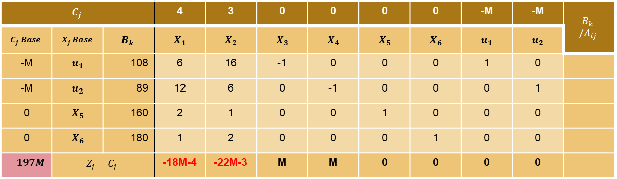


Resolución con SIMPLEX
$$C_{j}$$ |  |  | 4 | 3 | 0 | 0 | 0 | 0 | -M | -M | $$B_{k} /A_{ij}$$
$$C_{j} Base$$ | $$X_{j} Base$$ | $$B_{k}$$ | $$X_{1}$$ | $$X_{2}$$ | $$X_{3}$$ | $$X_{4}$$ | $$X_{5}$$ | $$X_{6}$$ | $$u_{1}$$ | $$u_{2}$$
-M | $$u_{1}$$ | 108 | 6 | 16 | -1 | 0 | 0 | 0 | 1 | 0
-M | $$u_{2}$$ | 89 | 12 | 6 | 0 | -1 | 0 | 0 | 0 | 1
0 | $$X_{5}$$ | 160 | 2 | 1 | 0 | 0 | 1 | 0 | 0 | 0
0 | $$X_{6}$$ | 180 | 1 | 2 | 0 | 0 | 0 | 1 | 0 | 0
$$−197M$$ | $$Z_{j}−C_{j}$$ |  | -18M-4 | -22M-3 | M | M | 0 | 0 | 0 | 0
Resolvemos $Z_{j}−C_{j}$y valor del funcional $Z$
Existen variables no básicas con $Z_{j}−C_{j}$ negativo, ¡$Z$ puede mejorar!
Seleccionamos $X_{2}$ para entrar a la base

Slide 7
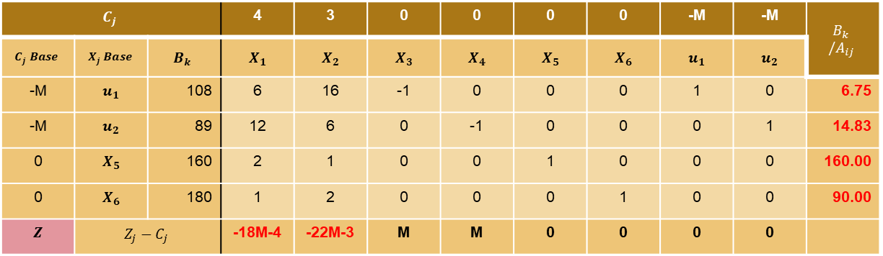



Resolución con SIMPLEX
$$C_{j}$$ |  |  | 4 | 3 | 0 | 0 | 0 | 0 | -M | -M | $$B_{k} /A_{ij}$$
$$C_{j} Base$$ | $$X_{j} Base$$ | $$B_{k}$$ | $$X_{1}$$ | $$X_{2}$$ | $$X_{3}$$ | $$X_{4}$$ | $$X_{5}$$ | $$X_{6}$$ | $$u_{1}$$ | $$u_{2}$$
-M | $$u_{1}$$ | 108 | 6 | 16 | -1 | 0 | 0 | 0 | 1 | 0 | 6.75
-M | $$u_{2}$$ | 89 | 12 | 6 | 0 | -1 | 0 | 0 | 0 | 1 | 14.83
0 | $$X_{5}$$ | 160 | 2 | 1 | 0 | 0 | 1 | 0 | 0 | 0 | 160.00
0 | $$X_{6}$$ | 180 | 1 | 2 | 0 | 0 | 0 | 1 | 0 | 0 | 90.00
$$Z$$ | $$Z_{j}−C_{j}$$ |  | -18M-4 | -22M-3 | M | M | 0 | 0 | 0 | 0
Resolvemos $B_{k} /A_{ij}$
Mínimo positivo $B_{k} /A_{ij}$ en $u_{1}$
Sale $u_{1}$, entra $X_{2}$

Slide 8
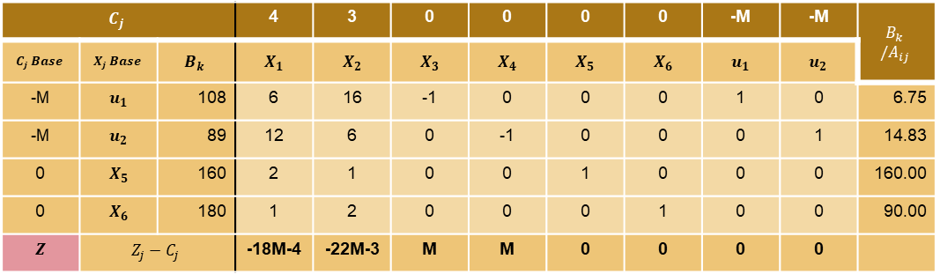
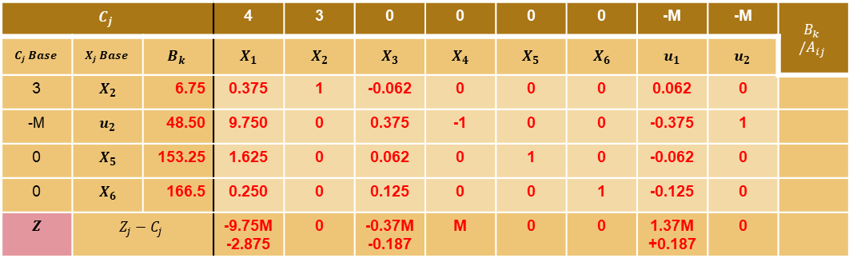
Resolución con SIMPLEX
$$C_{j}$$ |  |  | 4 | 3 | 0 | 0 | 0 | 0 | -M | -M | $$B_{k} /A_{ij}$$
$$C_{j} Base$$ | $$X_{j} Base$$ | $$B_{k}$$ | $$X_{1}$$ | $$X_{2}$$ | $$X_{3}$$ | $$X_{4}$$ | $$X_{5}$$ | $$X_{6}$$ | $$u_{1}$$ | $$u_{2}$$
-M | $$u_{1}$$ | 108 | 6 | 16 | -1 | 0 | 0 | 0 | 1 | 0 | 6.75
-M | $$u_{2}$$ | 89 | 12 | 6 | 0 | -1 | 0 | 0 | 0 | 1 | 14.83
0 | $$X_{5}$$ | 160 | 2 | 1 | 0 | 0 | 1 | 0 | 0 | 0 | 160.00
0 | $$X_{6}$$ | 180 | 1 | 2 | 0 | 0 | 0 | 1 | 0 | 0 | 90.00
$$Z$$ | $$Z_{j}−C_{j}$$ |  | -18M-4 | -22M-3 | M | M | 0 | 0 | 0 | 0
Tabla
iteración 0
$$C_{j}$$ |  |  | 4 | 3 | 0 | 0 | 0 | 0 | -M | -M | $$B_{k} /A_{ij}$$
$$C_{j} Base$$ | $$X_{j} Base$$ | $$B_{k}$$ | $$X_{1}$$ | $$X_{2}$$ | $$X_{3}$$ | $$X_{4}$$ | $$X_{5}$$ | $$X_{6}$$ | $$u_{1}$$ | $$u_{2}$$
3 | $$X_{2}$$ | 6.75 | 0.375 | 1 | -0.062 | 0 | 0 | 0 | 0.062 | 0
-M | $$u_{2}$$ | 48.50 | 9.750 | 0 | 0.375 | -1 | 0 | 0 | -0.375 | 1
0 | $$X_{5}$$ | 153.25 | 1.625 | 0 | 0.062 | 0 | 1 | 0 | -0.062 | 0
0 | $$X_{6}$$ | 166.5 | 0.250 | 0 | 0.125 | 0 | 0 | 1 | -0.125 | 0
$$Z$$ | $$Z_{j}−C_{j}$$ |  | -9.75M -2.875 | 0 | -0.37M -0.187 | M | 0 | 0 | 1.37M +0.187 | 0
Tabla
iteración 1

Slide 9
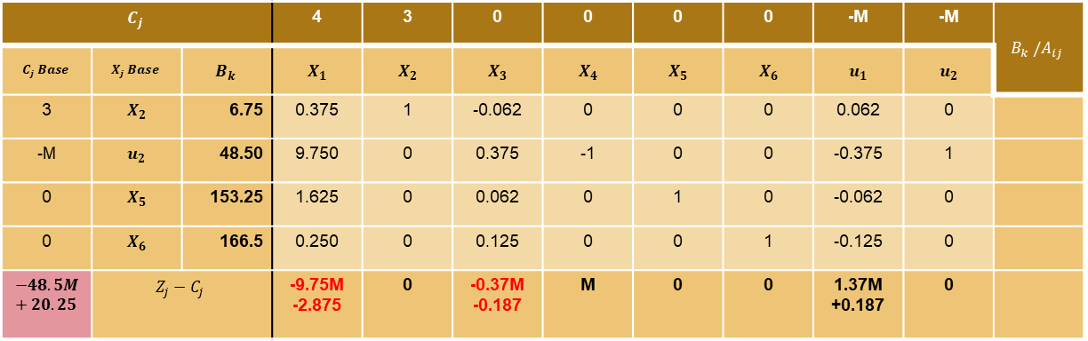

Resolución con SIMPLEX
$$C_{j}$$ |  |  | 4 | 3 | 0 | 0 | 0 | 0 | -M | -M | $$B_{k} /A_{ij}$$
$$C_{j} Base$$ | $$X_{j} Base$$ | $$B_{k}$$ | $$X_{1}$$ | $$X_{2}$$ | $$X_{3}$$ | $$X_{4}$$ | $$X_{5}$$ | $$X_{6}$$ | $$u_{1}$$ | $$u_{2}$$
3 | $$X_{2}$$ | 6.75 | 0.375 | 1 | -0.062 | 0 | 0 | 0 | 0.062 | 0
-M | $$u_{2}$$ | 48.50 | 9.750 | 0 | 0.375 | -1 | 0 | 0 | -0.375 | 1
0 | $$X_{5}$$ | 153.25 | 1.625 | 0 | 0.062 | 0 | 1 | 0 | -0.062 | 0
0 | $$X_{6}$$ | 166.5 | 0.250 | 0 | 0.125 | 0 | 0 | 1 | -0.125 | 0
$$−48.5M+20.25$$ | $$Z_{j}−C_{j}$$ |  | -9.75M -2.875 | 0 | -0.37M -0.187 | M | 0 | 0 | 1.37M +0.187 | 0
Resolvemos $Z_{j}−C_{j}$y valor del funcional $Z$
Existen variables no básicas con $Z_{j}−C_{j}$ negativo, ¡$Z$ puede mejorar!
Seleccionamos $X_{1}$ para entrar a la base

Slide 10
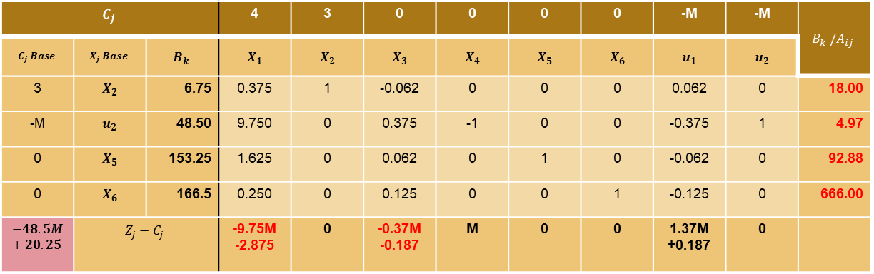


Resolución con SIMPLEX
$$C_{j}$$ |  |  | 4 | 3 | 0 | 0 | 0 | 0 | -M | -M | $$B_{k} /A_{ij}$$
$$C_{j} Base$$ | $$X_{j} Base$$ | $$B_{k}$$ | $$X_{1}$$ | $$X_{2}$$ | $$X_{3}$$ | $$X_{4}$$ | $$X_{5}$$ | $$X_{6}$$ | $$u_{1}$$ | $$u_{2}$$
3 | $$X_{2}$$ | 6.75 | 0.375 | 1 | -0.062 | 0 | 0 | 0 | 0.062 | 0 | 18.00
-M | $$u_{2}$$ | 48.50 | 9.750 | 0 | 0.375 | -1 | 0 | 0 | -0.375 | 1 | 4.97
0 | $$X_{5}$$ | 153.25 | 1.625 | 0 | 0.062 | 0 | 1 | 0 | -0.062 | 0 | 92.88
0 | $$X_{6}$$ | 166.5 | 0.250 | 0 | 0.125 | 0 | 0 | 1 | -0.125 | 0 | 666.00
$$−48.5M+20.25$$ | $$Z_{j}−C_{j}$$ |  | -9.75M -2.875 | 0 | -0.37M -0.187 | M | 0 | 0 | 1.37M +0.187 | 0
Resolvemos $B_{k} /A_{ij}$
Mínimo positivo $B_{k} /A_{ij}$ en $u_{2}$
Sale $u_{2}$, entra $X_{1}$

Slide 11
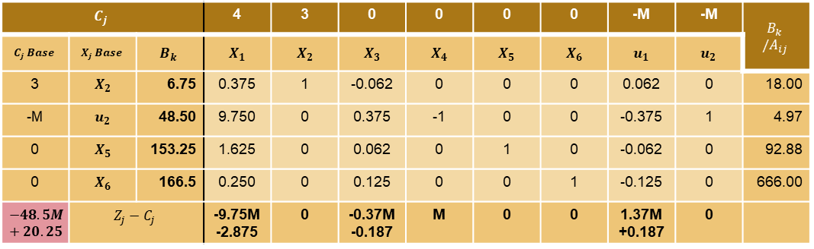
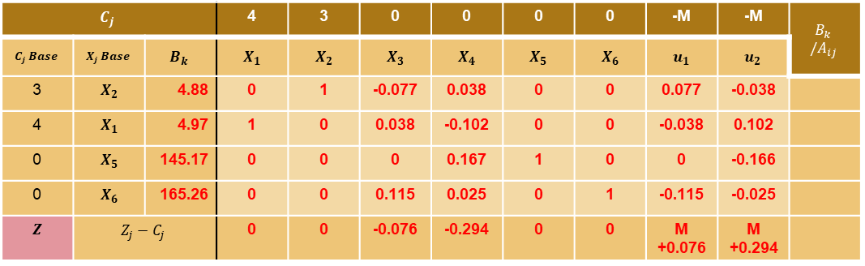
Resolución con SIMPLEX
$$C_{j}$$ |  |  | 4 | 3 | 0 | 0 | 0 | 0 | -M | -M | $$B_{k} /A_{ij}$$
$$C_{j} Base$$ | $$X_{j} Base$$ | $$B_{k}$$ | $$X_{1}$$ | $$X_{2}$$ | $$X_{3}$$ | $$X_{4}$$ | $$X_{5}$$ | $$X_{6}$$ | $$u_{1}$$ | $$u_{2}$$
3 | $$X_{2}$$ | 6.75 | 0.375 | 1 | -0.062 | 0 | 0 | 0 | 0.062 | 0 | 18.00
-M | $$u_{2}$$ | 48.50 | 9.750 | 0 | 0.375 | -1 | 0 | 0 | -0.375 | 1 | 4.97
0 | $$X_{5}$$ | 153.25 | 1.625 | 0 | 0.062 | 0 | 1 | 0 | -0.062 | 0 | 92.88
0 | $$X_{6}$$ | 166.5 | 0.250 | 0 | 0.125 | 0 | 0 | 1 | -0.125 | 0 | 666.00
$$−48.5M+20.25$$ | $$Z_{j}−C_{j}$$ |  | -9.75M -2.875 | 0 | -0.37M -0.187 | M | 0 | 0 | 1.37M +0.187 | 0
Tabla
iteración 1
$$C_{j}$$ |  |  | 4 | 3 | 0 | 0 | 0 | 0 | -M | -M | $$B_{k} /A_{ij}$$
$$C_{j} Base$$ | $$X_{j} Base$$ | $$B_{k}$$ | $$X_{1}$$ | $$X_{2}$$ | $$X_{3}$$ | $$X_{4}$$ | $$X_{5}$$ | $$X_{6}$$ | $$u_{1}$$ | $$u_{2}$$
3 | $$X_{2}$$ | 4.88 | 0 | 1 | -0.077 | 0.038 | 0 | 0 | 0.077 | -0.038
4 | $$X_{1}$$ | 4.97 | 1 | 0 | 0.038 | -0.102 | 0 | 0 | -0.038 | 0.102
0 | $$X_{5}$$ | 145.17 | 0 | 0 | 0 | 0.167 | 1 | 0 | 0 | -0.166
0 | $$X_{6}$$ | 165.26 | 0 | 0 | 0.115 | 0.025 | 0 | 1 | -0.115 | -0.025
$$Z$$ | $$Z_{j}−C_{j}$$ |  | 0 | 0 | -0.076 | -0.294 | 0 | 0 | M +0.076 | M +0.294
Tabla
iteración 2

Slide 12
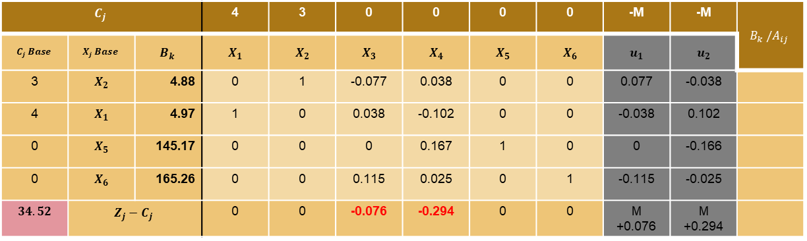

Resolución con SIMPLEX
$$C_{j}$$ |  |  | 4 | 3 | 0 | 0 | 0 | 0 | -M | -M | $$B_{k} /A_{ij}$$
$$C_{j} Base$$ | $$X_{j} Base$$ | $$B_{k}$$ | $$X_{1}$$ | $$X_{2}$$ | $$X_{3}$$ | $$X_{4}$$ | $$X_{5}$$ | $$X_{6}$$ | $$u_{1}$$ | $$u_{2}$$
3 | $$X_{2}$$ | 4.88 | 0 | 1 | -0.077 | 0.038 | 0 | 0 | 0.077 | -0.038
4 | $$X_{1}$$ | 4.97 | 1 | 0 | 0.038 | -0.102 | 0 | 0 | -0.038 | 0.102
0 | $$X_{5}$$ | 145.17 | 0 | 0 | 0 | 0.167 | 1 | 0 | 0 | -0.166
0 | $$X_{6}$$ | 165.26 | 0 | 0 | 0.115 | 0.025 | 0 | 1 | -0.115 | -0.025
$$34.52$$ | $$Z_{j}−C_{j}$$ |  | 0 | 0 | -0.076 | -0.294 | 0 | 0 | M +0.076 | M +0.294
Resolvemos $Z_{j}−C_{j}$y valor del funcional $Z$
Existen variables no básicas con $Z_{j}−C_{j}$ negativo, ¡$Z$ puede mejorar!
Seleccionamos $X_{4}$ para entrar a la base

Slide 13
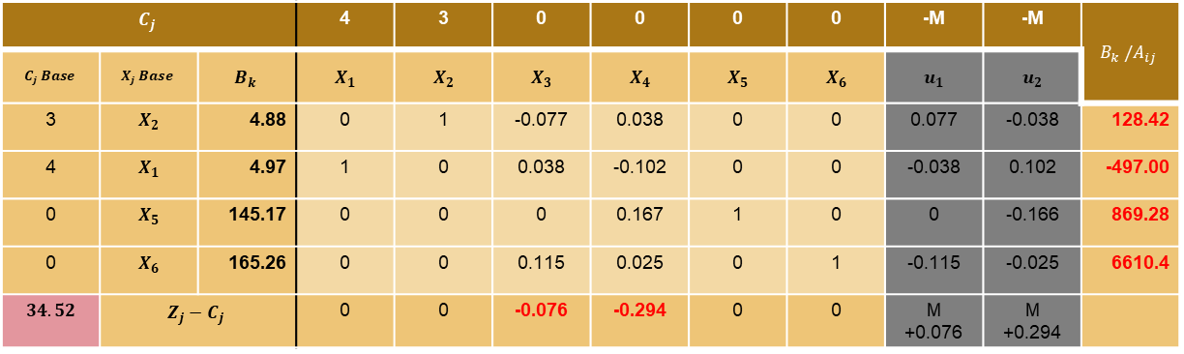


Resolución con SIMPLEX
$$C_{j}$$ |  |  | 4 | 3 | 0 | 0 | 0 | 0 | -M | -M | $$B_{k} /A_{ij}$$
$$C_{j} Base$$ | $$X_{j} Base$$ | $$B_{k}$$ | $$X_{1}$$ | $$X_{2}$$ | $$X_{3}$$ | $$X_{4}$$ | $$X_{5}$$ | $$X_{6}$$ | $$u_{1}$$ | $$u_{2}$$
3 | $$X_{2}$$ | 4.88 | 0 | 1 | -0.077 | 0.038 | 0 | 0 | 0.077 | -0.038 | 128.42
4 | $$X_{1}$$ | 4.97 | 1 | 0 | 0.038 | -0.102 | 0 | 0 | -0.038 | 0.102 | -497.00
0 | $$X_{5}$$ | 145.17 | 0 | 0 | 0 | 0.167 | 1 | 0 | 0 | -0.166 | 869.28
0 | $$X_{6}$$ | 165.26 | 0 | 0 | 0.115 | 0.025 | 0 | 1 | -0.115 | -0.025 | 6610.4
$$34.52$$ | $$Z_{j}−C_{j}$$ |  | 0 | 0 | -0.076 | -0.294 | 0 | 0 | M +0.076 | M +0.294
Resolvemos $B_{k} /A_{ij}$
Mínimo positivo $B_{k} /A_{ij}$ en $X_{2}$
Sale $X_{2}$, entra $X_{4}$

Slide 14
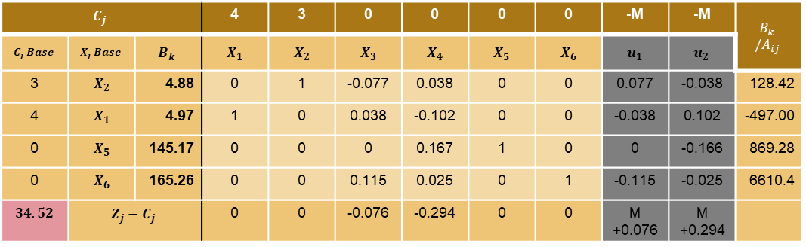
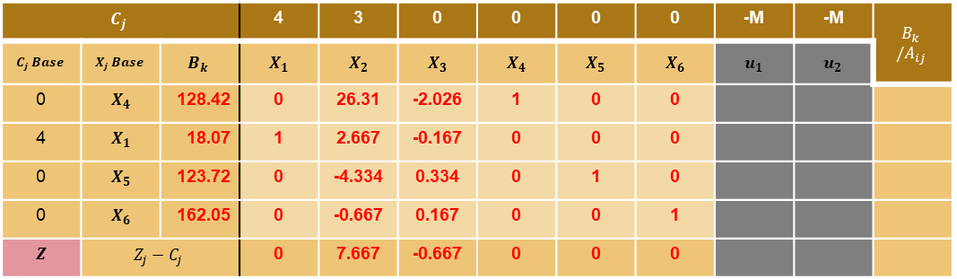
Resolución con SIMPLEX
$$C_{j}$$ |  |  | 4 | 3 | 0 | 0 | 0 | 0 | -M | -M | $$B_{k} /A_{ij}$$
$$C_{j} Base$$ | $$X_{j} Base$$ | $$B_{k}$$ | $$X_{1}$$ | $$X_{2}$$ | $$X_{3}$$ | $$X_{4}$$ | $$X_{5}$$ | $$X_{6}$$ | $$u_{1}$$ | $$u_{2}$$
3 | $$X_{2}$$ | 4.88 | 0 | 1 | -0.077 | 0.038 | 0 | 0 | 0.077 | -0.038 | 128.42
4 | $$X_{1}$$ | 4.97 | 1 | 0 | 0.038 | -0.102 | 0 | 0 | -0.038 | 0.102 | -497.00
0 | $$X_{5}$$ | 145.17 | 0 | 0 | 0 | 0.167 | 1 | 0 | 0 | -0.166 | 869.28
0 | $$X_{6}$$ | 165.26 | 0 | 0 | 0.115 | 0.025 | 0 | 1 | -0.115 | -0.025 | 6610.4
$$34.52$$ | $$Z_{j}−C_{j}$$ |  | 0 | 0 | -0.076 | -0.294 | 0 | 0 | M +0.076 | M +0.294
Tabla
iteración 2
$$C_{j}$$ |  |  | 4 | 3 | 0 | 0 | 0 | 0 | -M | -M | $$B_{k} /A_{ij}$$
$$C_{j} Base$$ | $$X_{j} Base$$ | $$B_{k}$$ | $$X_{1}$$ | $$X_{2}$$ | $$X_{3}$$ | $$X_{4}$$ | $$X_{5}$$ | $$X_{6}$$ | $$u_{1}$$ | $$u_{2}$$
0 | $$X_{4}$$ | 128.42 | 0 | 26.31 | -2.026 | 1 | 0 | 0
4 | $$X_{1}$$ | 18.07 | 1 | 2.667 | -0.167 | 0 | 0 | 0
0 | $$X_{5}$$ | 123.72 | 0 | -4.334 | 0.334 | 0 | 1 | 0
0 | $$X_{6}$$ | 162.05 | 0 | -0.667 | 0.167 | 0 | 0 | 1
$$Z$$ | $$Z_{j}−C_{j}$$ |  | 0 | 7.667 | -0.667 | 0 | 0 | 0
Tabla
iteración 3

Slide 15
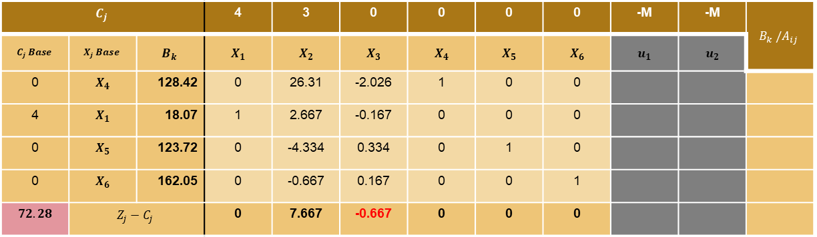

Resolución con SIMPLEX
$$C_{j}$$ |  |  | 4 | 3 | 0 | 0 | 0 | 0 | -M | -M | $$B_{k} /A_{ij}$$
$$C_{j} Base$$ | $$X_{j} Base$$ | $$B_{k}$$ | $$X_{1}$$ | $$X_{2}$$ | $$X_{3}$$ | $$X_{4}$$ | $$X_{5}$$ | $$X_{6}$$ | $$u_{1}$$ | $$u_{2}$$
0 | $$X_{4}$$ | 128.42 | 0 | 26.31 | -2.026 | 1 | 0 | 0
4 | $$X_{1}$$ | 18.07 | 1 | 2.667 | -0.167 | 0 | 0 | 0
0 | $$X_{5}$$ | 123.72 | 0 | -4.334 | 0.334 | 0 | 1 | 0
0 | $$X_{6}$$ | 162.05 | 0 | -0.667 | 0.167 | 0 | 0 | 1
$$72.28$$ | $$Z_{j}−C_{j}$$ |  | 0 | 7.667 | -0.667 | 0 | 0 | 0
Resolvemos $Z_{j}−C_{j}$y valor del funcional $Z$
Existen variables no básicas con $Z_{j}−C_{j}$ negativo, ¡$Z$ puede mejorar!
Seleccionamos $X_{3}$ para entrar a la base

Slide 16
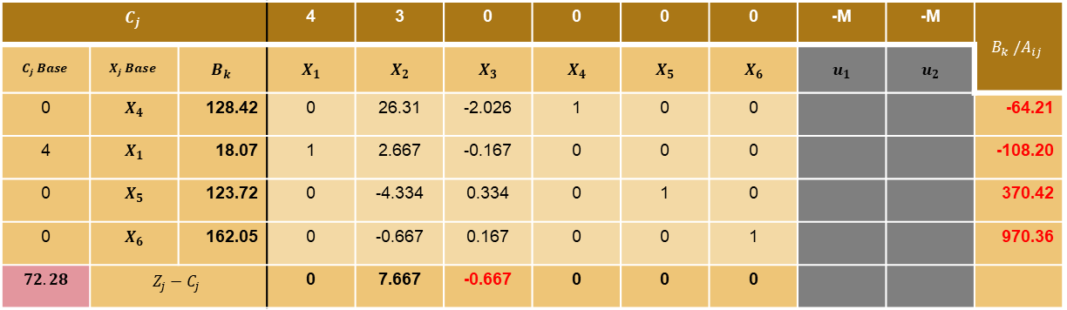


Resolución con SIMPLEX
$$C_{j}$$ |  |  | 4 | 3 | 0 | 0 | 0 | 0 | -M | -M | $$B_{k} /A_{ij}$$
$$C_{j} Base$$ | $$X_{j} Base$$ | $$B_{k}$$ | $$X_{1}$$ | $$X_{2}$$ | $$X_{3}$$ | $$X_{4}$$ | $$X_{5}$$ | $$X_{6}$$ | $$u_{1}$$ | $$u_{2}$$
0 | $$X_{4}$$ | 128.42 | 0 | 26.31 | -2.026 | 1 | 0 | 0 |  |  | -64.21
4 | $$X_{1}$$ | 18.07 | 1 | 2.667 | -0.167 | 0 | 0 | 0 |  |  | -108.20
0 | $$X_{5}$$ | 123.72 | 0 | -4.334 | 0.334 | 0 | 1 | 0 |  |  | 370.42
0 | $$X_{6}$$ | 162.05 | 0 | -0.667 | 0.167 | 0 | 0 | 1 |  |  | 970.36
$$72.28$$ | $$Z_{j}−C_{j}$$ |  | 0 | 7.667 | -0.667 | 0 | 0 | 0
Resolvemos $B_{k} /A_{ij}$
Mínimo positivo $B_{k} /A_{ij}$ en $X_{5}$
Sale $X_{5}$, entra $X_{3}$

Slide 17
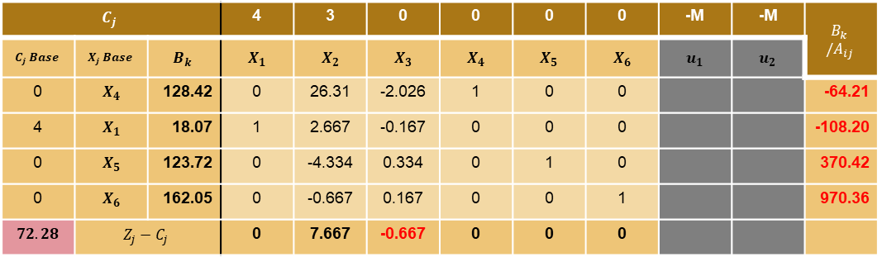
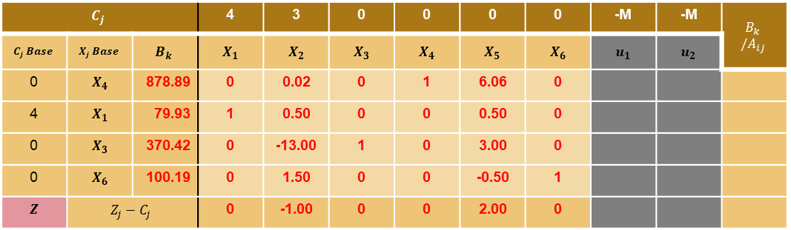
Resolución con SIMPLEX
$$C_{j}$$ |  |  | 4 | 3 | 0 | 0 | 0 | 0 | -M | -M | $$B_{k} /A_{ij}$$
$$C_{j} Base$$ | $$X_{j} Base$$ | $$B_{k}$$ | $$X_{1}$$ | $$X_{2}$$ | $$X_{3}$$ | $$X_{4}$$ | $$X_{5}$$ | $$X_{6}$$ | $$u_{1}$$ | $$u_{2}$$
0 | $$X_{4}$$ | 128.42 | 0 | 26.31 | -2.026 | 1 | 0 | 0 |  |  | -64.21
4 | $$X_{1}$$ | 18.07 | 1 | 2.667 | -0.167 | 0 | 0 | 0 |  |  | -108.20
0 | $$X_{5}$$ | 123.72 | 0 | -4.334 | 0.334 | 0 | 1 | 0 |  |  | 370.42
0 | $$X_{6}$$ | 162.05 | 0 | -0.667 | 0.167 | 0 | 0 | 1 |  |  | 970.36
$$72.28$$ | $$Z_{j}−C_{j}$$ |  | 0 | 7.667 | -0.667 | 0 | 0 | 0
Tabla
iteración 3
$$C_{j}$$ |  |  | 4 | 3 | 0 | 0 | 0 | 0 | -M | -M | $$B_{k} /A_{ij}$$
$$C_{j} Base$$ | $$X_{j} Base$$ | $$B_{k}$$ | $$X_{1}$$ | $$X_{2}$$ | $$X_{3}$$ | $$X_{4}$$ | $$X_{5}$$ | $$X_{6}$$ | $$u_{1}$$ | $$u_{2}$$
0 | $$X_{4}$$ | 878.89 | 0 | 0.02 | 0 | 1 | 6.06 | 0
4 | $$X_{1}$$ | 79.93 | 1 | 0.50 | 0 | 0 | 0.50 | 0
0 | $$X_{3}$$ | 370.42 | 0 | -13.00 | 1 | 0 | 3.00 | 0
0 | $$X_{6}$$ | 100.19 | 0 | 1.50 | 0 | 0 | -0.50 | 1
$$Z$$ | $$Z_{j}−C_{j}$$ |  | 0 | -1.00 | 0 | 0 | 2.00 | 0
Tabla
iteración 4

Slide 18
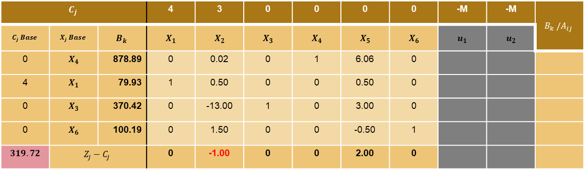
Resolución con SIMPLEX
$$C_{j}$$ |  |  | 4 | 3 | 0 | 0 | 0 | 0 | -M | -M | $$B_{k} /A_{ij}$$
$$C_{j} Base$$ | $$X_{j} Base$$ | $$B_{k}$$ | $$X_{1}$$ | $$X_{2}$$ | $$X_{3}$$ | $$X_{4}$$ | $$X_{5}$$ | $$X_{6}$$ | $$u_{1}$$ | $$u_{2}$$
0 | $$X_{4}$$ | 878.89 | 0 | 0.02 | 0 | 1 | 6.06 | 0
4 | $$X_{1}$$ | 79.93 | 1 | 0.50 | 0 | 0 | 0.50 | 0
0 | $$X_{3}$$ | 370.42 | 0 | -13.00 | 1 | 0 | 3.00 | 0
0 | $$X_{6}$$ | 100.19 | 0 | 1.50 | 0 | 0 | -0.50 | 1
$$319.72$$ | $$Z_{j}−C_{j}$$ |  | 0 | -1.00 | 0 | 0 | 2.00 | 0
Resolvemos $Z_{j}−C_{j}$y valor del funcional $Z$
Existen variables no básicas con $Z_{j}−C_{j}$ negativo, ¡$Z$ puede mejorar!
Seleccionamos $X_{2}$ para entrar a la base

Slide 19
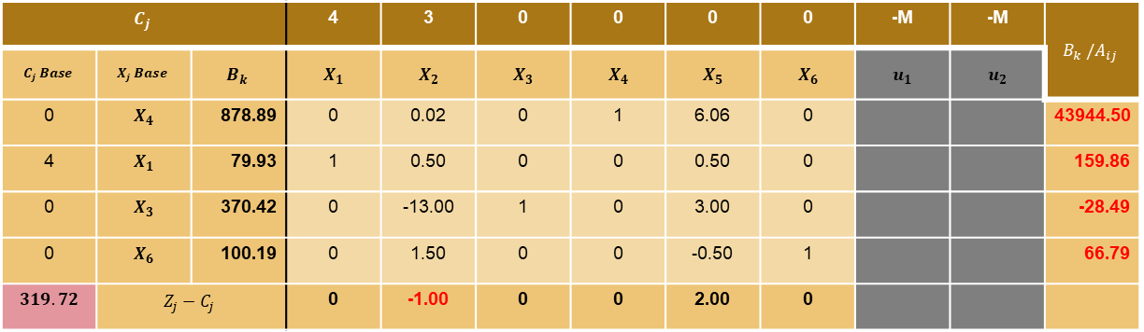


Resolución con SIMPLEX
$$C_{j}$$ |  |  | 4 | 3 | 0 | 0 | 0 | 0 | -M | -M | $$B_{k} /A_{ij}$$
$$C_{j} Base$$ | $$X_{j} Base$$ | $$B_{k}$$ | $$X_{1}$$ | $$X_{2}$$ | $$X_{3}$$ | $$X_{4}$$ | $$X_{5}$$ | $$X_{6}$$ | $$u_{1}$$ | $$u_{2}$$
0 | $$X_{4}$$ | 878.89 | 0 | 0.02 | 0 | 1 | 6.06 | 0 |  |  | 43944.50
4 | $$X_{1}$$ | 79.93 | 1 | 0.50 | 0 | 0 | 0.50 | 0 |  |  | 159.86
0 | $$X_{3}$$ | 370.42 | 0 | -13.00 | 1 | 0 | 3.00 | 0 |  |  | -28.49
0 | $$X_{6}$$ | 100.19 | 0 | 1.50 | 0 | 0 | -0.50 | 1 |  |  | 66.79
$$319.72$$ | $$Z_{j}−C_{j}$$ |  | 0 | -1.00 | 0 | 0 | 2.00 | 0
Resolvemos $B_{k} /A_{ij}$
Mínimo positivo $B_{k} /A_{ij}$ en $X_{6}$
Sale $X_{6}$, entra $X_{2}$

Slide 20
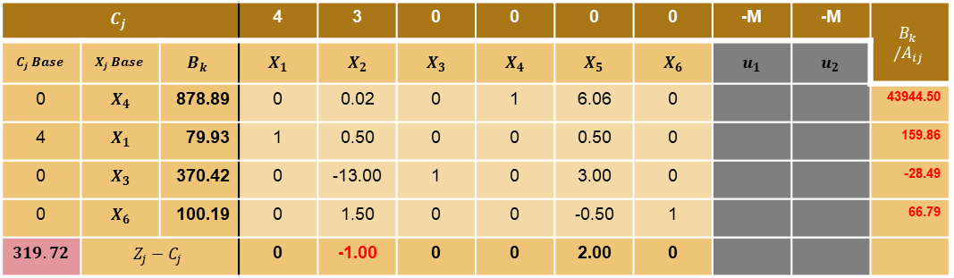
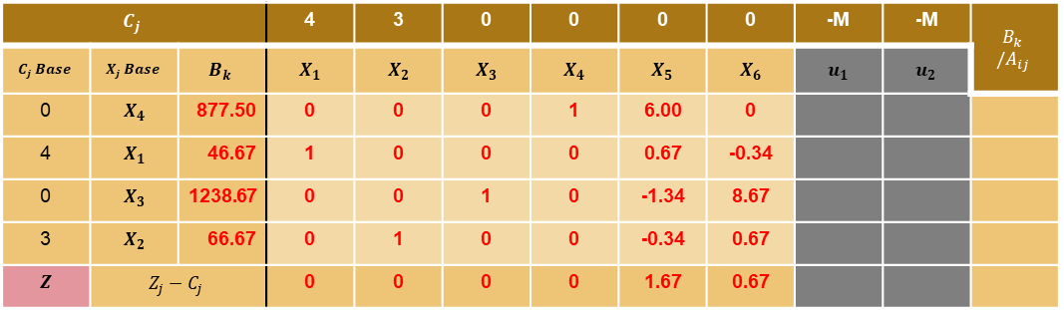
Resolución con SIMPLEX
$$C_{j}$$ |  |  | 4 | 3 | 0 | 0 | 0 | 0 | -M | -M | $$B_{k} /A_{ij}$$
$$C_{j} Base$$ | $$X_{j} Base$$ | $$B_{k}$$ | $$X_{1}$$ | $$X_{2}$$ | $$X_{3}$$ | $$X_{4}$$ | $$X_{5}$$ | $$X_{6}$$ | $$u_{1}$$ | $$u_{2}$$
0 | $$X_{4}$$ | 878.89 | 0 | 0.02 | 0 | 1 | 6.06 | 0 |  |  | 43944.50
4 | $$X_{1}$$ | 79.93 | 1 | 0.50 | 0 | 0 | 0.50 | 0 |  |  | 159.86
0 | $$X_{3}$$ | 370.42 | 0 | -13.00 | 1 | 0 | 3.00 | 0 |  |  | -28.49
0 | $$X_{6}$$ | 100.19 | 0 | 1.50 | 0 | 0 | -0.50 | 1 |  |  | 66.79
$$319.72$$ | $$Z_{j}−C_{j}$$ |  | 0 | -1.00 | 0 | 0 | 2.00 | 0
Tabla
iteración 4
$$C_{j}$$ |  |  | 4 | 3 | 0 | 0 | 0 | 0 | -M | -M | $$B_{k} /A_{ij}$$
$$C_{j} Base$$ | $$X_{j} Base$$ | $$B_{k}$$ | $$X_{1}$$ | $$X_{2}$$ | $$X_{3}$$ | $$X_{4}$$ | $$X_{5}$$ | $$X_{6}$$ | $$u_{1}$$ | $$u_{2}$$
0 | $$X_{4}$$ | 877.50 | 0 | 0 | 0 | 1 | 6.00 | 0
4 | $$X_{1}$$ | 46.67 | 1 | 0 | 0 | 0 | 0.67 | -0.34
0 | $$X_{3}$$ | 1238.67 | 0 | 0 | 1 | 0 | -1.34 | 8.67
3 | $$X_{2}$$ | 66.67 | 0 | 1 | 0 | 0 | -0.34 | 0.67
$$Z$$ | $$Z_{j}−C_{j}$$ |  | 0 | 0 | 0 | 0 | 1.67 | 0.67
Tabla
iteración 5

Slide 21
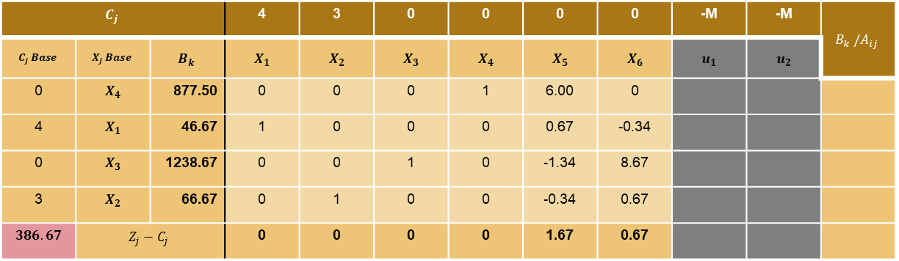
Resolución con SIMPLEX
$$C_{j}$$ |  |  | 4 | 3 | 0 | 0 | 0 | 0 | -M | -M | $$B_{k} /A_{ij}$$
$$C_{j} Base$$ | $$X_{j} Base$$ | $$B_{k}$$ | $$X_{1}$$ | $$X_{2}$$ | $$X_{3}$$ | $$X_{4}$$ | $$X_{5}$$ | $$X_{6}$$ | $$u_{1}$$ | $$u_{2}$$
0 | $$X_{4}$$ | 877.50 | 0 | 0 | 0 | 1 | 6.00 | 0
4 | $$X_{1}$$ | 46.67 | 1 | 0 | 0 | 0 | 0.67 | -0.34
0 | $$X_{3}$$ | 1238.67 | 0 | 0 | 1 | 0 | -1.34 | 8.67
3 | $$X_{2}$$ | 66.67 | 0 | 1 | 0 | 0 | -0.34 | 0.67
$$386.67$$ | $$Z_{j}−C_{j}$$ |  | 0 | 0 | 0 | 0 | 1.67 | 0.67
Resolvemos $Z_{j}−C_{j}$y valor del funcional $Z$
No existen variables no básicas con $Z_{j}−C_{j}$ negativo, ¡$Z$ es óptimo!

Slide 22





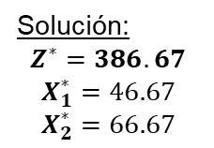

Resolución con SIMPLEX
$$X_{2}$$
Solución:
$$Z^{∗}=386.67$$
$$X_{1}^{∗}=46.67$$
$$X_{2}^{∗}=66.67$$
$$Y_{4}$$
$$RP_{X_{1}}$$
$$X_{4}^{∗}$$
$$Y_{3}$$
$$X_{3}^{∗}$$
$$Y_{2}$$
$$Y_{1}$$
$$RP_{i}:restricciones de positividad$$
$$RP_{X_{2}}$$
$$X_{1}$$

