Slide 1
Invictus Team
Hospital Management System
岳琮涵 Hammour
Register and Login
徐豪杰 Hunter
Registration
付珂 Simple
Doctor Manager
陈震洋 Cloud
Hospital Admission

Slide 2
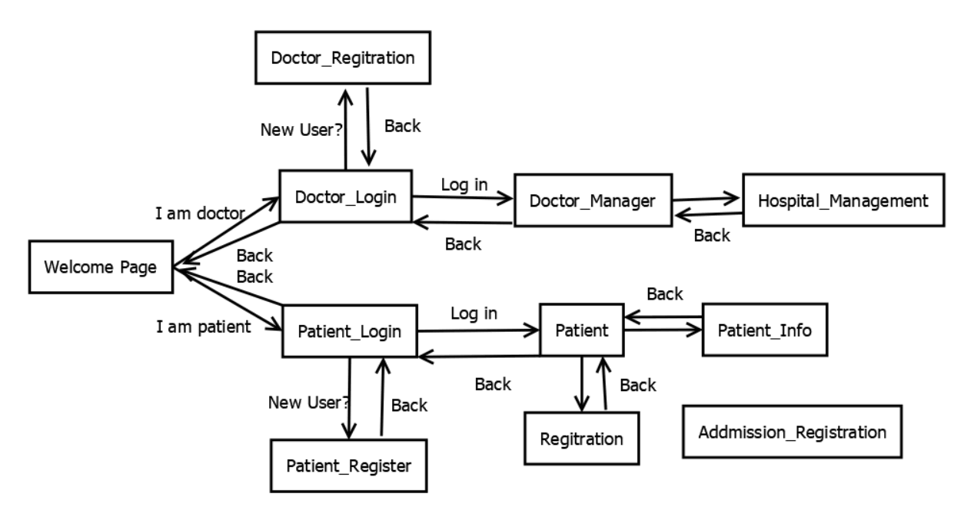

Slide 3
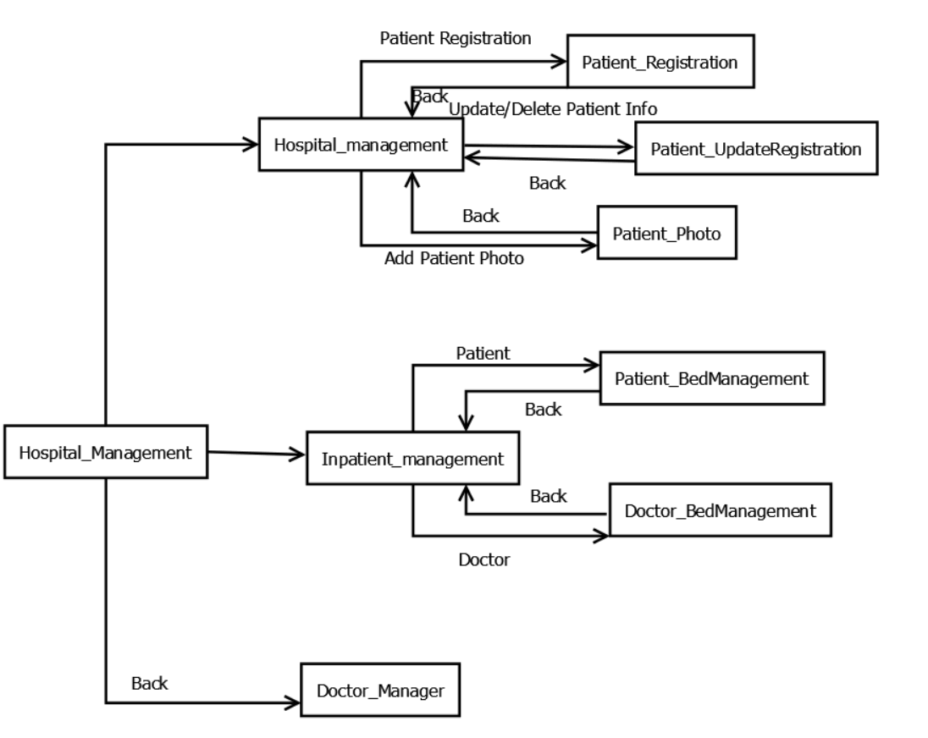

Slide 4
Next we'll present our project in actual operation

Slide 5
Thank you!

