Slide 1
GROUP 10086 – simulation of virtual memory and file system
Baicheng Zong, Shuaiyu Wang, Tianhao Wu

Slide 2
Part1 – simulation of virtual memory

Slide 3
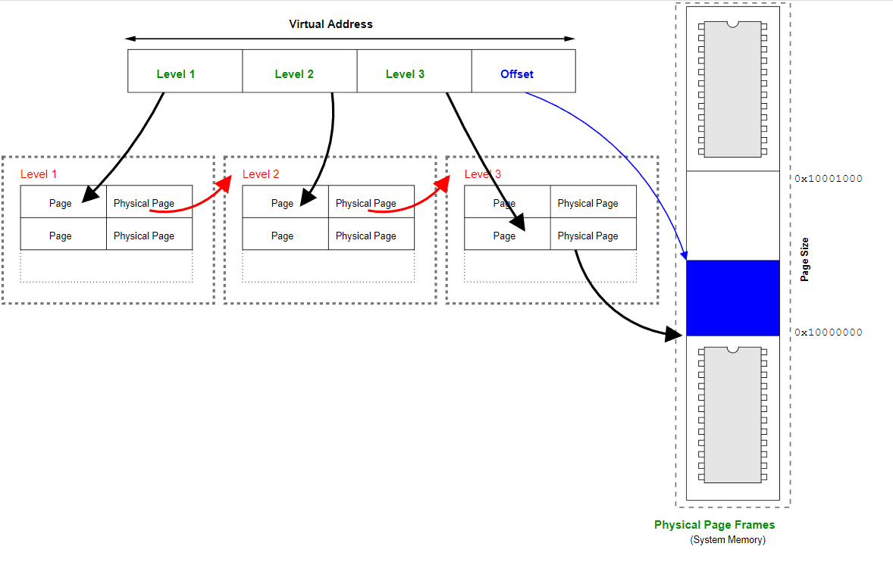
Basic idea: 1-level mapping

Slide 4
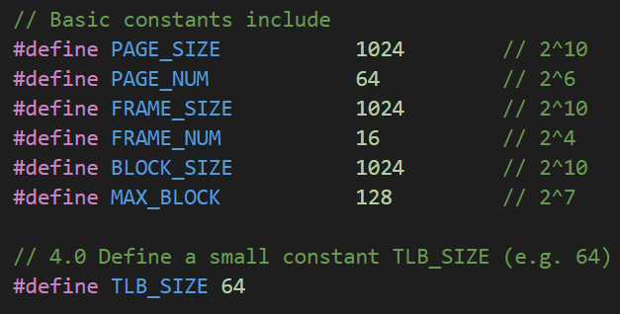
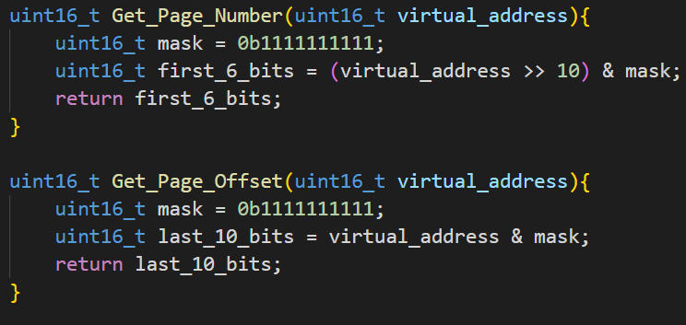
definitions

Slide 5
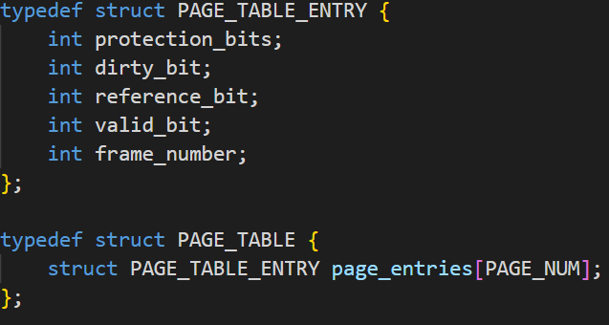
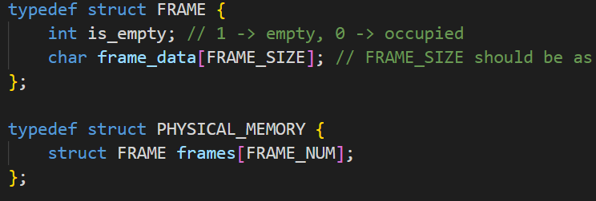
Page table design

Slide 6
Page Table Handler-A function to determine if a page fault occurred and resolve the fault：
1.get_free_frame():
2. load_page():
3. update_table():

Slide 7
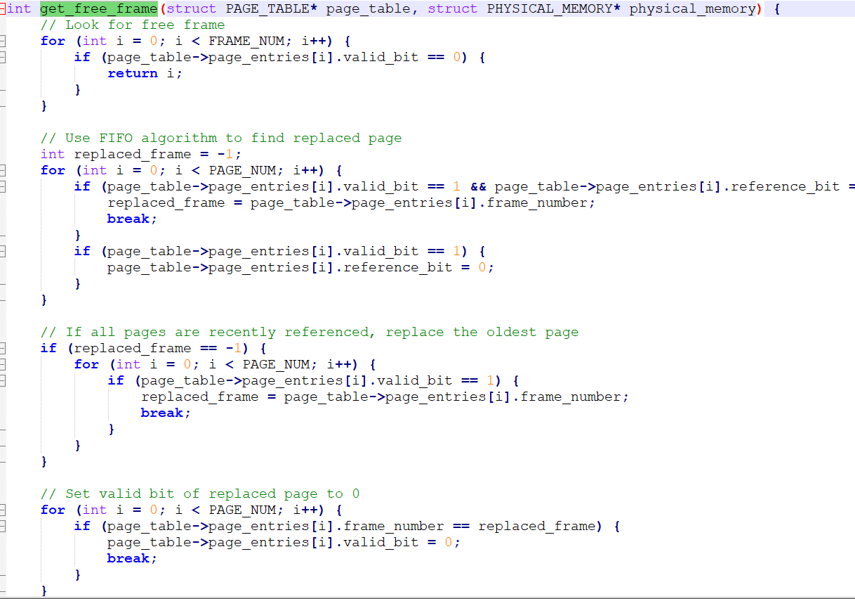
get_free_frame():
Introduction: This function is to find out whether there is already a free frame that can be used. If there is, it will be used directly, otherwise an algorithm(FIFO) will be used to find a replacement page.

Slide 8
Load_Page():
Introduction: This function loads a page from disk into physical memory. It needs to read page data on disk, copy it into available frames. Here the Read_Data_from_Disk() function constructed in the previous part is called

Slide 9
update_table():
Introduction: This function updates the page table entry to point to the correct frame in physical memory.

Slide 10
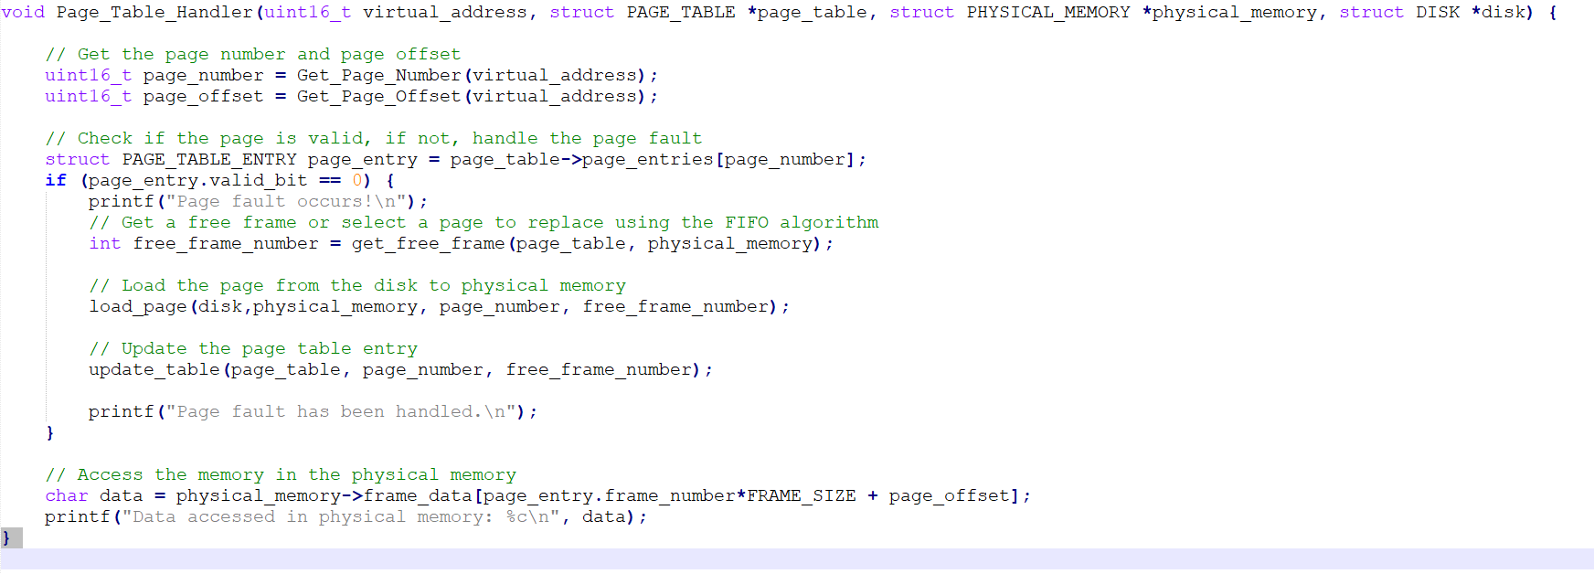
Page_Table_Handler():

Slide 11
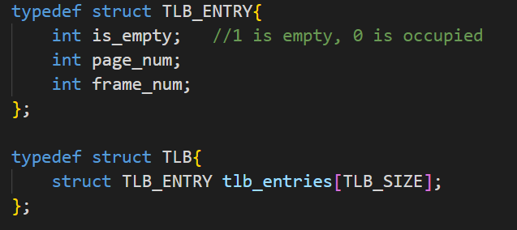
Translate lookaside buffer
Implement function search_TLB(): search the TLB for the desired page number's data:
Sequentially check the table from entries[0]
If found:
skip check page table and directly get frame number;
If not found:
check/calculate frame number using function in previous part;
update TLB_TABLE;
when there's not enough TLB_TABLE entries, overwrite entries[0]

Slide 12
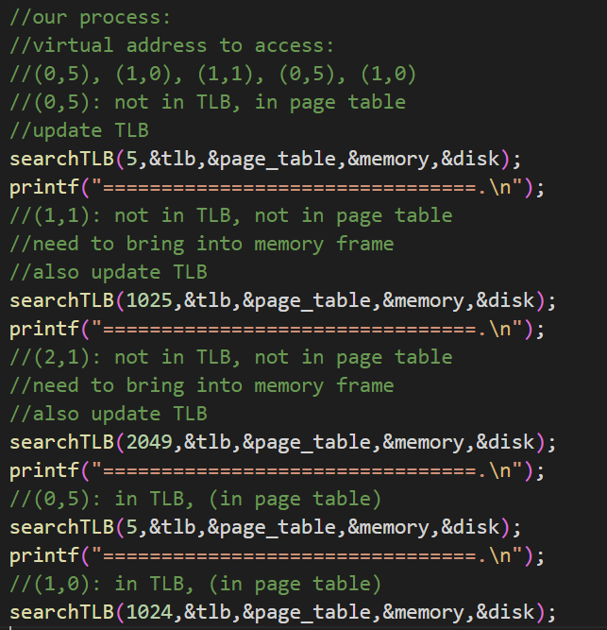
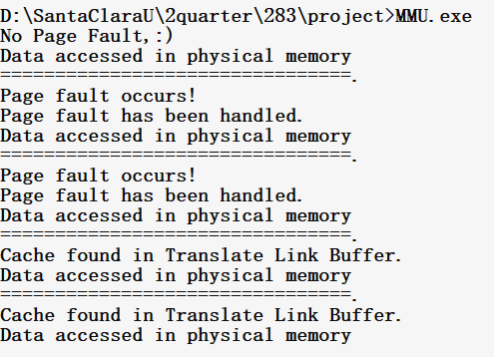
Memory management unit

Slide 13
Part2 – simulation of customized File system

Slide 14
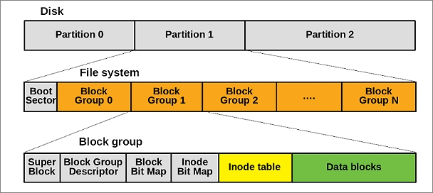
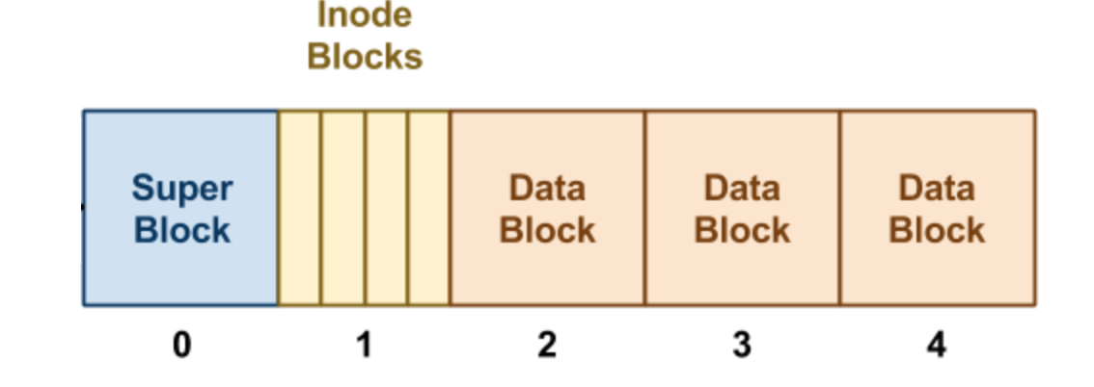
DATA Storage on disk – basic design
Linux Ex2 File System Layout
Boot sector, Super block, Block Group Descriptor, ….
Basic structure of our file system storage:
Superblock
I-nodes
Disk block data

Slide 15
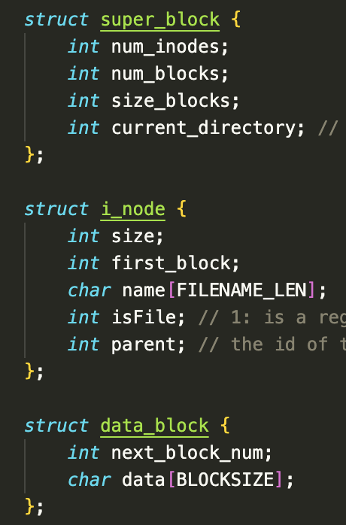
DATA Storage on disk – struct design
Superblock: basic global information for the whole system, like number of i-nodes, number of data blocks, size of each block,….
i-node: key information to access a particular file, like size of the file, index of the first block of the file (for linked allocation), name of the file, type of the file, ….
Data (disk blocks): includes content of a particular file and a pointer to the next possible block.

Slide 16
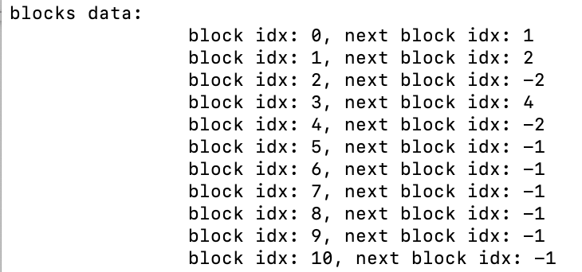
DATA Storage on disk – Linked Allocation
-1: Haven’t been allocated, -2: End of the file
Assume size of each block is 1024
File1 (size = 3000) : block0 ==> block1 ==> block2
File2 (size = 2000) : block3 ==> block4

Slide 17
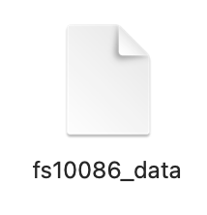
Basic logic and functions
mount()
Initialize/create the file system – void create()
Mount the file system – void mount()
Read data from disk and mount the data to the memory
-- All modification will take place after mount()
Save/synchronize the file system – void sync()
-- All modification will be saved into disk otherwise it will be deleted
sync()

Slide 18
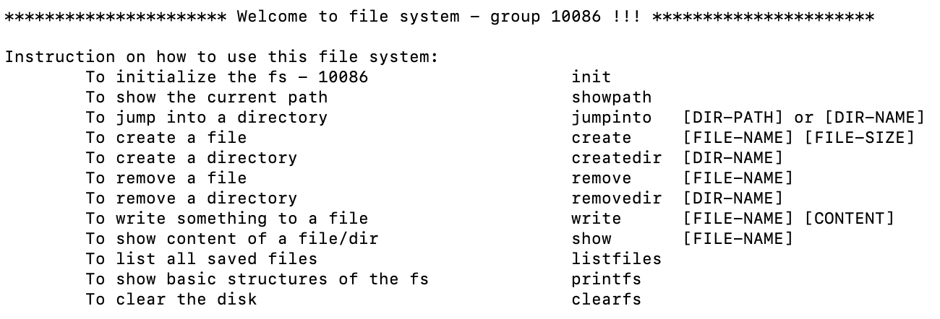
Supported features
Linux Instructions vs Our fs instructions
pwd showpath
cd jumpinto
touch create
mkdir createdir
rm remove
rm –rf removedir
>> write
cat show
ls listfiles

Slide 19
simulation – create / createdir
create / createdir:
1. mount data from the disk
2. allocate file and set size:
2.1. search for an empty i-node
2.2. search for empty data blocks and use pointer to connect them with each other
2.3. Initialize basic info for i-node (first block index, size, file type, parent dir, …)
* file type is used to distinguish files or directories.
3. save data to the disk
mount()
sync()

Slide 20
simulation – show / write
show / write:
1. mount data from the disk
2. read/write data from data blocks
2.1 Search target file by name among i-nodes
2.2 Find disk blocks related to the file
2.3 Read/Write data to disk blocks
*Make sure written data does not exceed size of the file
3. save data to the disk (for write instruction)
mount()
sync()

Slide 21
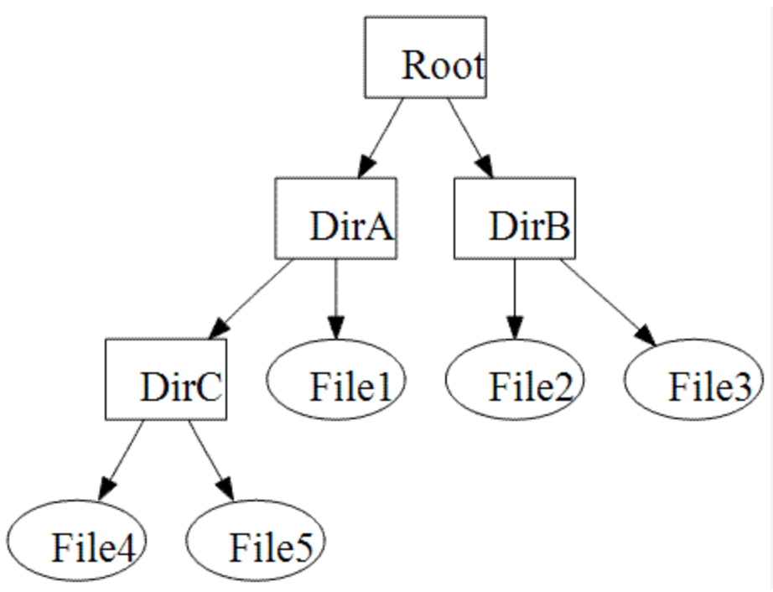
simulation – remove / removedir
remove / removedir:
1. mount data from the disk
2. remove data from data blocks
2.1 Search target file by name among i-nodes
For regular file:
2.2 Find disk blocks related to the file
2.3 Free these blocks and set them unused
*so that use them again when creating new files
2.4 Delete related i-node data
For directory:
2.2 Remove it from i-node if it has no children
2.3 Recursively remove its children
3. save data to the disk

Slide 22
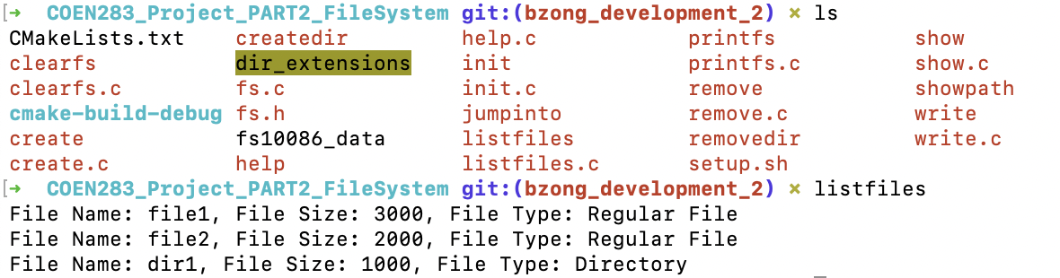
simulation – showpath / jumpinto / listfiles
Showpath: Finds the file directory up the hierarchy according to the parent pointer
Jumpinto: Change the current path info stored in superblock
Listfiles: Go through all i-nodes and list the files in the same path as the superblock

Slide 23
demo

Slide 24
Thank you

