Slide 1
Understanding Transformers in Machine Learning

Slide 2
Introduction to Transformers
Transformers are a type of model architecture that are pivotal in the field of machine learning, particularly in natural language processing. Originally proposed in 'Attention is All You Need' by Vaswani et al., transformers have revolutionized tasks like translation and text generation by utilizing mechanisms of attention to understand context relationships in data.

Slide 3
Core Concept: Attention Mechanisms
Why does attention matter to transformers?
- Allows the model to weigh the importance of different input parts.
- Improves the understanding of context, crucial for tasks like language translations.

Slide 4
Transformer Architecture Basics
Key Components:
- Encoder: Processes input data.
- Decoder: Generates output.
- Self-Attention Layers: Allow encoding of context from long sequences.

Slide 5
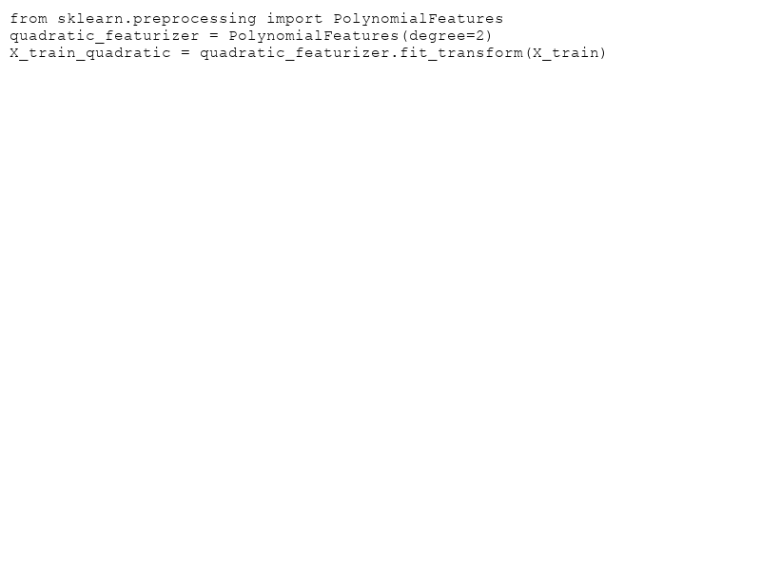
Application Example: Polynomial Features
How transformers can enhance polynomial regression models:
- They add polynomial features to linear models, increasing the model's complexity and accuracy without overfitting.

Slide 6
Comparing Models: Linear vs. Polynomial
- Linear Model: Fits data with a straight line.
- Polynomial Model: Uses curves for a better fit.

Slide 7
Real-World Impact
How have transformers transformed domains like NLP?
- Enhanced translation services.
- Advanced chatbots and virtual assistants.
- Breakthroughs in text-to-speech systems.

Slide 8
Conclusion: The Future of Transformers
Transformers represent a paradigm shift in machine learning, especially for sequential data processing. With ongoing research, they hold the promise of greater innovation and evolution in AI technology, allowing for even more sophisticated and efficient models.

