Slide 1
Understanding GANs: Generative Adversarial Networks

Slide 2
What is a GAN?
A Generative Adversarial Network (GAN) consists of two neural networks, a Generator and a Discriminator, that work against each other in a zero-sum game framework.

Slide 3
Inside a GAN
The Generator creates data similar to real data, while the Discriminator evaluates data as real or fake.

Slide 4
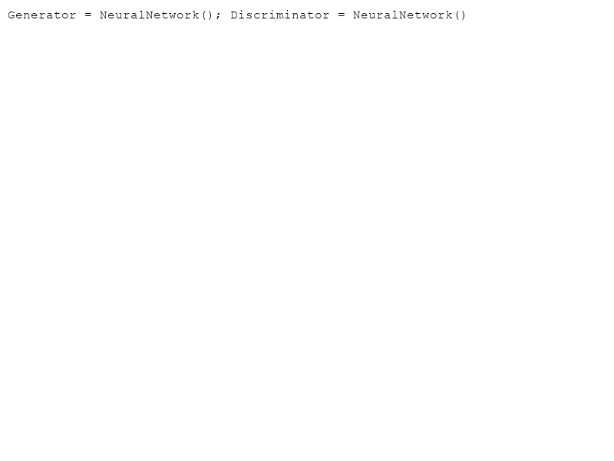
How Do They Compete?
The Generator is rewarded for fooling the Discriminator, and the Discriminator is rewarded for correctly identifying fake data.

Slide 5
Who Wins the Game?
The outcome ideally is a stalemate where both networks are perfectly balanced, making it difficult for the Discriminator to distinguish real from fake data.

Slide 6
Real-World Applications
- Image generation
- Video game development
- Text-to-image models
- Music composition

Slide 7
Challenges with GANs
- Training instability
- Mode collapse
- Resource intensity

Slide 8
Future of GANs
As GAN technology improves, we foresee enhanced capabilities in creating hyper-realistic media, bridging the gap between synthetic and real-world data.

