Slide 1
Introduction to Machine Learning

Slide 2
What is Machine Learning?
"Machine learning is the design and study of software artifacts that use past experience to inform future decisions."

Slide 3
Applications of Machine Learning
- Writing sports articles
- Autonomous vehicles
- Personalized marketing

Slide 4
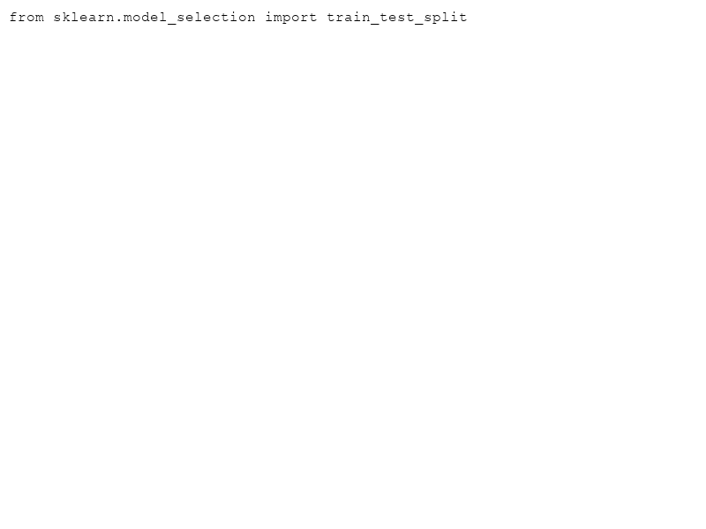
Key Concepts: Learning from Data
Machine learning aims to generalize from past data to make predictions or decisions without being explicitly programmed to perform tasks.

Slide 5
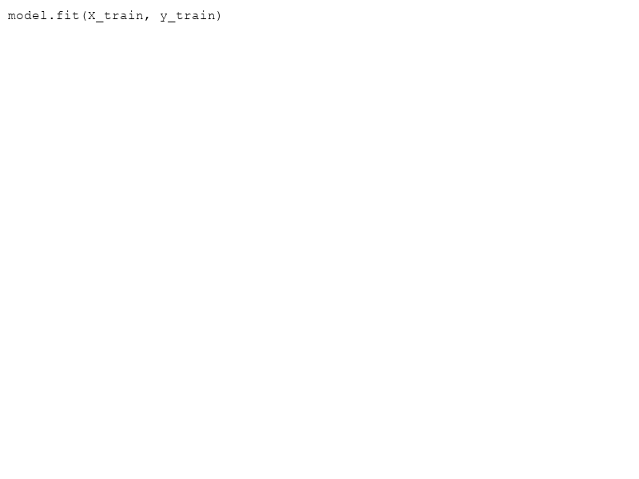
Supervised vs Unsupervised Learning
- **Supervised Learning**: Involves labeled data.
- **Unsupervised Learning**: Works with unlabeled data.

Slide 6
Common Algorithms
- Decision Trees
- Neural Networks
- Support Vector Machines

Slide 7
Challenges in Machine Learning
- Data Quality and Quantity
- Overfitting and Underfitting
- Interpretability of Models

Slide 8
Conclusion
Machine learning continues to transform industries by making more data-driven decisions possible. The journey from learning to application involves understanding key concepts, leveraging the right algorithms, and addressing real-world data challenges.

