Slide 1
Understanding Deep Learning
An Introduction to Concepts, Applications, and Techniques

Slide 2
What is Deep Learning?
Deep learning is a subset of machine learning where artificial neural networks, inspired by the human brain, learn from large amounts of data. It is particularly effective for tasks such as image and speech recognition.

Slide 3

Neural Networks Explained
Neural networks consist of layers of interconnected nodes, or neurons. Each connection has an associated weight, and learning involves adjusting these weights based on the input data.

Slide 4
Applications of Deep Learning
Deep learning is used in various fields such as computer vision, natural language processing, and robotics. It powers technologies like autonomous vehicles, virtual assistants, and recommendation systems.

Slide 5
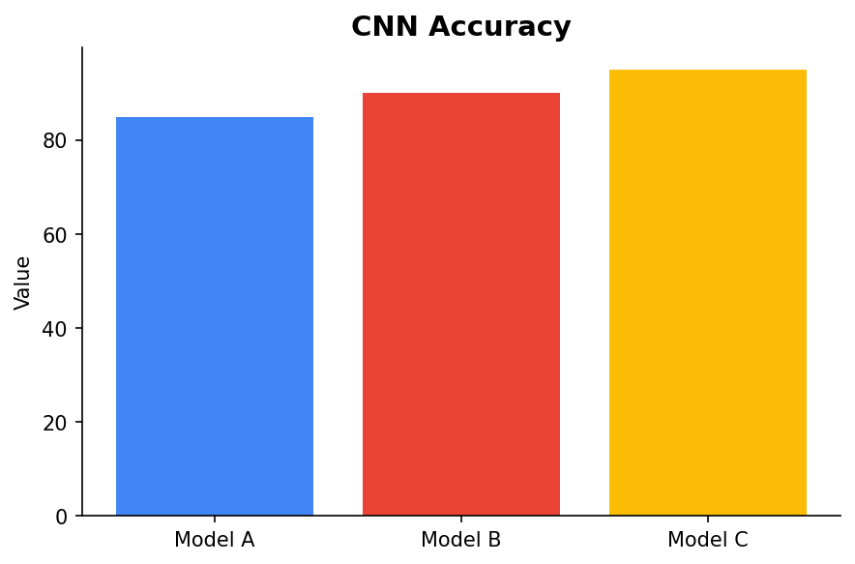
Convolutional Neural Networks (CNNs)
CNNs are specialized neural networks designed for processing structured grid data like images. They excel in tasks such as image recognition and classification.

Slide 6
Challenges in Deep Learning
While powerful, deep learning requires large datasets and significant computational resources. It can also be difficult to interpret and explain the decisions made by deep learning models.

Slide 7
Future of Deep Learning
The future of deep learning is promising, with ongoing research focused on creating more efficient algorithms, improving model interpretability, and reducing resource requirements.

