Slide 1
Understanding Sorting Algorithms
An Educational Guide on Sorting Techniques

Slide 2
Introduction to Sorting Algorithms
Sorting algorithms are methods used to rearrange a list or array of items into a particular order, such as numerical or lexicographical order. These algorithms are crucial in enhancing the efficiency of other algorithms that require sorted data.

Slide 3
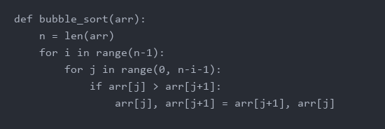
Bubble Sort
Bubble Sort is a simple comparison-based algorithm. It repeatedly steps through the list, compares adjacent elements and swaps them if they are in the wrong order. It continues this process until the list is sorted.

Slide 4
Merge Sort
Merge Sort is a divide-and-conquer algorithm that divides the input array into two halves, recursively sorts the two halves, and then merges the sorted halves to produce a single sorted array.

Slide 5
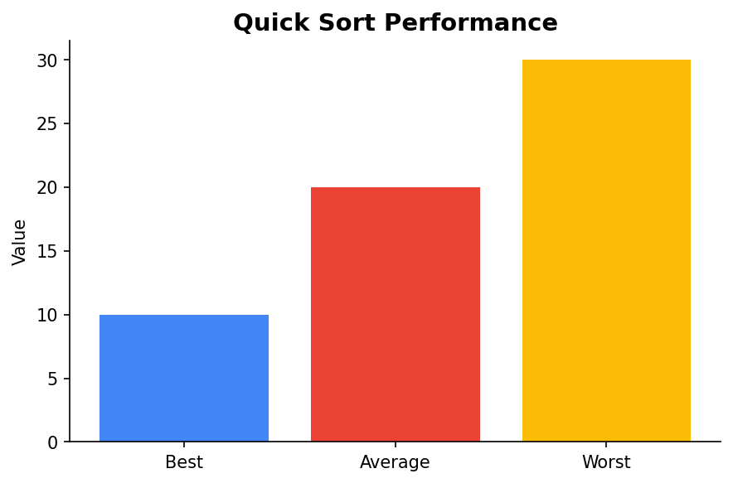
Quick Sort
Quick Sort is another divide-and-conquer algorithm. It selects a 'pivot' element from the array and partitions the other elements into two sub-arrays, according to whether they are less than or greater than the pivot.

Slide 6
Comparing Sorting Algorithms
Different sorting algorithms have varying performance in terms of time complexity. For example, Bubble Sort has a time complexity of O(n^2), while Merge Sort and Quick Sort have average time complexities of O(n log n).

Slide 7
Conclusion
Sorting algorithms are fundamental in computer science, each with its own strengths and weaknesses. Understanding these algorithms is essential for optimizing data processing tasks.

