Slide 1
Understanding Convolutional Neural Networks (CNNs)

Slide 2
The Basics of CNNs
What makes CNNs special in the world of machine learning?
- Designed to process grid-like data
- Excels in tasks such as image recognition

Slide 3
How CNNs Work
CNNs primarily utilize Convolutional and Pooling layers.
- **Convolutional Layer:** Extracts features using filters
- **Pooling Layer:** Reduces dimensionality, retaining important information

Slide 4
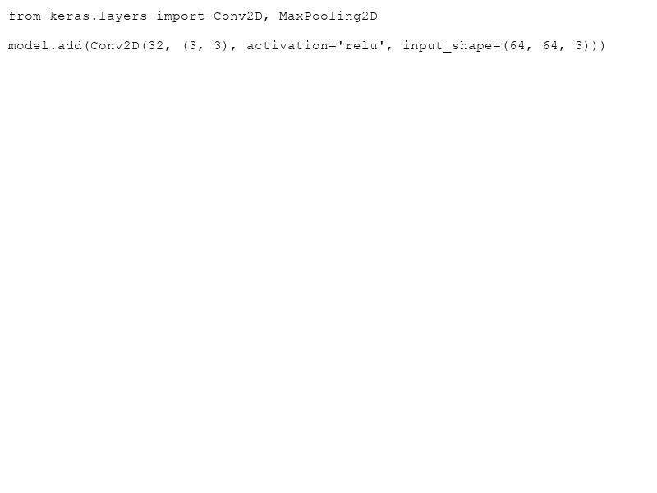
Feature Extraction with CNNs
Why use CNNs for feature extraction?
- Captures spatial hierarchies in images
- Reduces need for manual feature engineering

Slide 5
CNNs in Action: Image Recognition
CNNs are widely used in image recognition tasks like:
- Object Detection
- Semantic Segmentation
"A picture is worth a thousand words, and CNNs speak fluent picture."

Slide 6
Beyond Vision: CNN Applications
CNNs aren't just for vision tasks:
- Sound processing
- Anomaly detection
- Natural language processing

Slide 7
Common CNN Architectures
- LeNet: One of the earliest convolutional networks
- AlexNet: Popularized deep learning
- ResNet: Introduced residual connections for deeper networks
Understanding these architectures provides insights into evolutionary improvements.

Slide 8
Key Takeaways
- CNNs are powerful for grid-like data processing
- Essential in modern computer vision
- Adaptable to various data types beyond images
Remember, experimentation is key to mastering CNNs!

