Slide 1
Understanding Convolutional Neural Networks (CNNs)

Slide 2
Introduction to CNNs
Convolutional Neural Networks (CNNs) are a class of deep neural networks, most commonly applied to analyze visual imagery.
- Widely used in image and video recognition, recommender systems, and natural language processing.

Slide 3
CNN Architecture: An Overview
- Input Layer: Takes raw image data.
- Convolutional Layer: Applies filters to detect features.
- Pooling Layer: Reduces spatial dimensions, retaining important features.
- Fully Connected Layer: Combines features for prediction.

Slide 4
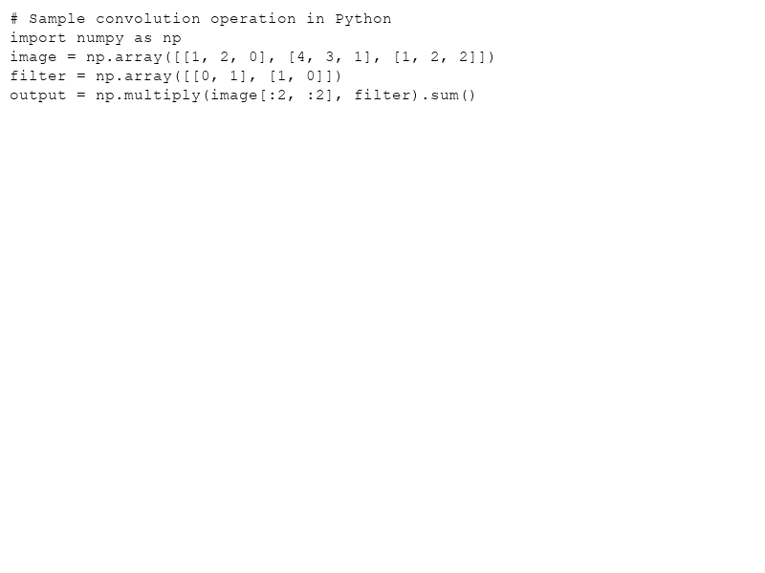
How Convolution Works
Convolutional layers apply a set of filters which activate when they detect specific features.
- Filter slides across the input.
- Each region produces a single output value.

Slide 5
Why Use CNNs?
CNNs have proven to be successful in many fields due to their:
- Translation Invariance
- Automatic Feature Extraction
- Parameter Sharing
- Hierarchical Feature Learning

Slide 6
Real-world Applications of CNNs
CNNs are integral to various innovative technologies:
- Self-driving Cars: Image and video analysis for navigation.
- Facial Recognition: Identify individuals in images or videos.
- Healthcare: Analyze medical imagery for diagnosis.

Slide 7
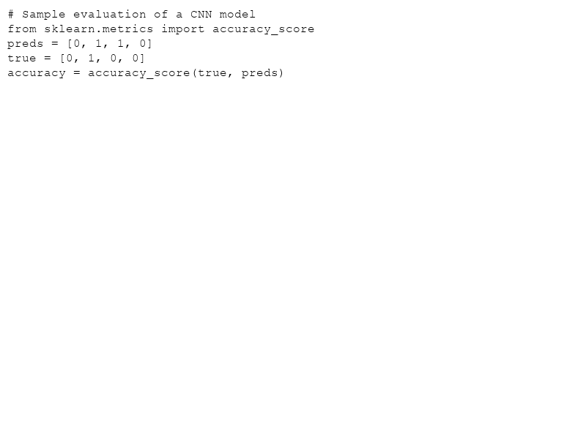
Evaluating CNNs
Key metrics include:
- Accuracy: Percentage of correct predictions.
- Recall: Ability to find all relevant cases.
- Precision: The ratio of true positive observations.

Slide 8
Conclusion and Future of CNNs
CNNs continue to evolve, with research focusing on making models:
- More Efficient: In terms of computational power.
- More Accurate: Through better architectures and training methods.
- More General: Capable of understanding diverse data types beyond images.

