Slide 1
Introduction to Linear Regression
Exploring Chapter 2: Linear Regression Concepts

Slide 2
What is Linear Regression?
Linear regression is a statistical method for modeling the relationship between a dependent variable and one or more independent variables. It is used to predict the value of the dependent variable based on the values of the independent variables.

Slide 3
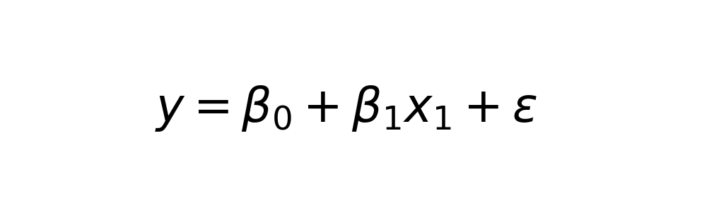
Simple vs. Multiple Linear Regression
Simple linear regression involves one independent variable, whereas multiple linear regression involves two or more independent variables. Both models aim to find the line of best fit that minimizes the error between the predicted and actual values.

Slide 4
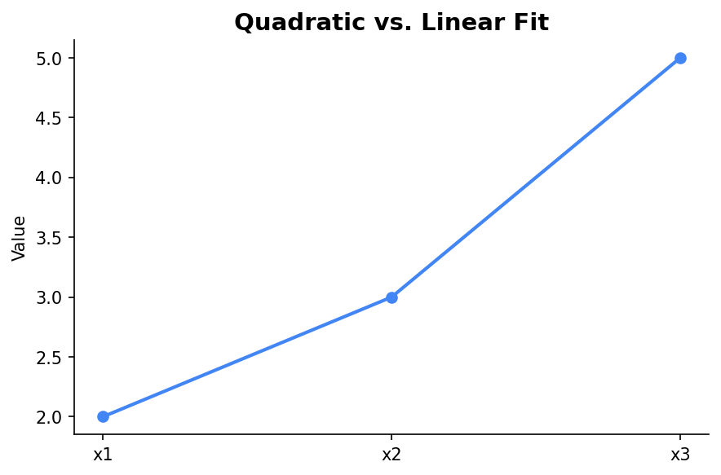
Quadratic Regression
Quadratic regression is a type of polynomial regression where the relationship between the independent variable and the dependent variable is modeled as an nth degree polynomial. It provides a better fit for certain datasets compared to linear models.

Slide 5
Understanding R-squared
R-squared is a statistical measure that represents the proportion of the variance for the dependent variable that's explained by the independent variables. A higher R-squared value indicates a better fit for the model.

Slide 6

Code Example: Implementing Linear Regression
Here's a simple Python code snippet to implement a linear regression model using Scikit-Learn. This helps in understanding how linear regression models are built and trained.

Slide 7
Conclusion
Linear regression is a foundational tool in statistical modeling and machine learning. Understanding its concepts and applications is crucial for analyzing relationships in data and making predictions.

