Slide 1
Introduction to RAG

Slide 2
What is RAG?
RAG stands for Retrieval-Augmented Generation. It is an AI approach that combines information retrieval with natural language generation to provide more accurate and relevant responses.

Slide 3
How RAG Works
- Retrieves relevant data from a knowledge base
- Generates responses based on retrieved data
- Enhances response accuracy and relevance

Slide 4
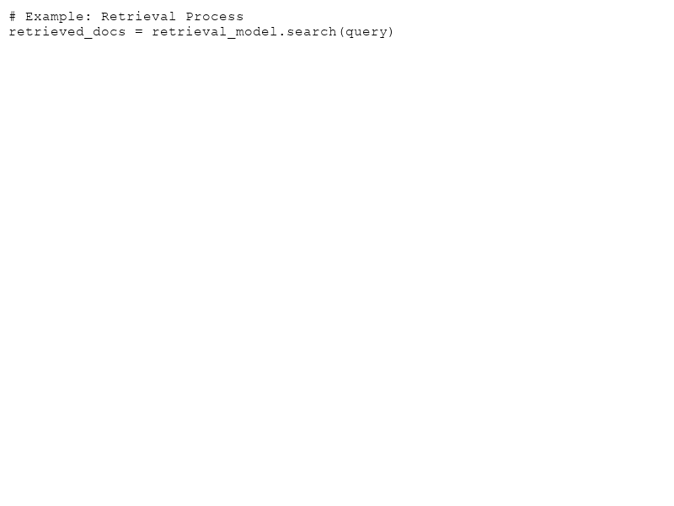
Key Components of RAG
- **Retrieval Module:** Searches database for relevant documents.
- **Generator Module:** Utilizes retrieved information for response generation.

Slide 5
Benefits of RAG
- Improves response accuracy
- Leverages existing knowledge
- Reduces reliance on massive datasets for training

Slide 6
RAG vs Traditional Models
- Traditional AI relies heavily on pre-training data.
- RAG minimizes inaccuracies by using live data retrieval.

Slide 7
RAG in Action
- **Use Case:** Customer support using RAG for real-time problem-solving by retrieving and generating responses based on a comprehensive knowledge base.

Slide 8
Conclusion and Future of RAG
RAG presents a promising evolution in AI, enabling more dynamic and context-aware interactions. As it evolves, the potential applications across various sectors make it a critical component in the future of AI.

