Slide 1
Understanding Recurrent Neural Networks (RNNs)
A Journey into Sequence Modeling

Slide 2
Introduction to RNNs
Recurrent Neural Networks (RNNs) are a class of neural networks designed for processing sequences of data. They are particularly effective for tasks where context and sequence order are important, such as language modeling and time series prediction.

Slide 3
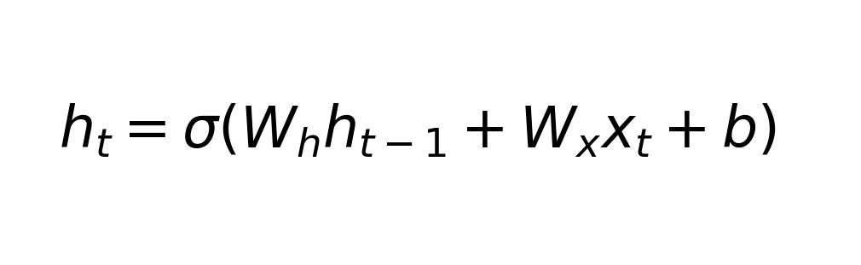
Basic Structure of RNNs
RNNs have a unique architecture that allows them to maintain a 'memory' of previous inputs, making them suitable for sequence prediction tasks. This memory is achieved through loops within the network, enabling information to persist.

Slide 4
Applications of RNNs
RNNs are used in a variety of applications, including natural language processing, speech recognition, and time series forecasting. Their ability to process sequential data makes them ideal for tasks that require understanding of context and temporal dependencies.

Slide 5
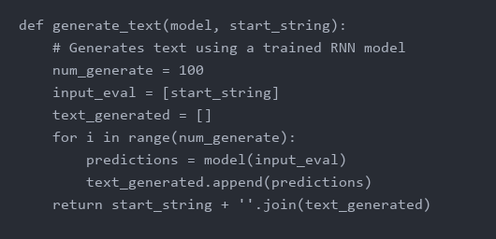
Example: Text Generation
In text generation, RNNs can be trained to predict the next word in a sequence, allowing them to generate coherent text based on a given input. This process involves learning the probability distribution of words in a given language context.

Slide 6
Challenges of Training RNNs
Training RNNs can be challenging due to issues like vanishing gradients, which can prevent the network from learning long-range dependencies. Techniques like Long Short-Term Memory (LSTM) and Gated Recurrent Units (GRU) have been developed to address these challenges.

Slide 7
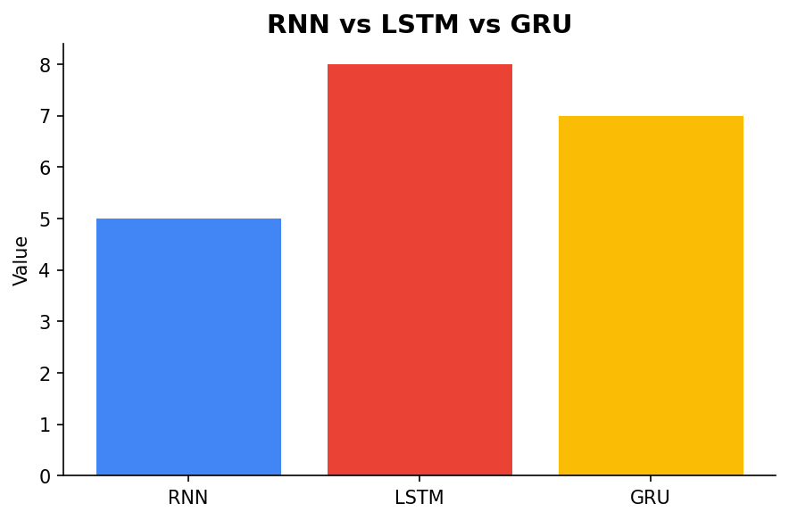
Comparing RNN Variants
Different variants of RNNs, such as LSTMs and GRUs, offer solutions to the limitations of basic RNNs. These architectures introduce mechanisms to better capture long-term dependencies by controlling the flow of information.

