Slide 1
Understanding Convolutional Neural Networks (CNNs)
A foundational guide to CNN basics

Slide 2
Introduction to CNNs
Convolutional Neural Networks (CNNs) are a class of deep neural networks, most commonly applied to analyzing visual imagery. They have been successfully used in tasks such as object recognition, image classification, and semantic segmentation.

Slide 3
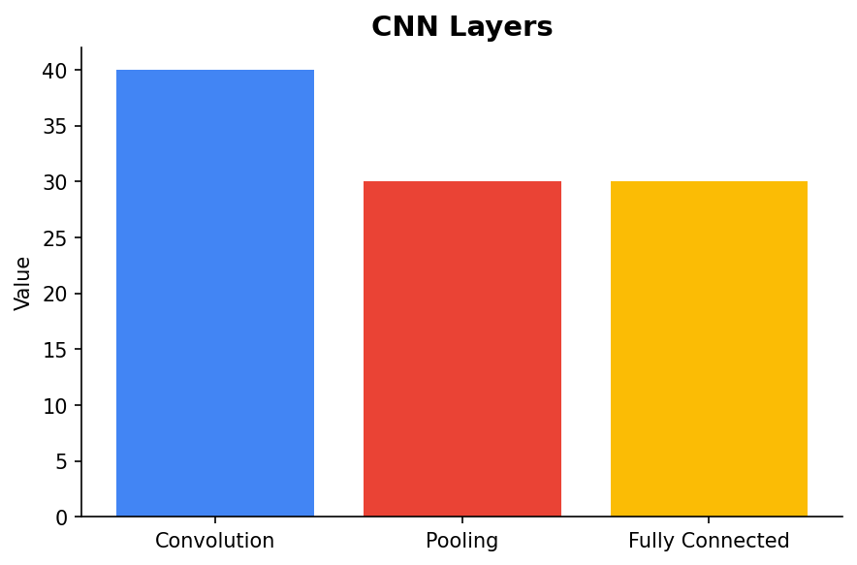
Components of CNNs
CNNs consist of several key components: convolutional layers, pooling layers, and fully connected layers. Each plays a critical role in how the network processes and learns from data.

Slide 4
How Convolution Works
The convolution operation involves a filter or kernel passing over an input image to produce a feature map. This enables the network to detect patterns such as edges and textures.

Slide 5

Pooling Layers
Pooling layers reduce the spatial dimensions of feature maps, retaining the most important information. This helps in reducing the computational cost and helps prevent overfitting.

Slide 6
Applications of CNNs
CNNs are widely used in various fields including medical imaging, autonomous vehicles, and facial recognition. Their ability to automatically learn spatial hierarchies of features from input images makes them powerful for these applications.

Slide 7
Conclusion
CNNs are a cornerstone of computer vision and deep learning. Understanding their components and functionality is crucial for leveraging their power in practical applications.

