Slide 1
Introduction to Valorant

Slide 2
What is Valorant?
Valorant is a free-to-play multiplayer tactical first-person shooter developed and published by Riot Games. Released on June 2, 2020, the game operates on a 5v5 game mode where each player assumes the control of 'agents', characters with unique abilities.

Slide 3
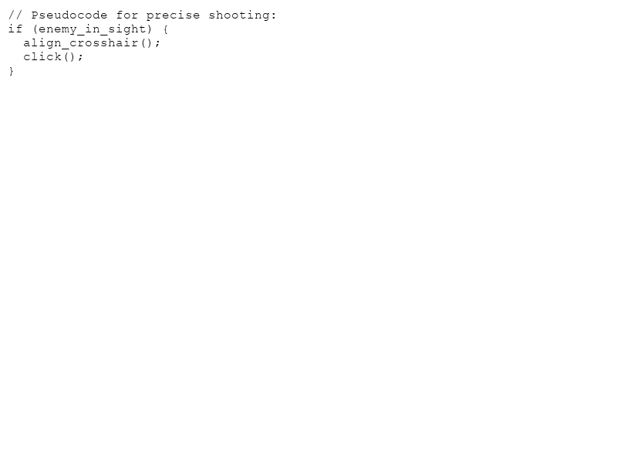
Core Gameplay Mechanics
- Teamwork and strategy
- Ability usage
- Precise shooting skills

Slide 4
Game Modes
- Unrated
- Competitive
- Spike Rush
- Deathmatch

Slide 5
Agents and Their Roles
- Duelists: Initiators in attacks
- Sentinels: Strategic defenders
- Initiators: Entry enablers
- Controllers: Area denial

Slide 6
Visual and Sound Design
Valorant emphasizes visual clarity and a distinct sound design to enhance gameplay immersion. Its graphics are optimized for performance, ensuring smooth gameplay even on lower-end systems.

Slide 7
Community and Esports
- A thriving esports scene
- Active community forums and fan content
- Regular updates and new content from Riot Games

Slide 8
Conclusion
Valorant has rapidly grown into a significant player in the gaming world due to its engaging gameplay, strategic depth, and strong community support. Whether you're a casual player or an aspiring esports competitor, Valorant offers something for everyone.

