Slide 1
Introduction to Machine Learning
Understanding the Basics and Applications

Slide 2
What is Machine Learning?
Machine learning is the design and study of software that learns from data. It allows computers to use past experiences to make future decisions, aiming to generalize rules from examples.

Slide 3

Key Concept: Generalization
Generalization is the goal of machine learning to induce an unknown rule from examples. It plays a crucial role in making predictions on new data.

Slide 4
Applications of Machine Learning
Machine learning is central to many industries, impacting areas like finance, healthcare, and autonomous systems. It is also involved in tasks considered uniquely human, such as writing and decision making.

Slide 5
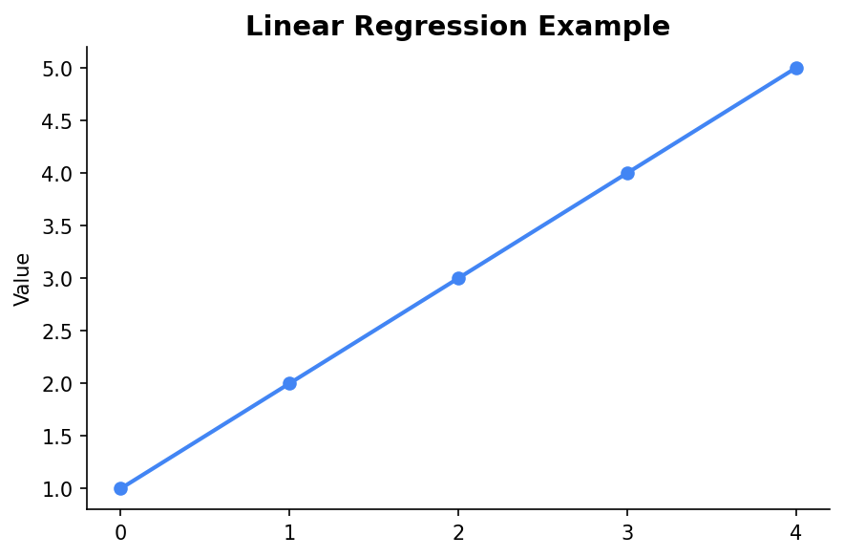
Example: Linear Regression
Linear regression is a fundamental machine learning algorithm used to predict a continuous target variable based on input features.

Slide 6
Challenges in Machine Learning
Common challenges include overfitting, underfitting, and ensuring the quality and quantity of data. Addressing these challenges is crucial for successful model deployment.

Slide 7
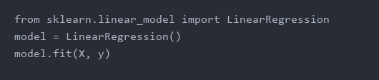
Python Code Example
Python is a popular language for implementing machine learning algorithms due to its rich ecosystem of libraries like Scikit-Learn.

Slide 8
Conclusion
Machine learning is a powerful tool for data-driven decision-making. Understanding its fundamentals and applications can unlock new opportunities across various fields.

