Slide 1
Introduction to Generative Adversarial Networks (GANs)

Slide 2
What Are GANs?
Generative Adversarial Networks (GANs) are a class of machine learning frameworks designed by Ian Goodfellow and his colleagues in 2014. GANs aim to generate new data with the same statistics as the training dataset. Unlike traditional neural networks, GANs consist of two neural networks contesting with each other in a zero-sum game.

Slide 3
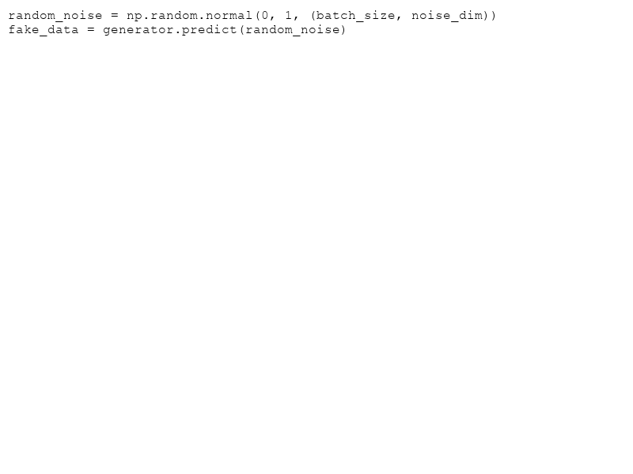
How GANs Work
GANs operate through two main components: a Generator and a Discriminator.
- **Generator**: Creates fake data from random noise.
- **Discriminator**: Evaluates data and distorts between real and fake.

Slide 4
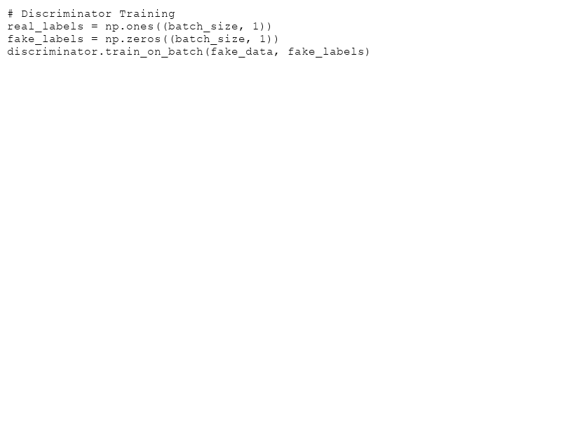
Training Process
Training alternates between:
- Training the Discriminator to appraise the real against fake data.
- Training the Generator to produce more realistic fake data.
This cyclical process leads to progressively more lifelike outcomes.

Slide 5
Why Are GANs Powerful?
Potential Applications:
- Image generation
- Video synthesis
- Data augmentation
GANs are versatile, able to produce data that mimics real-world distribution closely.

Slide 6
Ethical Considerations
While GANs hold vast potential, they also pose ethical challenges such as:
- Creating deepfakes
- Implications on privacy
- Trust in digital content
It's crucial to balance innovation with ethical responsibility.

Slide 7
Challenges in GANs
Common challenges include:
- Mode collapse: Generator produces limited varieties of samples.
- Training instability: Competition between Generator and Discriminator can lead to convergence issues.
Understanding and overcoming these challenges is key to effectively utilizing GANs.

Slide 8
Conclusion
GANs have revolutionized the field of AI with their ability to generate high-quality artificial data. Their developer community is active, constantly enhancing techniques and resolving challenges.
As quoted by Ian Goodfellow, 'If you're looking for a machine learning problem that you can spend your life working on, GANs have the deepest rabbit hole.'

