Slide 1
Understanding Convolutional Neural Networks (CNNs)
Basics, Applications, and Visual Insights

Slide 2
Introduction to CNNs
Convolutional Neural Networks (CNNs) are a class of deep learning models primarily used for analyzing visual data. They have been successfully applied to tasks like image and video recognition, image classification, and more.

Slide 3
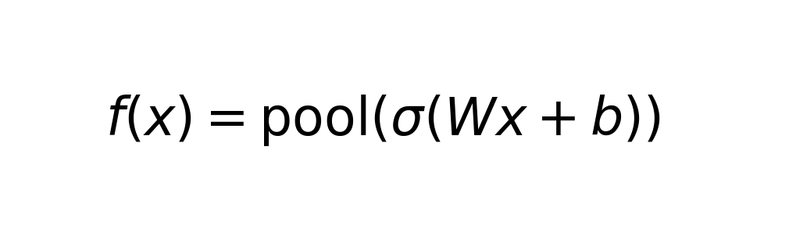
How CNNs Work
CNNs are composed of layers that automatically and adaptively learn spatial hierarchies of features from input images. They typically include convolutional layers, pooling layers, and fully connected layers.

Slide 4
Applications of CNNs
CNNs are widely used in various applications: 1. Object Detection 2. Semantic Segmentation 3. Image Classification 4. Medical Image Analysis

Slide 5
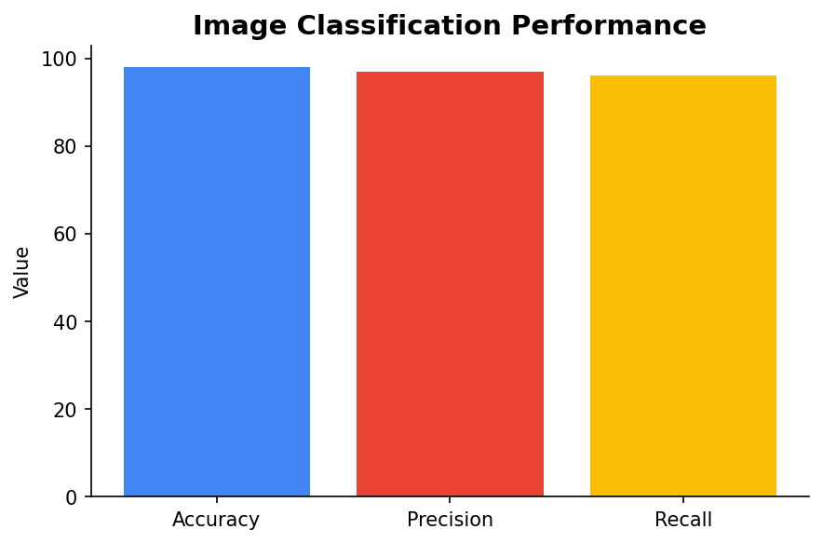
Example: Image Classification
In image classification, CNNs are used to categorize images into predefined classes. An example of this is the classification of handwritten digits using the MNIST dataset.

Slide 6
Key Components of CNNs
1. Convolutional Layers: Perform convolution operations to extract features. 2. Pooling Layers: Reduce dimensionality. 3. Fully Connected Layers: Perform classification tasks.

Slide 7
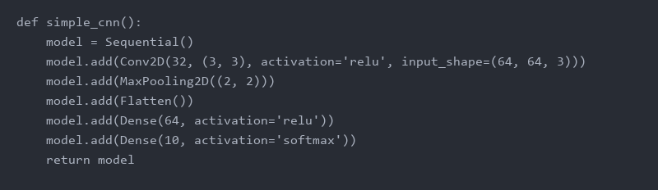
Code Example: Simple CNN with Python
Here is a basic structure of a CNN using Python and popular deep learning libraries like TensorFlow or PyTorch.

