Slide 1
Understanding Attention Mechanism
Exploring the Core Concepts and Applications

Slide 2
Introduction to Attention Mechanism
The attention mechanism is a neural network component that dynamically highlights specific parts of the input data, allowing models to focus on relevant information. This mechanism is crucial in improving the performance of models in tasks like language translation, image processing, and more.

Slide 3
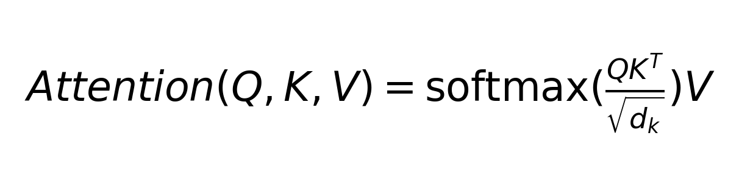
The Core Idea
Attention allows the model to weigh the importance of different input parts, similar to how humans focus on certain elements when processing information.

Slide 4
Applications of Attention
Attention mechanisms are widely used in natural language processing tasks such as translation and summarization, as well as in computer vision for image captioning and object detection.

Slide 5
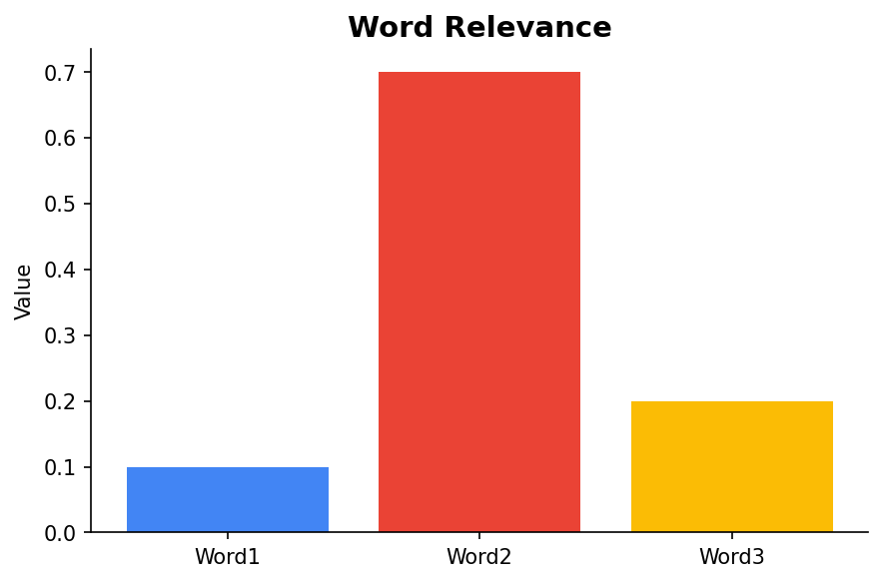
Attention in Action
Consider a language translation model where each word in a sentence is weighted differently based on its relevance to the current word being translated.

Slide 6
Types of Attention Mechanisms
There are various types of attention mechanisms, including self-attention, where a sequence's elements attend to each other, and cross-attention, where elements from one sequence attend to elements from another sequence.

Slide 7
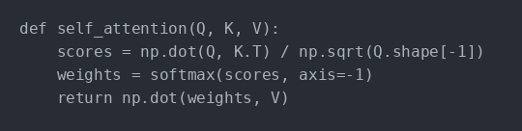
Self-attention Example
In self-attention, each word in a sentence is compared with every other word to model the relationships between them.

Slide 8
Conclusion
Attention mechanisms have revolutionized machine learning by enabling models to selectively process information, leading to significant improvements in accuracy and efficiency across various tasks.

