Slide 1
Understanding Actor-Critic in Reinforcement Learning
An educational overview of the Actor-Critic method

Slide 2
Introduction to Reinforcement Learning
Reinforcement Learning (RL) involves an agent that learns to make decisions by interacting with an environment. It receives feedback in the form of rewards and aims to maximize the cumulative reward.

Slide 3
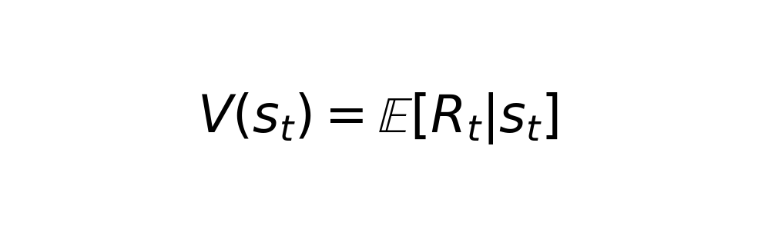
What is Actor-Critic?
Actor-Critic is a popular algorithm in RL that combines the benefits of value-based and policy-based methods. The 'actor' updates the policy by suggesting actions, while the 'critic' evaluates these actions by providing feedback.

Slide 4
The Role of the Actor
The actor in the Actor-Critic model is responsible for selecting actions based on the current policy. It uses the feedback from the critic to update and improve the policy over time.

Slide 5
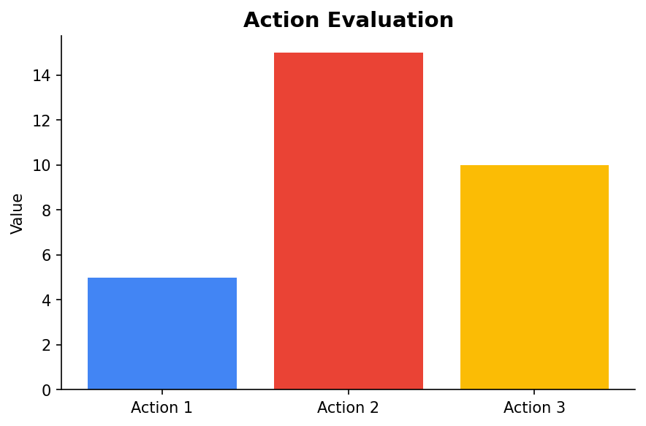
The Role of the Critic
The critic evaluates the actions taken by the actor by calculating the expected reward. This evaluation helps the actor adjust its policy to maximize future rewards.

Slide 6
Advantages of Actor-Critic
Actor-Critic methods are more sample efficient than pure policy-based methods, as they leverage the critic's value function to guide policy updates. They also provide more stable learning by reducing variance in the updates.

Slide 7
Summary
Actor-Critic is a hybrid approach that combines the strengths of value-based and policy-based methods in reinforcement learning. By employing both an actor and a critic, it efficiently learns optimal policies while maintaining learning stability.

