Slide 1
Understanding Linear Regression
An Introduction to Simple Linear Regression

Slide 2
What is Linear Regression?
Linear regression is a statistical method used to model and analyze the relationships between a dependent variable and one or more independent variables. It helps in predicting the value of the dependent variable based on the values of the independent variables.

Slide 3

Simple Linear Regression
Simple linear regression involves a single explanatory variable and models the relationship as a straight line. It is the foundation for more complex regression models.

Slide 4
Applications of Linear Regression
Linear regression is used in various fields such as economics for forecasting, biology for growth modeling, and engineering for quality control. It provides insights into how changes in predictors impact the outcome variable.

Slide 5
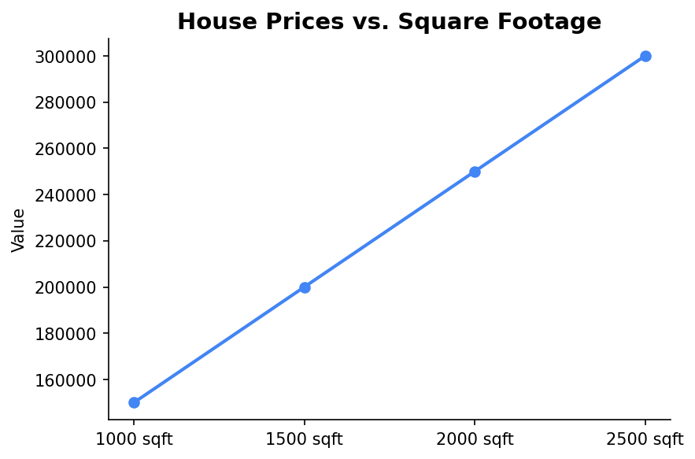
Example of Linear Regression
Consider a dataset where we predict house prices based on square footage. The relationship can be visualized and analyzed using linear regression.

Slide 6
Key Concepts in Linear Regression
Key concepts include the slope and intercept of the line, the coefficient of determination (R²), and residuals. These help in understanding the accuracy and reliability of the model.

Slide 7
Conclusion
Linear regression is a powerful tool for modeling relationships between variables. Understanding its fundamentals is crucial for exploring more advanced statistical models.

