Slide 1
Understanding Naive Bayes
A Probabilistic Approach to Classification

Slide 2
Introduction to Bayes' Theorem
Bayes' theorem is a foundational concept in probability that describes the probability of an event based on prior knowledge of related events. It forms the basis for the Naive Bayes classifier, which is used in machine learning for classification tasks.

Slide 3
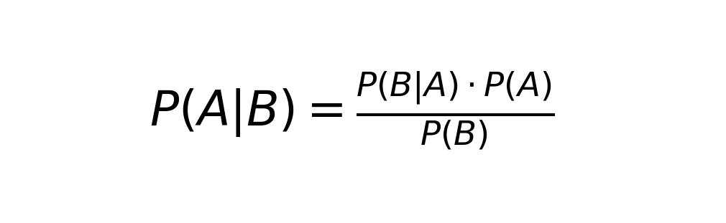
Formula of Bayes' Theorem
Bayes' theorem can be expressed as P(A|B) = [P(B|A) * P(A)] / P(B). This formula calculates the probability of event A occurring given that event B is true.

Slide 4
Naive Bayes Assumptions
Naive Bayes assumes that the features used in classification are independent of each other. This assumption simplifies the computation and is often effective even when the independence assumption is violated.

Slide 5
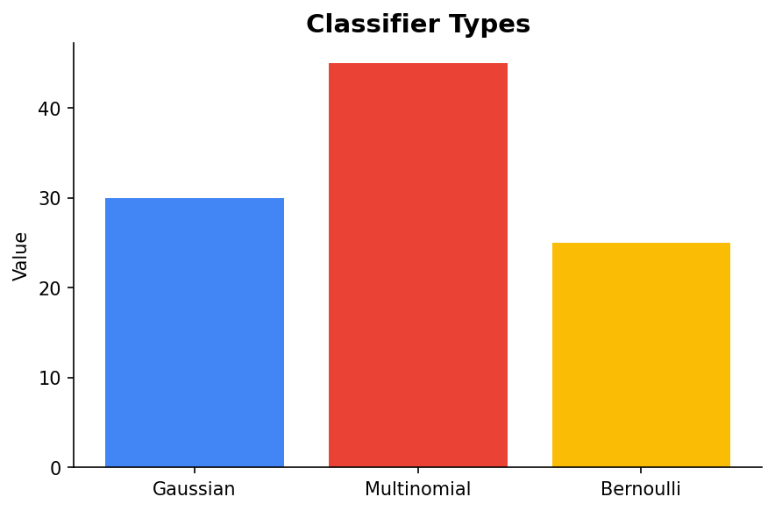
Types of Naive Bayes Classifiers
There are several types of Naive Bayes classifiers including Gaussian, Multinomial, and Bernoulli. Each is suited for different types of data and applications.

Slide 6
Application Example: Text Classification
Naive Bayes is widely used in text classification due to its simplicity and effectiveness. It can be employed to classify emails as spam or not spam based on the frequency of words.

Slide 7
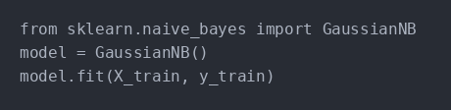
Example Code: Naive Bayes with Scikit-Learn
Scikit-Learn, a popular Python library, provides easy-to-use tools to implement Naive Bayes classifiers. Here is a basic example of using Scikit-Learn for classification.

Slide 8
Conclusion
Naive Bayes is a powerful and efficient algorithm for classification tasks in machine learning. Despite its simplicity and assumption of feature independence, it provides robust results in various applications.

