Slide 1
K-Means Clustering
Understanding the Basics and Applications

Slide 2
Introduction to K-Means
K-Means is a popular clustering algorithm known for its speed and scalability. It involves partitioning data into K distinct clusters based on feature similarity.

Slide 3
How K-Means Works
The algorithm iteratively assigns data points to clusters and adjusts the cluster centroids. The goal is to minimize the variance within each cluster and achieve convergence.

Slide 4
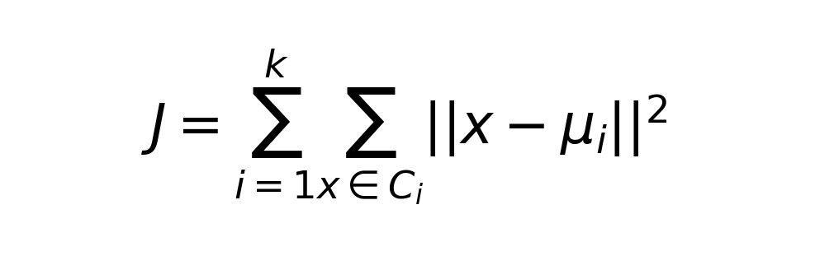
Mathematical Representation
K-Means aims to minimize the sum of squared distances between data points and their respective cluster centroids.

Slide 5
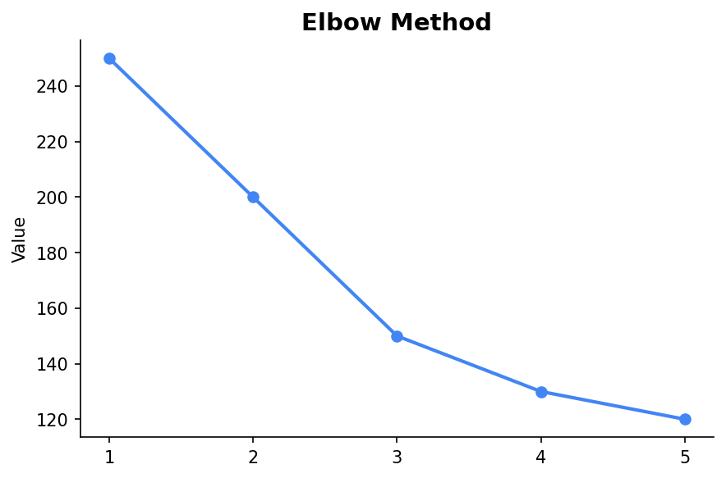
Choosing the Right K
Selecting the number of clusters (K) is crucial. It can be determined using methods like the Elbow Method, which evaluates the sum of squared errors for different K values.

Slide 6
Practical Applications
K-Means is widely used in market segmentation, image compression, and pattern recognition. It helps in identifying natural groupings in data.

Slide 7
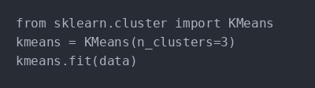
Python Code Example
Here's a basic implementation of K-Means clustering using Python's scikit-learn library.

Slide 8
Conclusion
K-Means is an efficient clustering technique suitable for large datasets. However, it requires careful selection of K and initial centroids to achieve optimal results.

