Slide 1
Understanding Transformers
A Comprehensive Guide to Polynomial Feature Transformation

Slide 2
Introduction to Transformers
Transformers are used to alter data representations. This can include converting linear features into polynomial features to improve model performance.

Slide 3
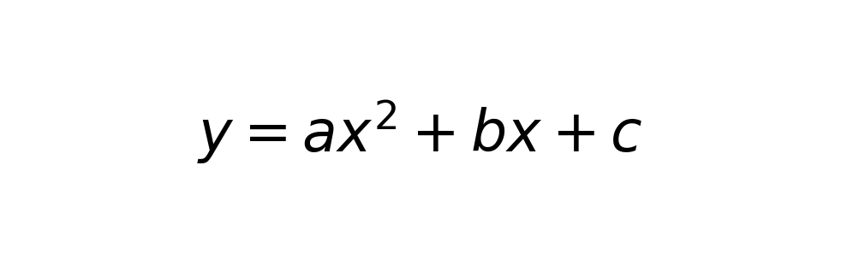
Polynomial Feature Transformation
By transforming the data into polynomial features, we can capture nonlinear relationships in the data that simple linear models might miss.

Slide 4
Implementation in Python
Using Python's sklearn library, we can easily apply polynomial transformations. This involves creating a PolynomialFeatures object and fitting it to our data.

Slide 5
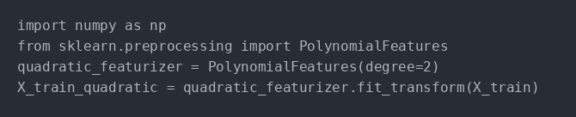
Code Example
Here's a Python code snippet to demonstrate polynomial transformation and comparing it with linear regression.

Slide 6
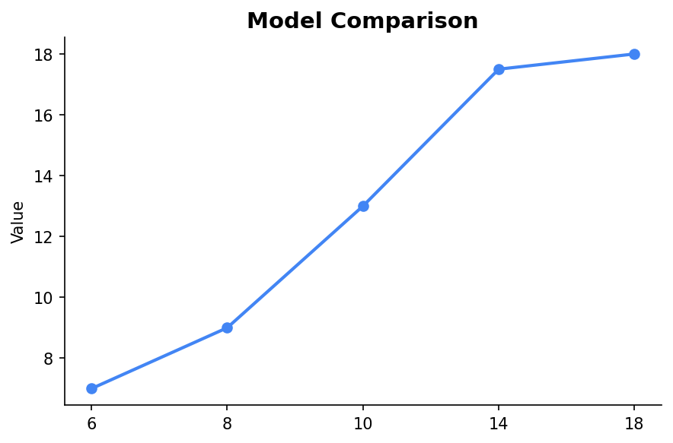
Model Comparison
The chart below compares predictions of a linear model versus a polynomial model, highlighting the improved fit of the latter.

Slide 7
Conclusion
Transformers, particularly polynomial transformers, are powerful tools for enhancing model predictions by capturing complex patterns in the data.

