Slide 1
Understanding Decision Trees
A Guide to Decision Trees in Machine Learning

Slide 2
Introduction to Decision Trees
Decision trees are a nonlinear model used for classification and regression tasks. They mimic human decision-making processes by breaking down data into smaller subsets while at the same time developing an associated decision tree incrementally.

Slide 3

Structure of Decision Trees
A decision tree is composed of nodes representing decisions, branches representing outcomes, and leaf nodes representing final decisions or classifications.

Slide 4
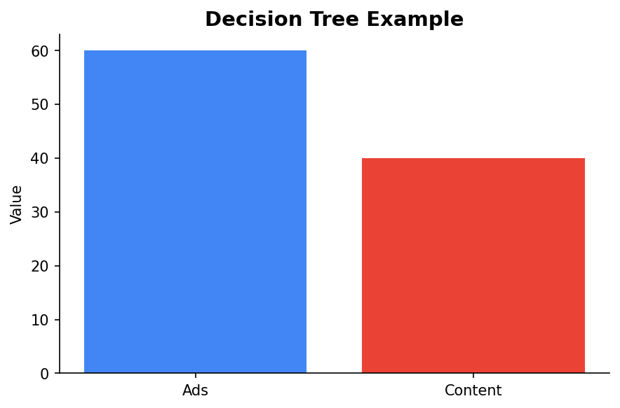
Example: Building an Ad Blocker
Decision trees can be used to classify images on a webpage as banner advertisements or page content, demonstrating their applicability in real-world scenarios.

Slide 5
Advantages of Decision Trees
They are simple to understand and interpret, require little data preparation, and can handle both numerical and categorical data.

Slide 6
Limitations of Decision Trees
Decision trees can be prone to overfitting, especially with complex trees. They can be unstable with small variations in data leading to a different tree being generated.

Slide 7
Conclusion
While decision trees are not frequently used independently in practice, they are crucial components of more sophisticated models like random forests and boosting algorithms, making their understanding essential.

