Slide 1
Understanding Markov Decision Process (MDP)
A Comprehensive Guide to MDP in Reinforcement Learning

Slide 2
Introduction to MDP
Markov Decision Process (MDP) is a mathematical framework for modeling decision-making where outcomes are partly random and partly under the control of a decision maker. It provides a formalization of sequential decision making.

Slide 3
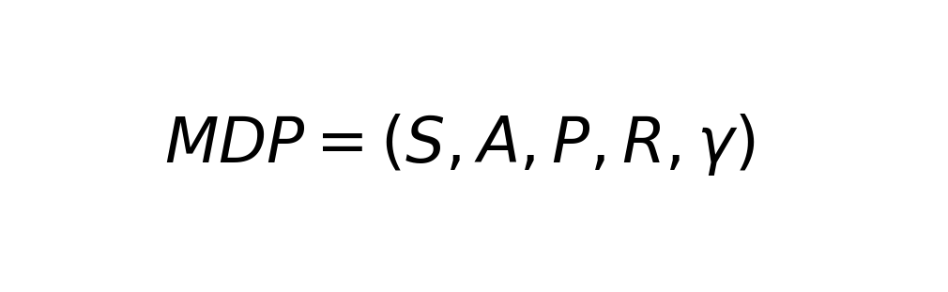
Components of MDP
An MDP consists of states, actions, transition model, and a reward function. These components work together to model the environment and the agent's interaction with it.

Slide 4
State and Action
The state represents the current situation or configuration of the environment. An action is a decision taken by the agent that affects the state of the environment. Transition probabilities determine the likelihood of moving from one state to another after an action.

Slide 5
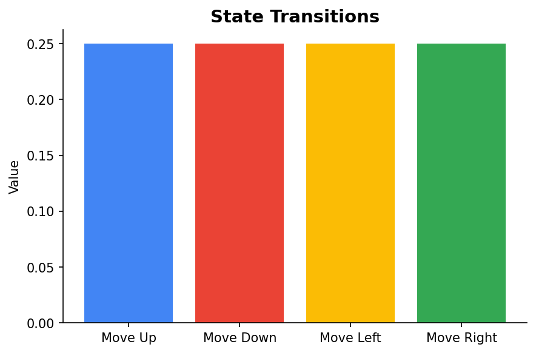
Example: Grid World
Consider a grid world where an agent navigates a grid to reach a goal. Each cell represents a state, and actions are movements in the grid. The agent receives a reward for reaching the goal.

Slide 6
Policy and Value Function
A policy is a strategy that defines the actions to be taken based on the current state. The value function estimates the expected return of a state, helping to evaluate how good a state is under a policy.

Slide 7
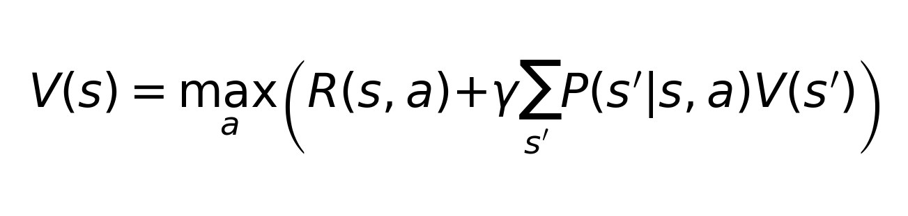
Bellman Equation
The Bellman Equation is fundamental in solving MDPs. It provides a recursive decomposition of the value function, allowing for efficient computation of optimal policies.

Slide 8
Conclusion
Markov Decision Processes provide a robust framework for modeling decision making in uncertain environments, forming the basis for many reinforcement learning algorithms.

