Slide 1
Understanding Bias-Variance Tradeoff
A Key Concept in Machine Learning Model Evaluation

Slide 2
Introduction to Bias and Variance
Bias and variance are two errors that affect the performance of machine learning models. Bias refers to the error due to overly simplistic assumptions in the learning algorithm, while variance refers to the error due to excessive sensitivity to small fluctuations in the training dataset.

Slide 3
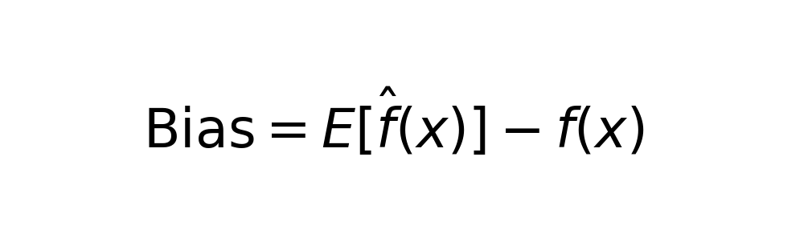
Bias Explained
High bias can lead to underfitting, where the model is too simple to capture the underlying trend of the data. It assumes a strong relationship structure that may not exist.

Slide 4
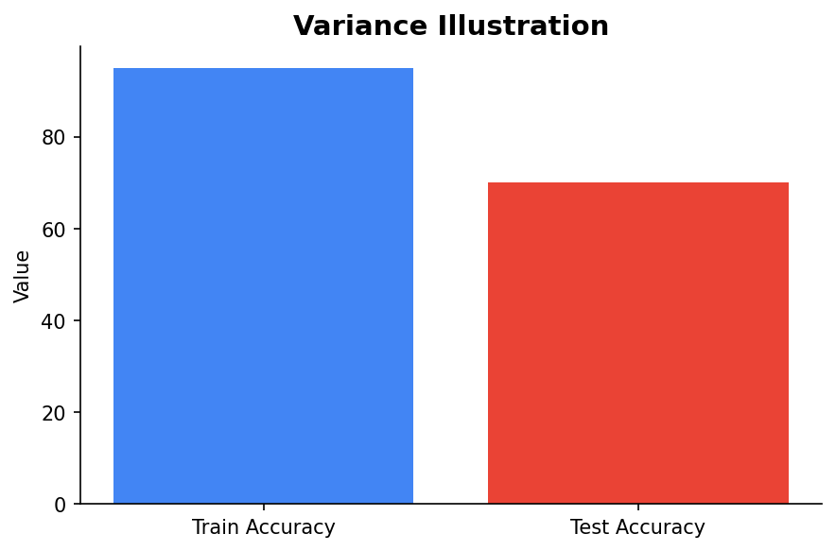
Variance Explained
High variance can lead to overfitting, where the model learns the noise in the training data. It results in a model that performs well on training data but poorly on unseen data.

Slide 5
Balancing Bias and Variance
The goal is to find a good balance between bias and variance, achieving optimal model complexity. This balance is known as the Bias-Variance Tradeoff.

Slide 6

Bias-Variance Tradeoff Visualized
Imagine darts on a dartboard. High bias and low variance: darts are clustered but far from the center. High variance and low bias: darts spread out, capturing noise.

Slide 7
Conclusion
Understanding and managing the bias-variance tradeoff is essential in building robust machine learning models. It helps in achieving better generalization and improved performance on unseen data.

