Slide 1
Understanding Logistic Regression
A Comprehensive Guide to Logistic Regression in Machine Learning

Slide 2
Introduction to Logistic Regression
Logistic regression is a statistical method for analyzing datasets in which there are one or more independent variables that determine an outcome. The outcome is measured with a dichotomous variable (in which there are only two possible outcomes).

Slide 3
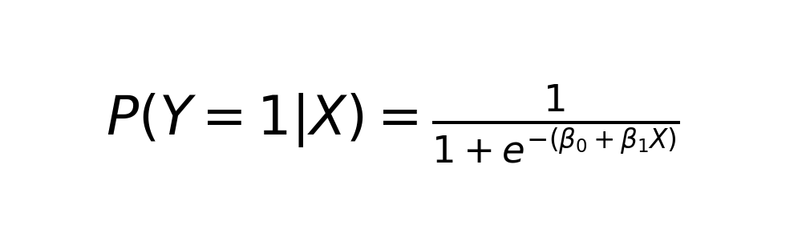
Mathematical Foundation
Logistic regression uses the logistic function to model a binary dependent variable. The formula used in logistic regression is a transformation of the linear regression equation.

Slide 4
Applications of Logistic Regression
Logistic regression can be used for various applications such as credit scoring, disease diagnosis, and marketing response prediction. Its ability to classify data into distinct categories makes it an invaluable tool for binary classification problems.

Slide 5
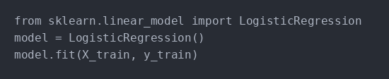
Example: Sentiment Analysis
In sentiment analysis, logistic regression can be used to classify text as positive or negative. The model learns from labeled data and predicts the sentiment of new, unseen text.

Slide 6
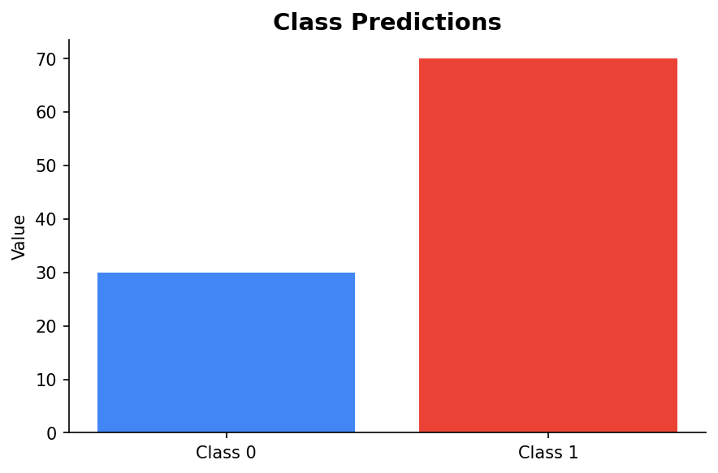
Visualizing Data
Visual representation of logistic regression can help in understanding the decision boundary that separates different classes. Here is an example of a bar chart comparing different class predictions.

Slide 7
Conclusion and Key Takeaways
Logistic regression is a powerful tool for binary classification tasks. It is important to understand its mathematical foundation and applications to effectively utilize this technique in real-world scenarios.

