Slide 1
Understanding Gradient Descent
An introduction to the algorithm driving machine learning optimization

Slide 2
What is Gradient Descent?
Gradient Descent is an optimization algorithm used to minimize a function by iteratively moving towards the steepest descent as defined by the negative of the gradient. It's a core algorithm behind training models in machine learning.

Slide 3
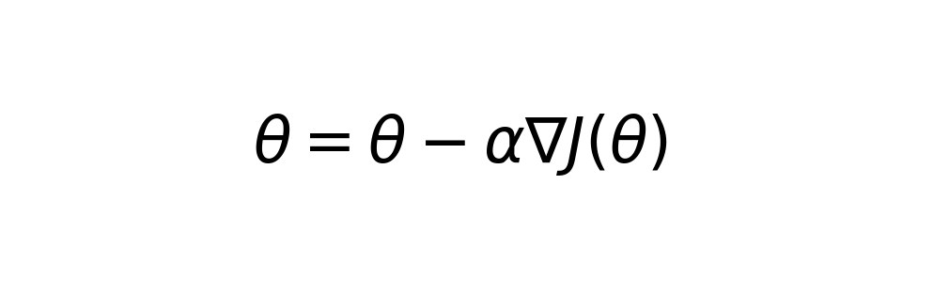
Mathematical Foundation
Gradient Descent involves updating parameters by taking steps proportional to the negative of the gradient of the function at the current point.

Slide 4
Types of Gradient Descent
1. **Batch Gradient Descent**: Uses all training instances for each update. 2. **Stochastic Gradient Descent (SGD)**: Uses one training instance per update, selected randomly. 3. **Mini-batch Gradient Descent**: Uses a small batch of training instances per update.

Slide 5
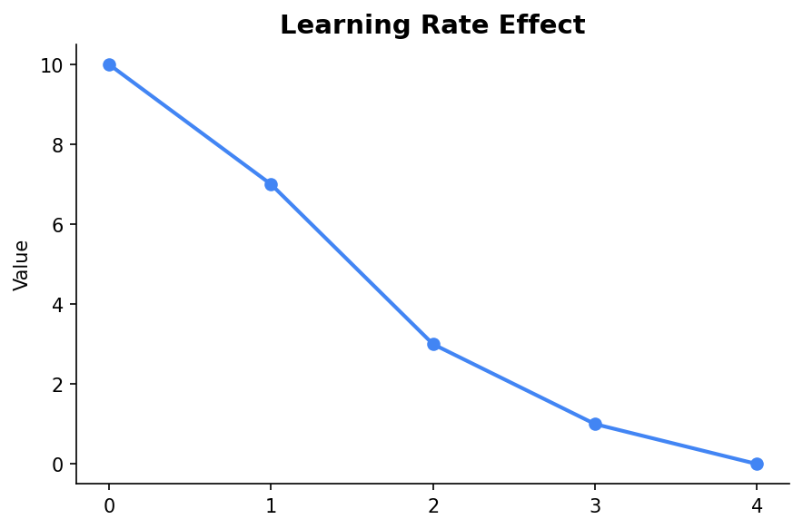
Learning Rate Importance
The learning rate determines the size of the steps taken towards the minimum. A small learning rate may lead to a long convergence time, while a large one might overshoot the minimum.

Slide 6
Applications in Machine Learning
Gradient Descent is widely used in training machine learning models, particularly in neural networks, where it helps to optimize the weights for better predictions.

Slide 7
Conclusion
Gradient Descent is a fundamental algorithm for optimization in machine learning. Understanding its types, the role of learning rate, and its applications can significantly enhance the efficiency of model training.

