Slide 1
Understanding Random Forests
A Comprehensive Guide to Random Forests in Machine Learning

Slide 2
Introduction to Random Forests
Random forests are an ensemble learning method for classification and regression. They operate by constructing multiple decision trees during training and outputting the mode of classes or mean prediction of individual trees.

Slide 3
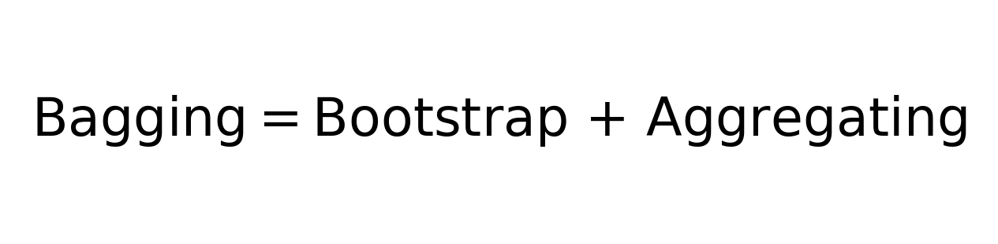
The Role of Bagging in Random Forests
Bagging, or Bootstrap Aggregating, is a technique used in random forests to improve the stability and accuracy of machine learning algorithms. It reduces variance and helps to avoid overfitting.

Slide 4
Hyperparameters in Random Forests
Key hyperparameters include the number of trees and the number of features to consider when looking for the best split. Increasing trees generally improves performance but also increases computational demands.

Slide 5
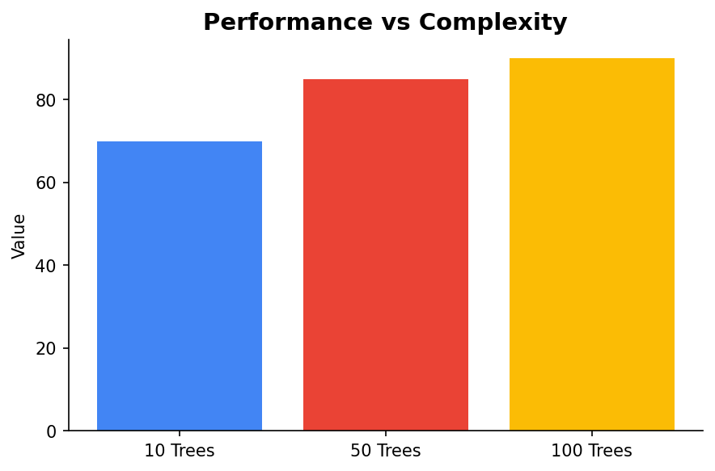
Performance and Complexity Trade-off
Increasing the number of trees improves model performance but at a cost of higher computational complexity. Regularization techniques become less critical, as the ensemble nature of forests provides inherent regularization.

Slide 6
Advantages of Random Forests
Random forests are robust against overfitting, handle large datasets efficiently, and maintain accuracy even with a large number of missing values. They also rank the importance of variables naturally.

Slide 7
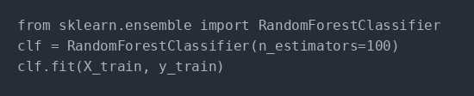
Example Code: Building a Random Forest
Here is a simple example of building a random forest classifier using Python's scikit-learn library.

