Slide 1
Understanding Overfitting and Regularization
Balancing Model Complexity and Generalization

Slide 2
Introduction to Overfitting
Overfitting occurs when a machine learning model learns the training data too well, capturing noise and exceptions. This results in poor performance on new, unseen data as the model fails to generalize.

Slide 3
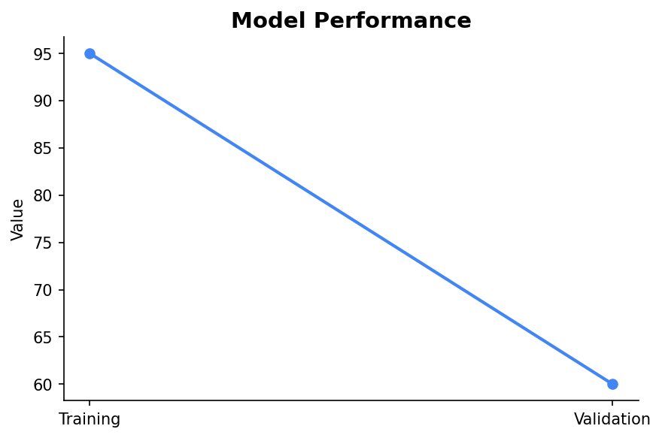
Identifying Overfitting
A clear sign of overfitting is when a model performs exceptionally well on training data but poorly on validation or test data. This indicates the model has memorized rather than learned.

Slide 4
Introduction to Regularization
Regularization is a technique used to prevent overfitting by adding a penalty to the model's complexity. This encourages simpler models that generalize better to new data.

Slide 5
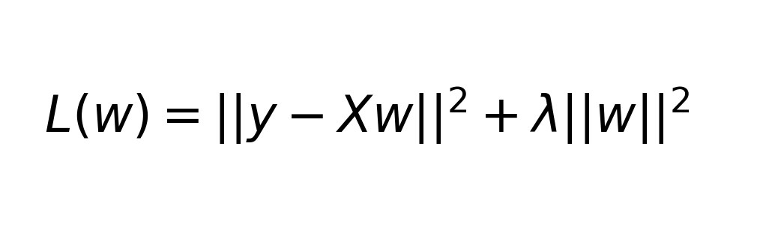
L2 Regularization
Also known as Ridge Regression, L2 Regularization adds a penalty equal to the square of the magnitude of coefficients. This discourages overly complex models.

Slide 6
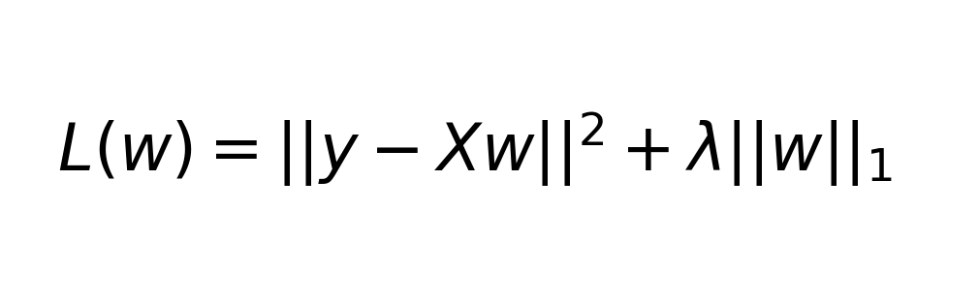
L1 Regularization
L1 Regularization, or Lasso Regression, adds a penalty equal to the absolute value of the coefficients. It can lead to sparse models with some coefficients exactly zero.

Slide 7
Conclusion
Understanding and addressing overfitting is crucial for developing robust machine learning models. Regularization techniques like L1 and L2 help balance model complexity and generalization.

