Slide 1
An Introduction to Actor-Critic Methods
Understanding the Role of Actor-Critic in Reinforcement Learning

Slide 2
What is Actor-Critic?
Actor-Critic methods combine two types of reinforcement learning agents: the Actor, which decides which action to take, and the Critic, which evaluates the action based on a given policy. This setup helps in improving the stability and efficiency of learning.

Slide 3

The Actor's Role
The Actor is responsible for selecting actions based on the current policy. It updates the policy in the direction suggested by the Critic's feedback.

Slide 4
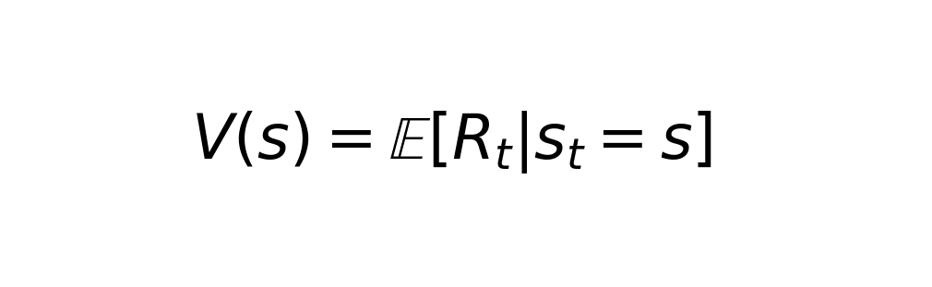
The Critic's Role
The Critic evaluates the actions taken by the Actor using a value function, which estimates the return or benefit of those actions.

Slide 5
Advantages of Actor-Critic Methods
Actor-Critic methods can converge faster than traditional methods. They leverage both the advantages of value-based and policy-based methods, providing a more stable learning process and better policy optimization.

Slide 6
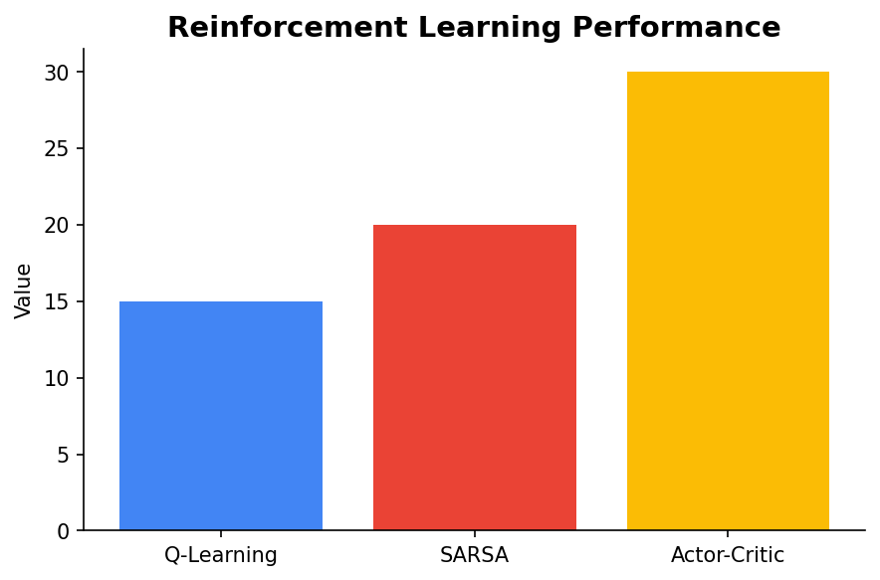
Visualizing Actor-Critic
Let's look at a simple comparison of performance between different reinforcement learning methods including Actor-Critic.

Slide 7
Conclusion
Actor-Critic methods provide a robust framework in reinforcement learning by effectively utilizing both actors and critics. They are widely used in complex environments due to their balance of exploration and exploitation.

