Slide 1
Understanding K-Nearest Neighbors (KNN)
A Comprehensive Guide to KNN in Machine Learning

Slide 2
Introduction to KNN
KNN is a non-parametric, instance-based learning algorithm used for classification and regression. It assumes that similar instances have similar outputs.

Slide 3
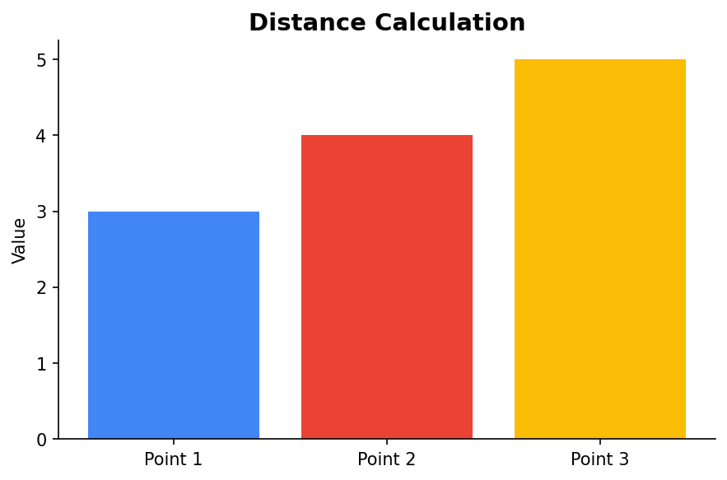
How KNN Works
KNN predicts the output for a new data point by considering the 'k' closest data points from the training data. It uses distance metrics like Euclidean distance to identify these neighbors.

Slide 4
Parametric vs Non-Parametric
Unlike parametric models, KNN does not assume any underlying data distribution, making it flexible but computationally expensive as it grows with the dataset size.

Slide 5
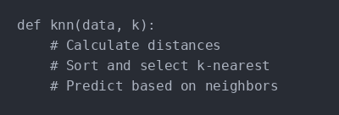
KNN Algorithm Steps
1. Choose the number of neighbors 'k'. 2. Calculate the distance between the new instance and all training samples. 3. Sort the distances and select the 'k' nearest neighbors. 4. For classification, use a majority vote; for regression, calculate the mean.

Slide 6
Advantages and Disadvantages
Advantages: Simple and effective for small datasets, no training phase. Disadvantages: Computationally expensive for large datasets, sensitive to irrelevant features.

Slide 7
Applications of KNN
KNN is widely used in recommendation systems, image recognition, and anomaly detection due to its simplicity and effectiveness in high-dimensional spaces.

