Slide 1
Understanding Q-Learning
A Deep Dive into Reinforcement Learning

Slide 2
Introduction to Q-Learning
Q-Learning is a model-free reinforcement learning algorithm used to find the optimal action-selection policy for a given finite Markov decision process. It is an off-policy learner that aims to learn the quality of actions, denoted as Q-values.

Slide 3
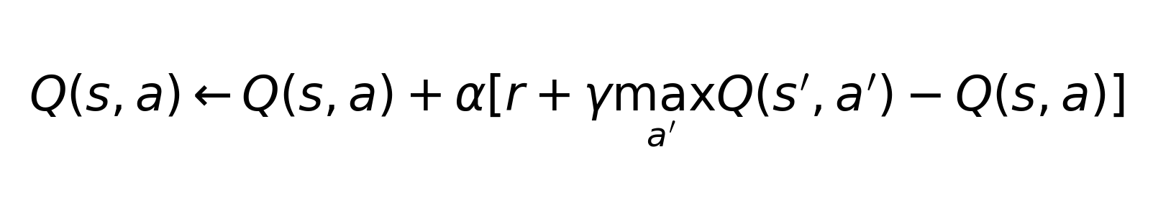
The Q-Learning Algorithm
The Q-Learning algorithm updates the Q-values using the Bellman equation. This involves adjusting the Q-value for a state-action pair based on the reward received and the maximum expected future rewards.

Slide 4
Exploration vs. Exploitation
A central challenge in Q-Learning is balancing exploration (trying new actions) and exploitation (choosing actions with known high rewards). Various strategies like epsilon-greedy are used to achieve this balance.

Slide 5
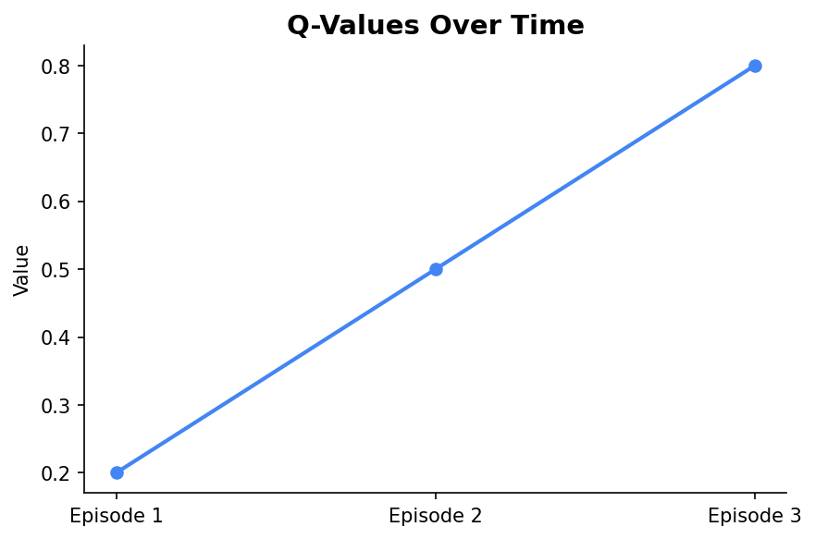
Example: Grid World
Consider a simple grid world where an agent must navigate to a goal. Q-Learning helps the agent learn optimal paths by updating Q-values based on rewards received upon reaching the goal.

Slide 6
Advantages and Limitations
Q-Learning is simple and effective for small state spaces but can be computationally expensive for larger problems. It also requires careful tuning of parameters like learning rate and discount factor.

Slide 7
Conclusion
Q-Learning is a foundational algorithm in reinforcement learning, offering a flexible approach to learning optimal policies. Its concepts are essential for understanding more advanced topics in machine learning.

