Slide 1
Understanding Support Vector Machines
A Comprehensive Guide to SVM

Slide 2
Introduction to SVM
Support Vector Machines (SVM) are supervised learning models used for classification and regression analysis. They work by finding the hyperplane that best divides a dataset into classes.

Slide 3

Hyperplane Concept
The hyperplane is a decision boundary that separates different classes in the data. The goal of SVM is to find the hyperplane with the maximum margin between the classes.

Slide 4
Kernel Trick
SVM can efficiently perform a nonlinear classification using the kernel trick, implicitly mapping their inputs into high-dimensional feature spaces.

Slide 5
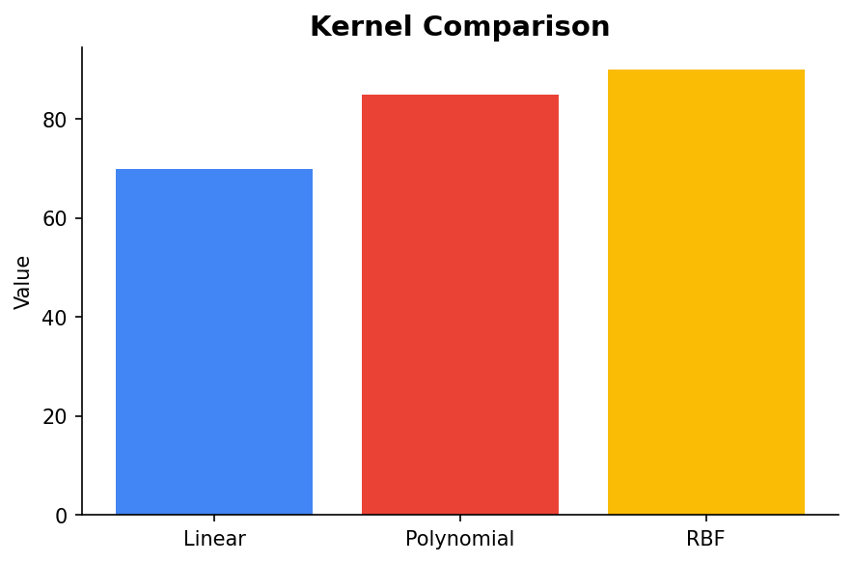
Types of Kernels
Common kernel functions include linear, polynomial, and Gaussian radial basis function (RBF). Each kernel transforms the data in different ways to find the optimal hyperplane.

Slide 6
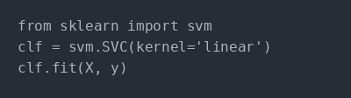
Example Code
Here's a basic example of how to implement an SVM in Python using Scikit-Learn.

Slide 7
Conclusion
SVM is a powerful tool for classification and regression. It is particularly effective in high-dimensional spaces and versatile due to the use of kernel functions.

