Slide 1
Understanding PCA
Principal Component Analysis Explained

Slide 2
Introduction to PCA
Principal Component Analysis (PCA) is a dimensionality reduction technique used to emphasize variation and bring out strong patterns in a dataset. It achieves this by transforming the dataset into a set of linearly uncorrelated variables known as principal components.

Slide 3

The Concept of PCA
PCA projects data from a high-dimensional space to a lower-dimensional space. This is done to retain as much of the variance as possible. By aligning the dataset with its principal components, PCA maximizes the variance contained within the first few components.

Slide 4
Why Use PCA?
PCA is used to simplify data, reduce noise, and enhance interpretability while preserving as much information as possible. It is often used in exploratory data analysis and for making predictive models more efficient.

Slide 5
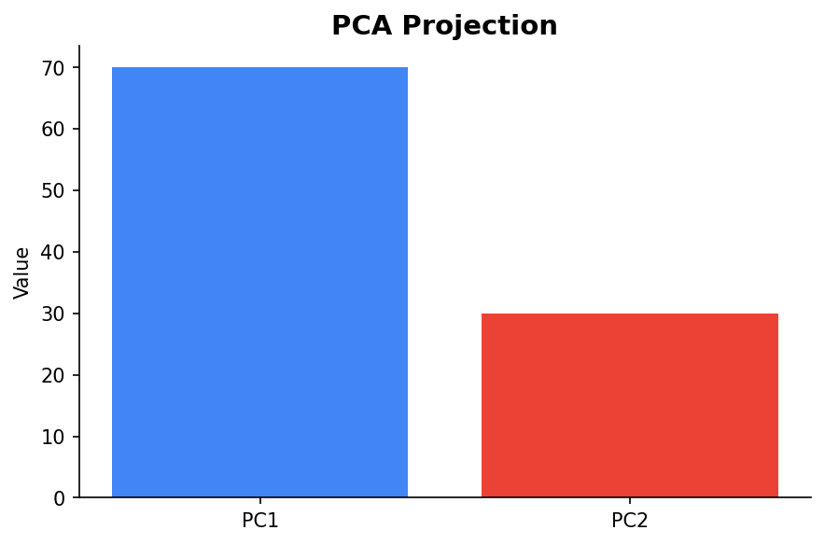
PCA in Action
Consider a dataset plotted in a 2D space forming a long, thin ellipse. PCA will align its principal components with the direction of maximum variance, reducing the dimensionality effectively.

Slide 6
Steps in PCA
1. Standardize the data. 2. Compute the covariance matrix. 3. Calculate the eigenvectors and eigenvalues. 4. Sort eigenvectors by decreasing eigenvalues. 5. Choose k eigenvectors and form a matrix W. 6. Transform the original dataset X using W.

Slide 7
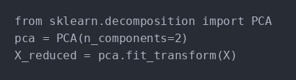
PCA Code Example
Here is a simple Python code snippet to perform PCA using Scikit-learn:

Slide 8
Conclusion
PCA is a powerful tool for data analysis and preprocessing that helps in reducing dimensionality, simplifying models, and highlighting important relationships in the data.

