Slide 1
Understanding RNNs and LSTMs
A Deep Dive into Recurrent Neural Networks

Slide 2
Introduction to RNNs
Recurrent Neural Networks (RNNs) are a class of neural networks designed to recognize patterns in sequences of data such as text, genomes, handwriting, or the spoken word. Unlike traditional neural networks, RNNs have a memory which allows them to maintain information about previous inputs in the sequence.

Slide 3
Challenges with Standard RNNs
Standard RNNs struggle with long-term dependencies due to the vanishing gradient problem. This limitation prevents them from effectively learning long-range dependencies in the data sequences.

Slide 4
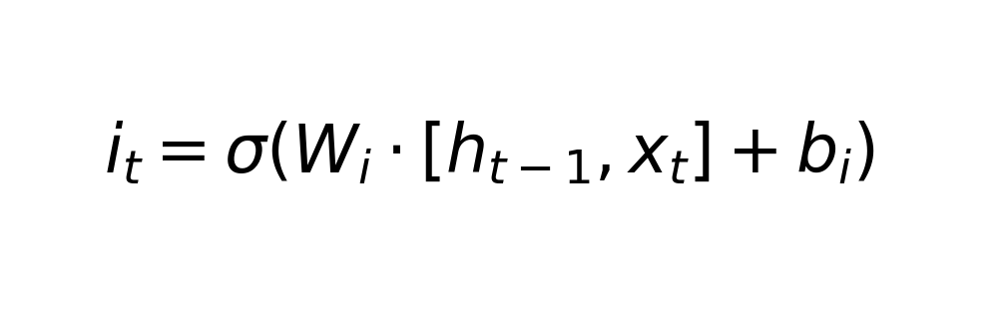
LSTM: Solution to Long-Term Dependencies
Long Short-Term Memory (LSTM) networks are a type of RNN that can learn long-term dependencies. They are explicitly designed to avoid the long-term dependency problem.

Slide 5
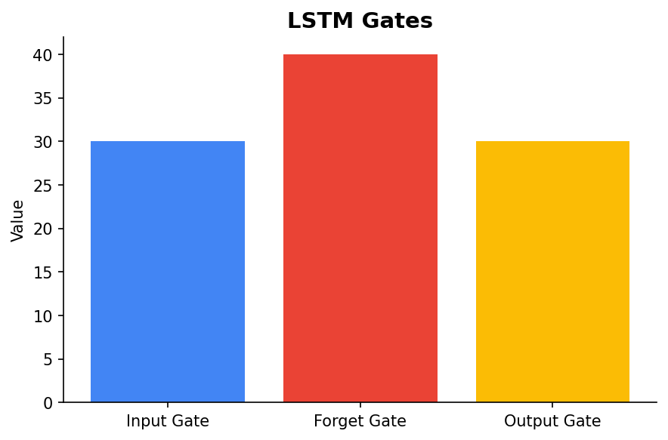
Key Components of LSTM
LSTMs use a gating mechanism to regulate the flow of information. The key components include the input gate, forget gate, and output gate.

Slide 6
Applications of RNNs and LSTMs
RNNs and LSTMs are widely used in various applications such as language modeling, machine translation, speech recognition, and time-series prediction. Their ability to handle sequential data makes them indispensable for tasks involving temporal patterns.

Slide 7
Conclusion
RNNs and LSTMs provide powerful tools for modeling sequential data. While RNNs are useful for short sequences, LSTMs excel at handling long-term dependencies, making them vital for complex applications in AI and machine learning.

