Slide 1
Understanding Convolutional Neural Networks (CNNs)
An Introduction to CNNs in Computer Vision

Slide 2
What are CNNs?
Convolutional Neural Networks (CNNs) are a class of deep learning algorithms primarily used for analyzing visual imagery. They are designed to automatically and adaptively learn spatial hierarchies of features from input images.

Slide 3
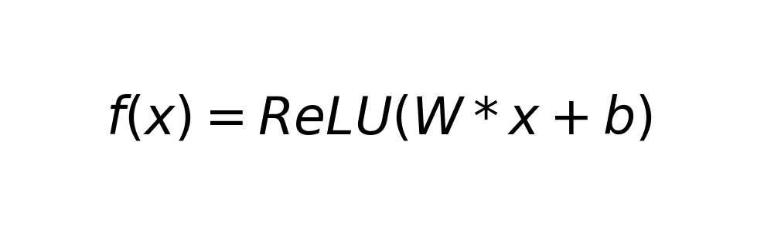
CNN Architecture
A typical CNN is composed of multiple layers, including convolutional layers, pooling layers, and fully connected layers. Each layer transforms the input data, allowing the network to learn complex representations.

Slide 4
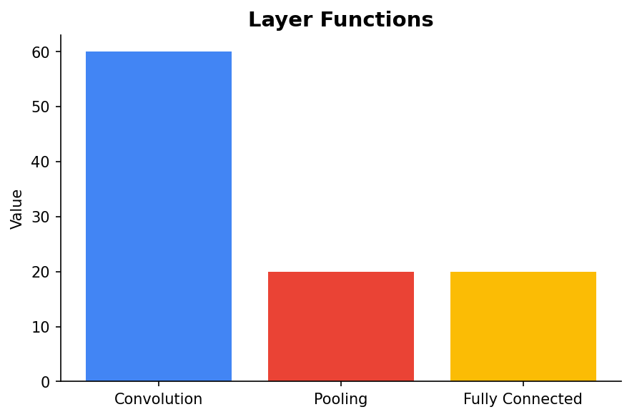
Key Components of CNNs
Convolutional layers apply filters to input data, pooling layers reduce dimensionality, and fully connected layers output the final prediction.

Slide 5
Applications of CNNs
CNNs are widely used in image and video recognition, recommender systems, image classification, medical image analysis, and natural language processing.

Slide 6
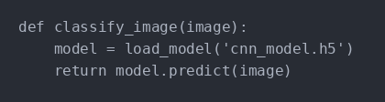
Example: Image Classification
CNNs are highly effective in classifying images by learning patterns and features at different levels of abstraction.

Slide 7
Conclusion
CNNs have transformed the field of computer vision with their ability to learn from data and improve over time. They continue to be a critical area of research and application in AI and machine learning.

