Slide 1
Understanding Multilayer Perceptron (MLP)
An Introduction to Neural Networks

Slide 2
What is a Multilayer Perceptron?
A Multilayer Perceptron (MLP) is a class of feedforward artificial neural network. It consists of at least three layers of nodes: an input layer, a hidden layer, and an output layer. MLPs are used to approximate complex functions and are a foundational model in deep learning.

Slide 3

Structure of MLP
MLPs have an input layer, one or more hidden layers, and an output layer. Each node in one layer connects with a certain weight to every node in the next layer.

Slide 4
Activation Functions
Activation functions introduce non-linear properties to the network. Commonly used activation functions include Sigmoid, ReLU, and Tanh. These functions help the network learn complex patterns.

Slide 5
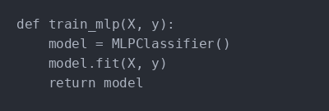
Training an MLP
Training an MLP involves adjusting the weights based on the error of the output compared to the expected result. This is often done using a method called backpropagation.

Slide 6
Applications of MLP
MLPs are used in various applications such as image and speech recognition, and natural language processing. Their ability to model complex relationships makes them suitable for these tasks.

Slide 7
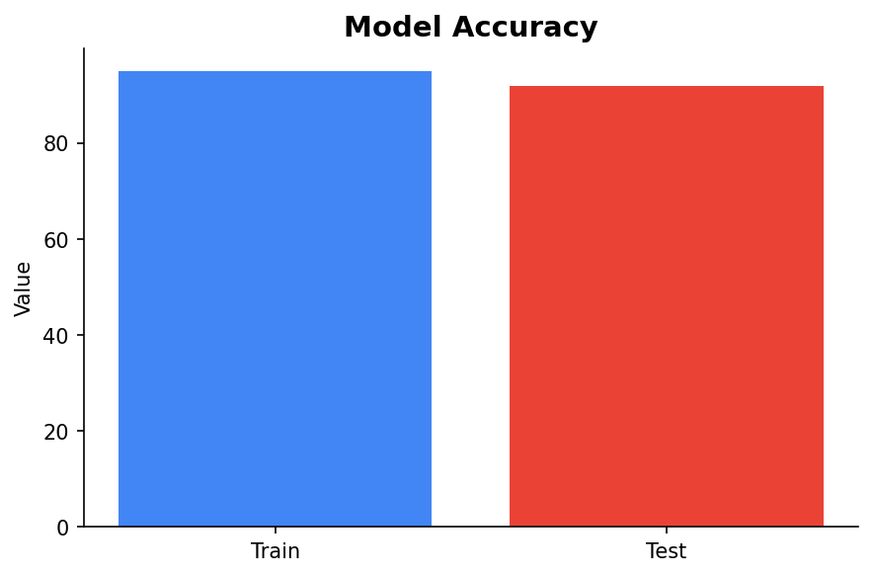
Performance Evaluation
Evaluating the performance of an MLP involves checking accuracy, precision, and recall metrics. These metrics help understand how well the model is performing on unseen data.

Slide 8
Summary
MLPs are a fundamental building block in neural networks and deep learning. Understanding their structure, training, and applications can significantly enhance machine learning projects.

