Slide 1
Introduction to Linear Regression

Slide 2
What is Regression?
Regression is a statistical method used to understand relationships between variables.
**Key Question**: How does one variable change when another one does?
Example: Predicting a person's weight based on their height.

Slide 3
The Line: y = mx + b
- **m**: Slope of the line
- **b**: Intercept
- This equation represents the simplest linear relationship.

Slide 4
Finding the Best-Fit Line
The best-fit line minimizes the difference between observed and predicted values.
**Intuition**: Think of it as a balancing act - all points should ideally balance around this line.

Slide 5
Understanding Loss: Mean Squared Error (MSE)
- MSE is a measure of the average squared differences between predicted and actual values.
**Equation**: MSE = (1/n) * Σ(actual - predicted)^2

Slide 6
Training with Gradient Descent
- An optimization technique to minimize errors.
- Iteratively updates parameters m and b to find the best-fit line.

Slide 7
Evaluating the Model: R² and MAE
- **R² (Co-efficient of determination)**: Measures proportion of variance.
- **MAE (Mean Absolute Error)**: Average of absolute differences.

Slide 8
Assumptions of Linear Regression
- **Linearity**: The relationship between X and Y is linear.
- **Independence**: Observations are independent.
- **Homoscedasticity**: Constant variance of errors.
- **Normal Errors**: Errors are normally distributed.

Slide 9
Overfitting & Underfitting
- **Overfitting**: Model captures noise instead of pattern.
- **Underfitting**: Model is too simple to capture the pattern.

Slide 10
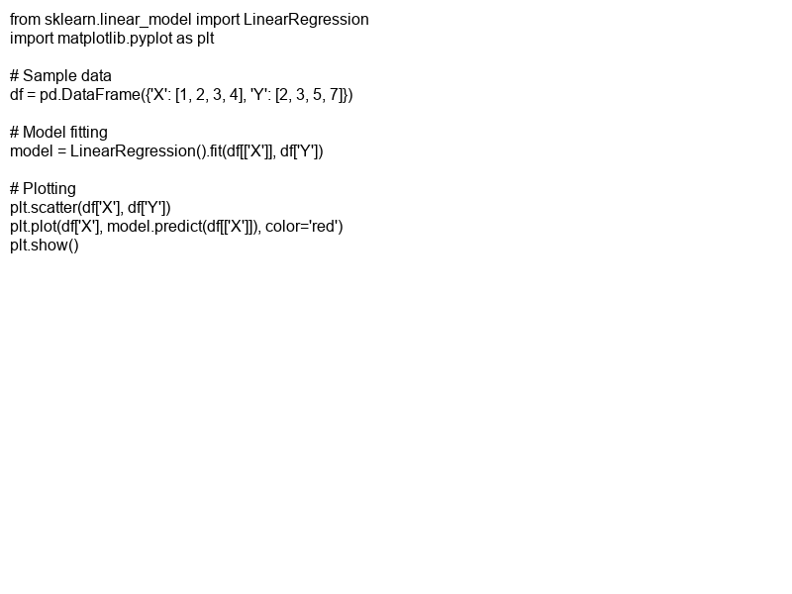
A Simple Example Using Python
- Load dataset.
- Fit linear regression model.
- Plot the results.

