Slide 1
Introduction to Linear Regression

Slide 2
What is Regression?
Think of regression as a way to predict the unknown:
- It models the relationship between a dependent variable and independent variables.
- There are various types of regression: linear, logistic, polynomial, etc.
Question: "When would you use regression?"
Quote: "Regression analysis is the bread and butter of predictive modeling."

Slide 3
The Linear Model: y = mx + b
Where:
- **y**: Dependent Variable
- **m**: Slope of the line
- **x**: Independent Variable
- **b**: Intercept of the line
Linear regression models a straight line through the data.

Slide 4
Intuition: Best-fit Line
The goal is to find a line that best fits the data points. This line minimizes the errors when predicting data points.
Question: "What does 'best fit' really mean?"

Slide 5
Loss Function: Mean Squared Error (MSE)
MSE measures the average of the squares of the errors.
Formula: MSE = (1/n) Σ(actual - predicted)^2
Loss helps us quantify how well a model's predictions match the actual data.

Slide 6
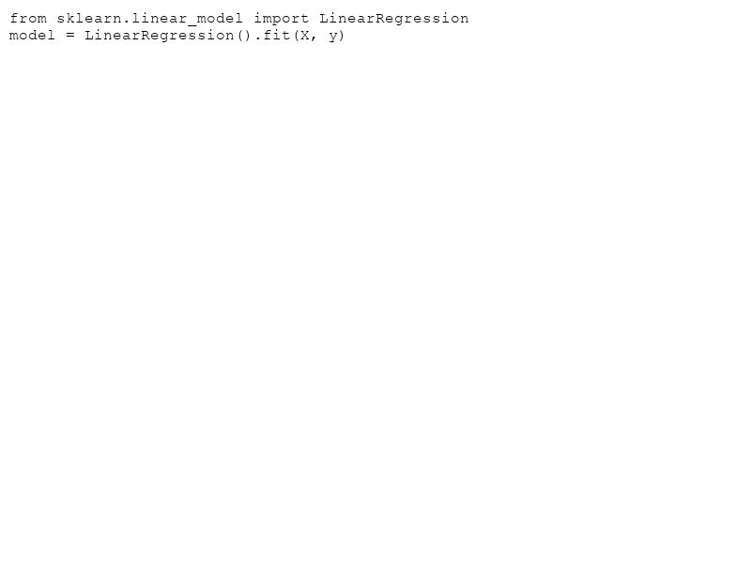
Training: Gradient Descent or Normal Equation
Gradient Descent:
- Iteratively adjust parameters to minimize the loss.
Normal Equation:
- Direct computation of parameters using matrix operations.
Question: "Why choose one method over the other?"

Slide 7
Interpreting Coefficients
- **Slope (m)**: Change in y for a one-unit change in x.
- **Intercept (b)**: Value of y when x = 0.
Key Insight: Coefficients reveal the impact of each feature on the target variable.

Slide 8
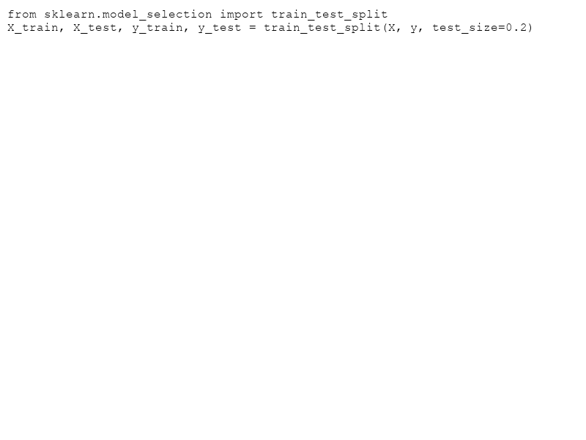
Train/Test Split & Evaluation
- **Train/Test Split**: Essential to test the model on unseen data.
- Evaluate performance using metrics:
- **R² Score**: Proportion of variance explained by the model.
- **Root Mean Square Error (RMSE)**: Standard deviation of prediction errors.

Slide 9
Common Pitfalls in Linear Regression
- **Overfitting**: Model captures noise instead of the underlying relationship.
- **Extrapolation**: Predicting outside the range of the training data can lead to errors.
Remember: Always visualize and validate assumptions before trusting predictions.

