Slide 1
Understanding Convolutional Neural Networks

Slide 2
Motivation and Use Cases
- CNNs excel in tasks like object recognition and semantic segmentation.
- Used for image classification, medical imaging, and even playing board games!
**Speaker Notes:**
CNNs have revolutionized fields by automating feature extraction using convolutional layers. They're pivotal in applications where spatial hierarchies matter.

Slide 3
Intuition: Convolution Operation
Think of convolution as a sliding window that extracts features.
- Multiplies the original pixel values by a filter's pixels and adds them up.
**Speaker Notes:**
Imagine viewing an image through a small window, catching specific patterns or features while shifting across it.

Slide 4
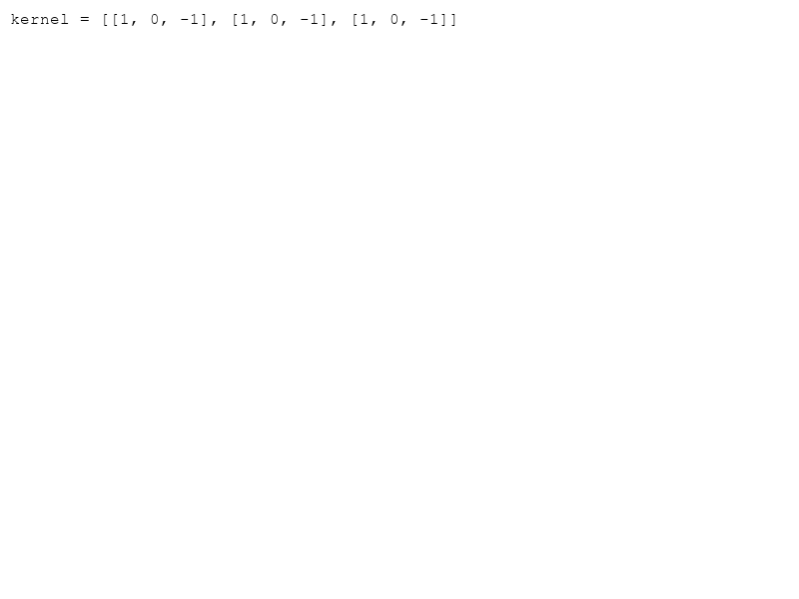
Kernels and Filters
- **Kernels** are small, square matrices (e.g., 3x3).
- They detect edges, shapes, textures.
**Speaker Notes:**
A kernel highlights specific features as it moves over input data, determining what is recognized as significant.

Slide 5
Stride and Padding
- **Stride:** How much the filter moves over the input.
- **Padding:** Adds border around input to control output size.
**Speaker Notes:**
Adjusting stride can skip over parts or scan slowly for detail. Padding helps preserve borders and avoids size reduction.

Slide 6
Pooling and Feature Maps
- **Pooling** reduces dimensionality and helps avoid overfitting (e.g., Max Pooling).
- **Feature Maps** are the output of convolution layers and act as inputs for the next layer.
**Speaker Notes:**
Pooling layers generalize features into critical signals, simplifying data and diminishing noise.

Slide 7
Training Overview and Prevention of Overfitting
- **Loss & Optimizer:** Guides learning.
- **Regularization:** Dropout reduces overfitting.
- **Data Augmentation:** Increases dataset variance.
**Speaker Notes:**
Properly tuning these aspects ensures robust model performance across unseen data without memorization.

Slide 8
Summary
CNNs automate feature extraction through layer stacking, kernel operations, and pool sub-sampling. They excel in handling unstructured data like images and are trained using strategies to prevent overfitting.
**Speaker Notes:**
Understanding the basic operations and components of CNNs provides a foundation for exploring complex deep learning models.

